Slide 1
BAD BLOOD

Slide 2
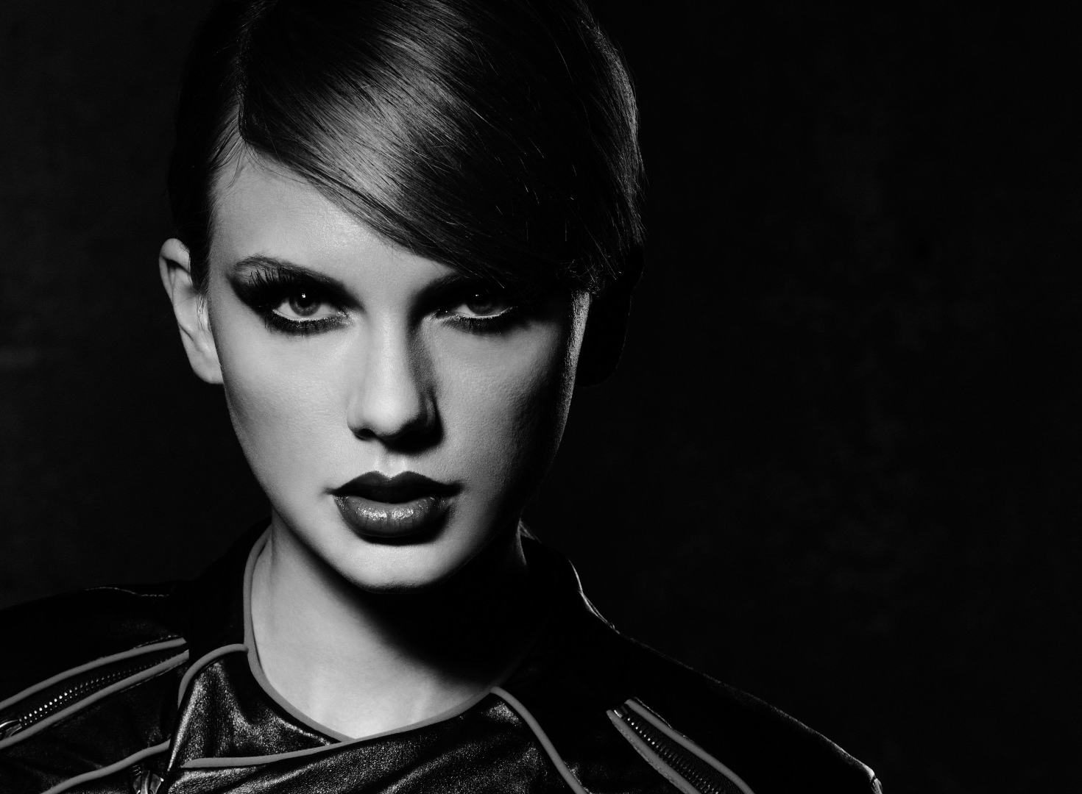

Slide 3
MISE-EN-SCENE | C.L.A.M.P.S
ENCODE | The meanings added to texts by media producers
DECODE | The audience interpret the meaning based on their demographic
IDEOLOGIES | The ideals/beliefs of the audience
REPRESENTATION | How people, places and ideas are presented
PROVOCATIVE | Deliberately trying to cause a reaction (provoke) from an audience
OBJECTIFICATION | Turning women (and sometimes men) into objects to be looked at
SELF-OBJECTIFICATION | Same as above, but when the person purposely makes themselves an object to be looked at
SEXUALISATION | Minimal clothing, sexual poses, gestures and expressions
HYPER-SEXUALISATION | A very over the top version of sexualisation
RECEPTION THEORY: PREFERRED NEGOTIATED- OPPOSITIONAL | Preferred (or 'hegemonic') reading: the audience fully shares the text’s code and accepts the preferred reading Negotiated reading: the audience mostly accepts the preferred reading Oppositional ('counter-hegemonic') reading: the audience rejects the reading
INTERTEXTUALITY | A link between texts (for example when you see a film referenced in a music video)
SOME KEY LANGUAGE

Slide 4
USES and GRATIFICATIONS (inform and educate, entertain, escapism, identity, communication)
Binary Oppositions
Reception theory (preferred, negotiated and oppositional reading)
Male Gaze theory
Almodovar's ethnicity theory (EXOTIC, DANGEROUS, HUMOROUS, PITIED)
Passive and Active audiences
Hypodermic Needle Theory (audiences are Passive)
Propp’s Character Theory (Hero, Villain, Princess, False Hero, Donor, Helper, Dispatcher)
Todorov’s Narrative Theory (Equilibrium, Disruption, Recognition, Attempt to Repair, New Equilibrium)
Feminist Theory
Semiotic Theory (Connotation and Denotation of Signs and Symbols) by Saussure
The Three V’s (Voyeurism, Vicarious and Visceral)
SOME KEY THEORIES

Slide 5
MEDIA CONTEXT

Slide 6
MEDIA CONTEXTS
Feud with Katy Perry The song is reportedly about Swift’s feud with fellow pop star Katy Perry. Swift claimed that Perry tried to sabotage her tour by hiring people that worked for her. The Bad Blood video is an over the top portrayal of that incident.
Fifth Album Bad Blood is from Swift’s fifth album 1989. The fact that she is on her fifth album shows us that she is an established artist.
SYNERGY: A-List Cast The video features many of Swift’s celebrity friends, known in the media as her ‘squad’. This includes Selena Gomez, Gigi Hadid, Ellie Goulding & more SYNERGY
Two Versions There are two official versions of the song. The original - the album version - features Swift singing alone. The radio version, featured in the music video, is a collaboration with Kendrick Lamar thus expanding the audience to include his fanbase as well.
Directed by Joseph Kahn The video was directed by Joseph Kahn, who has directed music videos for other big music stars including Eminem, Lady Gaga, Britney Spears and more. He has also worked with Swift on many of her other videos.

Slide 7
MEDIA REPRESENTATION

Slide 8
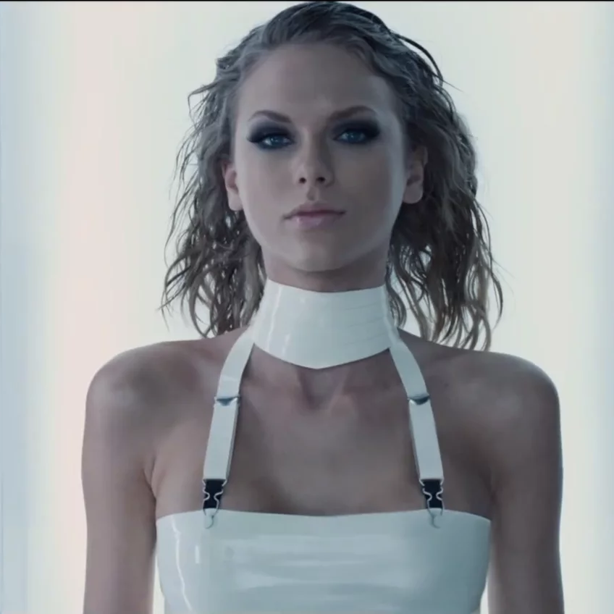
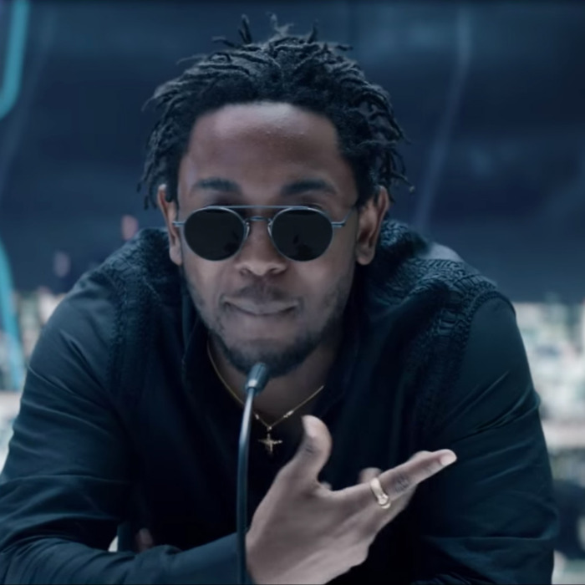
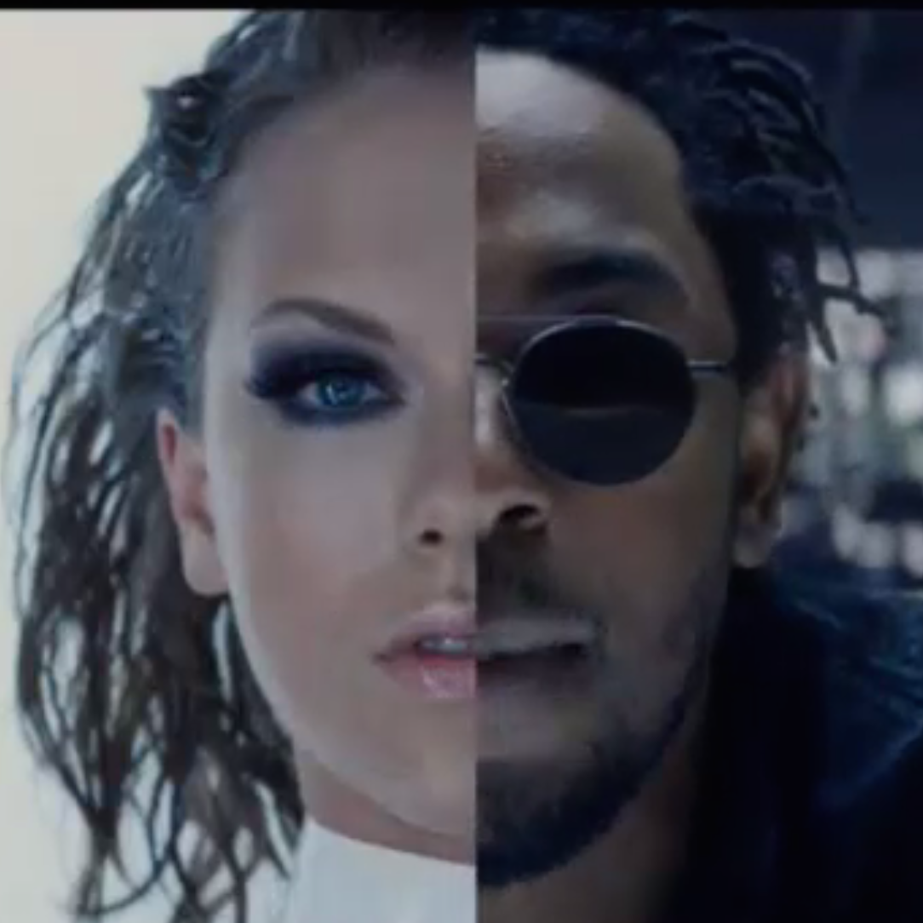
REPRESENTATION
BINARY OPPOSITIONS: Black vs White
Race
Swift appears as a white, idealised female - she has blonde hair, blue eyes and a slim figure and wears figure hugging or revealing clothes. She is sexualising herself. She is strong and independent.
Kendrick Lamar, a black male rapper, appears in stereotypical dress codes linked to black culture - sunglasses, cap, hoodie, sports car
However both are represented as equal in terms of power, indicated through use of split screen in the video. This is reflective of contemporary context, a progressive modern society

Slide 9
REPRESENTATION
Gender
Women in the video are often seen looking into make-up mirrors, playing up to the negative stereotype that women are vain about their appearance
The video also goes against stereotypes, portraying women as strong, violent and powerful, such as the scene when a character throws a knife through a teddy bear, challenging the stereotype of women being soft
The women featured in the video are all, by society’s standards, beautiful celebrities with slim figures (hegemonic)
The female characters are self-objectified in the video, appearing sexualised through their own choice. Laura Mulvey’s male gaze theory worth considering - do Swift and co present themselves sexually for their own pleasure/power, for women that look up to them, or for the pleasure of men? All three?
In contrast to the women in the video, the only prominent male character (portrayed by Kendrick Lamar) is fully clothed and not sexualised.
THE FIGHTING AND STRENGTH OF WOMEN SHOWS A FEMINIST APPROACH (They are equal)

Slide 10
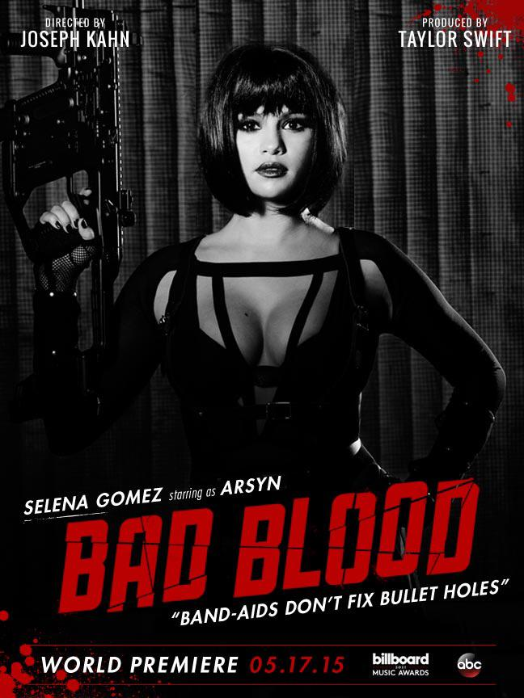
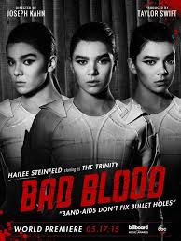
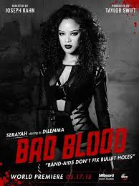
REPRESENTATION of race...
Is it a STEREOTYPE that ‘The Trinity’ is Asian and shown being good with technology?

Slide 11
MEDIA LANGUAGE
HOW TO ANALYSE BAD BLOOD

Slide 12
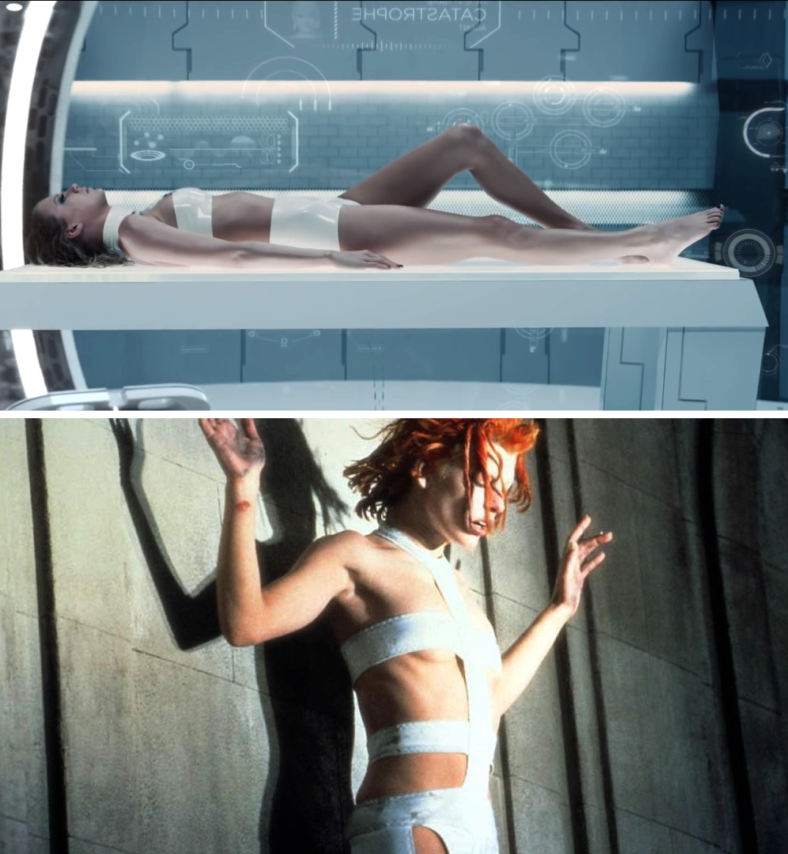
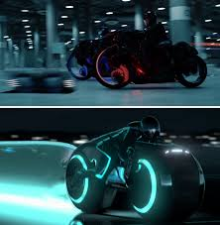
MEDIA LANGUAGE
Intertextual Links to Films
Kill Bill - the opening fight sequence is reminiscent of the Crazy 88 fight scene in Kill Bill. By referencing this film Taylor Swift’s character (Catastrophe) is aligned with Uma Thurman’s tough protagonist The Bride, suggesting that Catastrophe will also be a tough women on the quest for vengeance.
Sin City - choice of ‘Bad Blood’ font & colour
The Matrix - slow motion breaking window glass
The Fifth Element - Swift’s outfit closely represents the character Leeloo
Tron - futuristic light up bikes reference to those seen in Tron

Slide 13
MEDIA LANGUAGE
Narrative - Todorov’s Five Stages
Equilibrium – A female Office- worker (Swift) & Arsyn (Gomez) fight for their lives against several assailants in a high-rise office building.
Disruption - Arsyn betrays the office-worker (Swift) and kicks her out of the window. (this betrayal could be a metaphor for Swift’s feud with Katy Perry)
Recognition - Welvin da Great (Lamar) recognises Swift's potential, she joins an underground training facility and becomes ‘Catastrophe’.
Attempt to repair the damage caused - Catastrophe is trained to become a superhero crime fighter, alongside other powerful females.
A return to equilibrium - no return to equilibrium, the music video ends on a cliffhanger as Catastrophe faces Arsyn

Slide 14
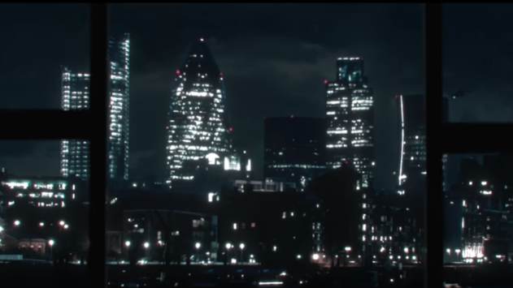
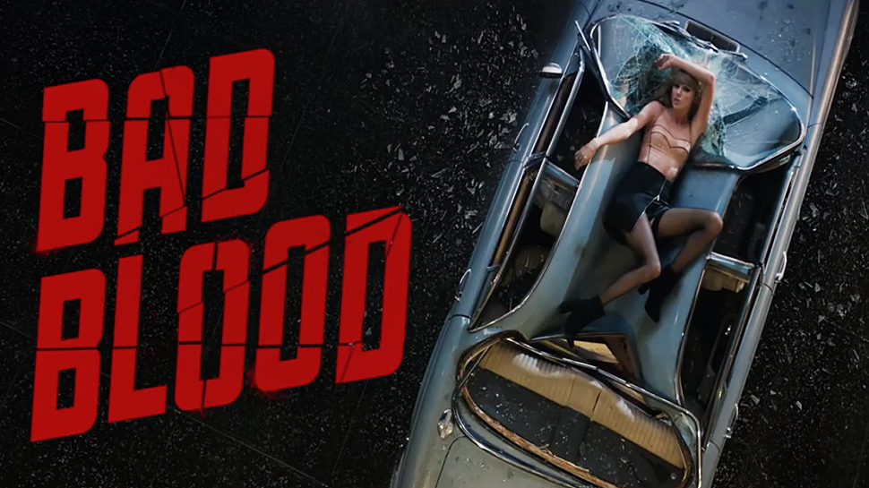
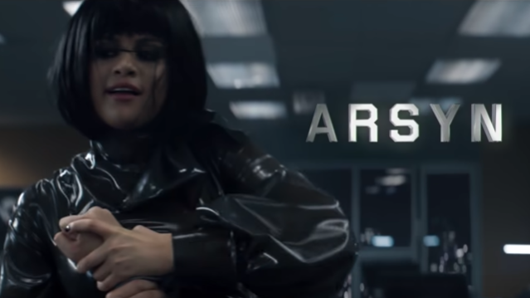
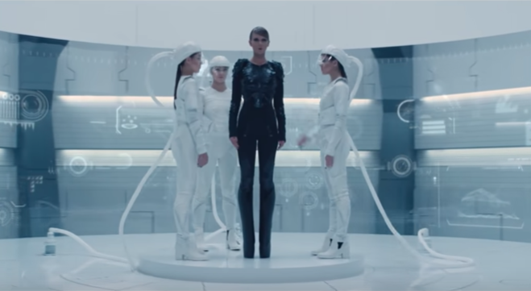
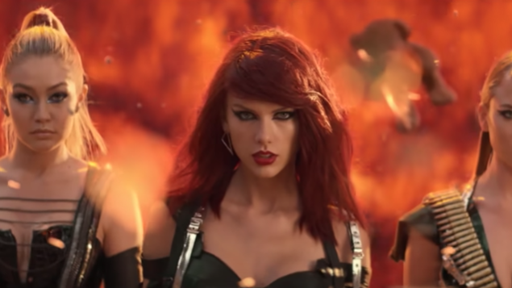
MEDIA LANGUAGE
Colour and Lighting QUICK VERSION
Low key lighting as seen here in the opening shot creates an ominous atmosphere
Red text connotes blood, violence, danger, strength
Selena Gomez’ character Arsyn is the villain - she is dressed all in black signifying death and evil while Swift’s character is dressed in lighter colours
The frequent use of direct address builds intimacy, though her tone and facial expressions are angry and threatening (in contrast with Swift’s ‘sweet girl’ image).
High key lighting with blues and whites are conventional of the science fiction genre
Swift’s red hair and lipstick in the final battle scene again connote blood, violence, danger, strength and power

Slide 16
STAR THEORY
RICHARD DRYER
CONSTRUCTION
COMMODITY
IDEOLOGY (hegemonic)

Slide 17
STAR THEORY
RICHARD DRYER
CONSTRUCTION
Stars images and personas are created, they are not real. They are designed to appeal to a target audience.
COMMODITY
Stars are used by the music industry to make money. Stars are nurtured and manufactured by the music studios in a way they think will appeal to audiences to make the most money.
IDEOLOGY (hegemonic)
Stars represent specific social groups, ideas (ideologies) or cultures. Taylor Swift may represent female equality and feminism, for example.

Slide 18
BAD BLOOD PREMIERE
https://www.youtube.com/watch?v=aNw7CT-j8Xo
‘Diss tracks’ are a popular form of songwriting: artists who have fallen out in ‘real life’ write songs attacking each other. Speculation about such songs builds audience engagement: fans take sides, and spats on social media make them feel they’re involved and part of the artist’s social circle.

Slide 19
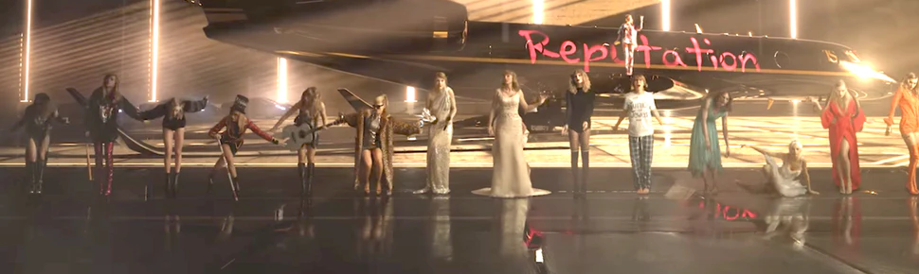
BAD BLOOD PREMIERE
https://www.youtube.com/watch?v=aNw7CT-j8Xo
You can see how Taylor’s ‘persona’ has been constructed and changed over time...

Slide 20
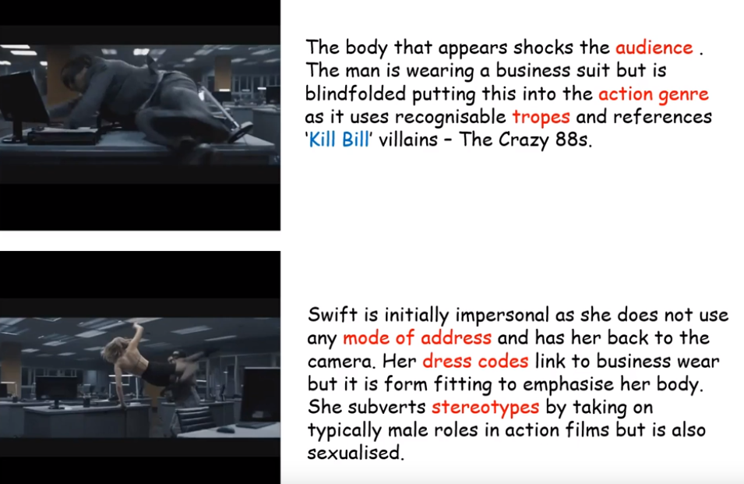
MEDIA LANGUAGE in BAD BLOOD: FULL VERSION

Slide 21
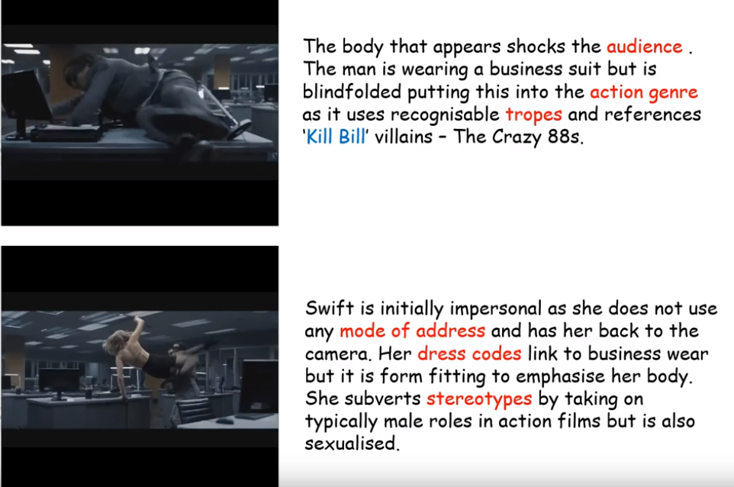
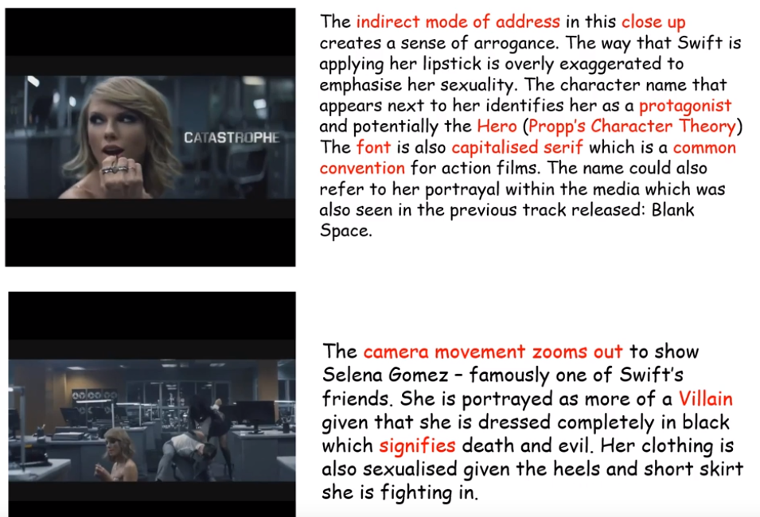
MEDIA LANGUAGE in BAD BLOOD

Slide 22
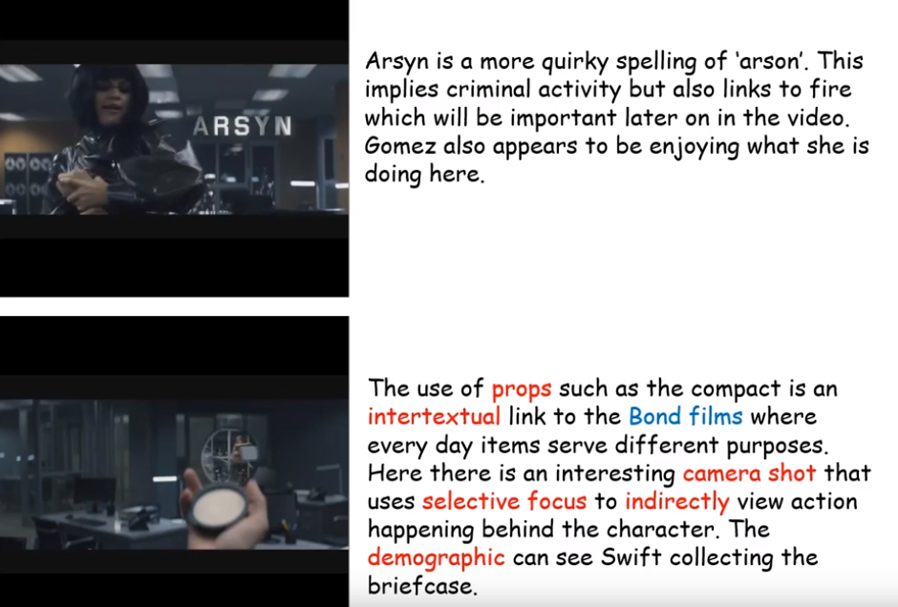
MEDIA LANGUAGE in BAD BLOOD
Using iconic landmarks forms IDENTITY as people recognise them...

Slide 23
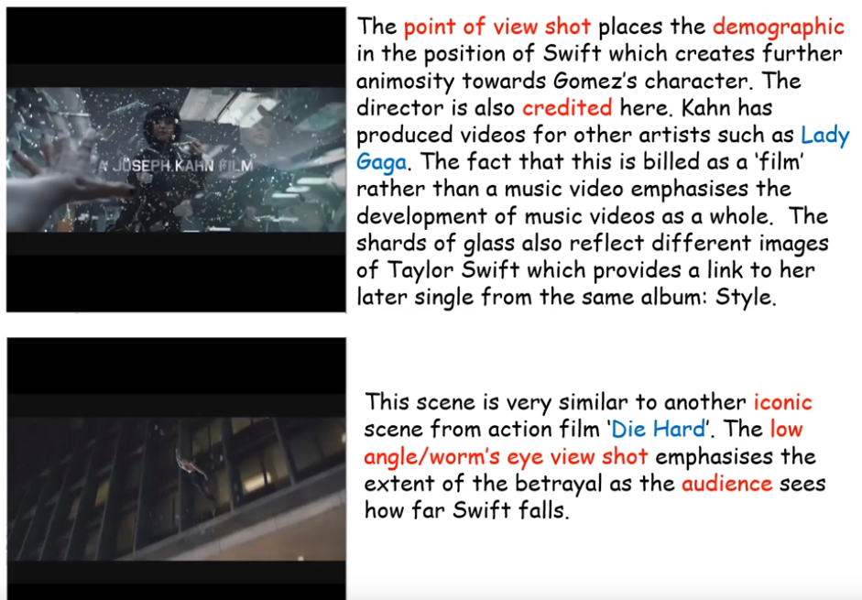
MEDIA LANGUAGE in BAD BLOOD

Slide 24
MEDIA LANGUAGE in BAD BLOOD
Synergy with Kendrick Lamar

Slide 25
MEDIA LANGUAGE in BAD BLOOD

Slide 26
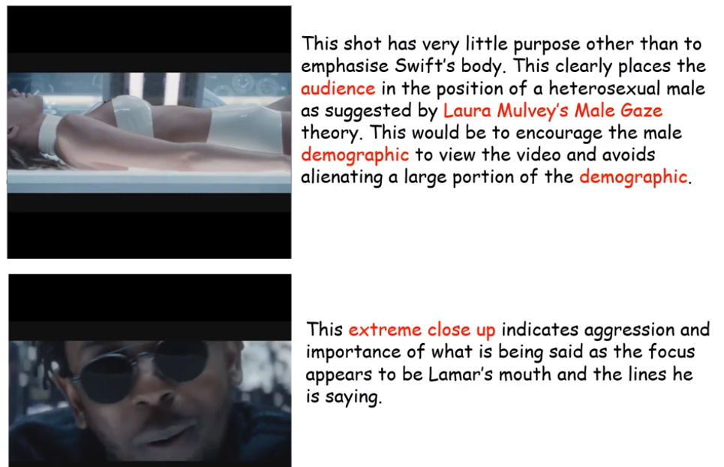
This is a direct intertextual link to the film THE FIFTH ELEMENT - appealing to older audiences
MEDIA LANGUAGE in BAD BLOOD

Slide 27
MEDIA LANGUAGE in BAD BLOOD

Slide 28
MEDIA LANGUAGE in BAD BLOOD

Slide 29
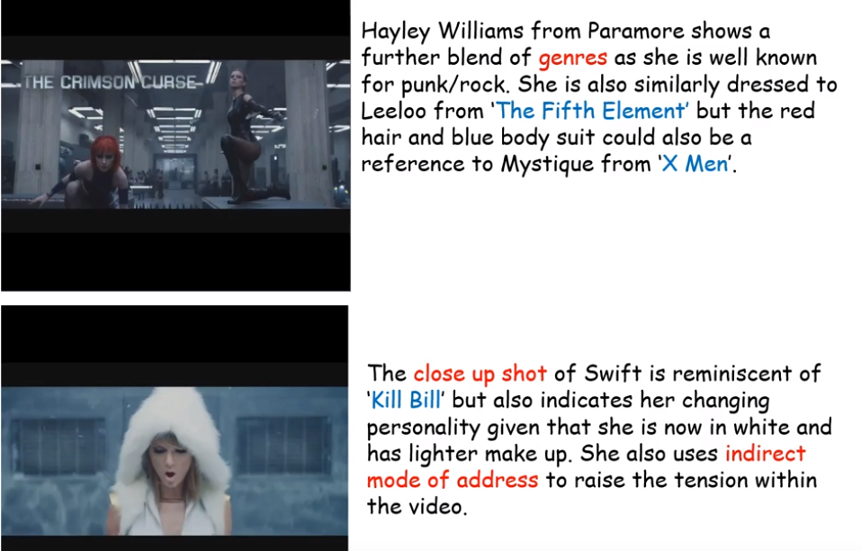
MEDIA LANGUAGE in BAD BLOOD

Slide 30
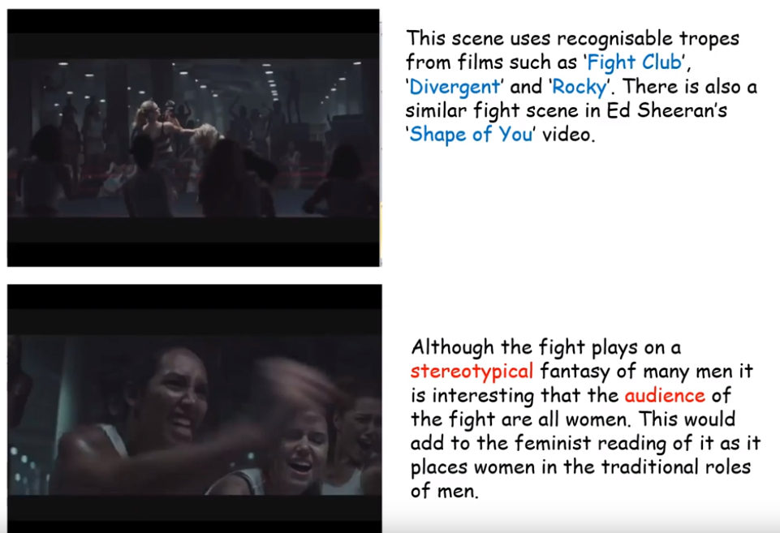
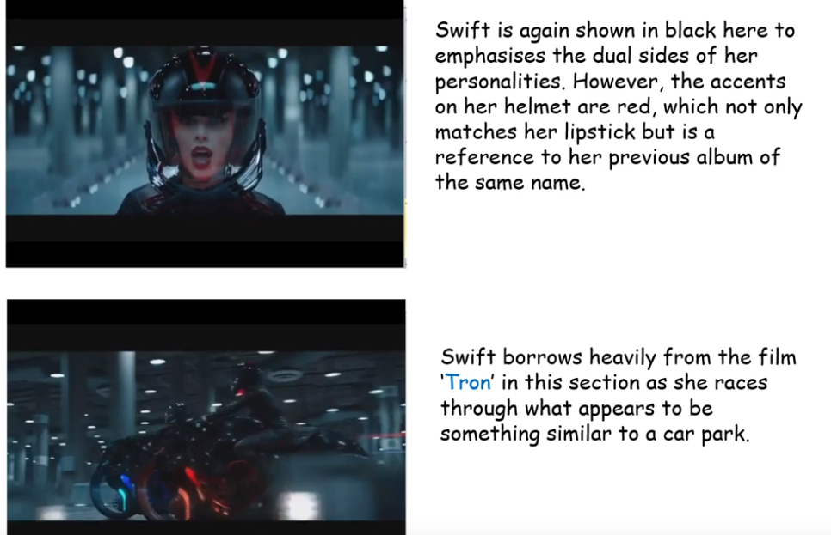
MEDIA LANGUAGE in BAD BLOOD

Slide 31
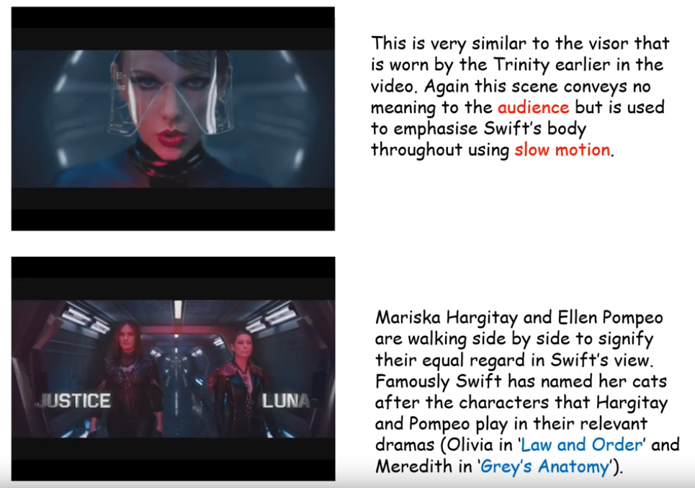
MEDIA LANGUAGE in BAD BLOOD

Slide 32
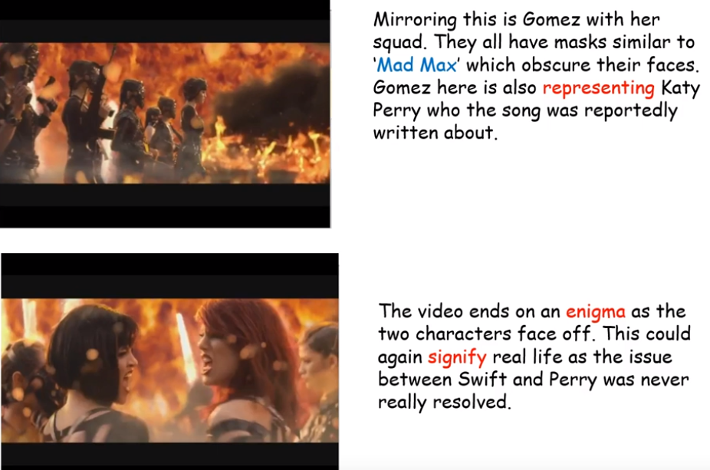
MEDIA LANGUAGE in BAD BLOOD

Slide 33
MEDIA INSTITUTIONS

Slide 34
MR FULLER THINKS YOU WILL BE ASKED ABOUT TAYLOR SWIFT’s WEBSITE AND SOCIAL MEDIA!

Slide 35
REVISING WEBSITES IS ESSENTIAL

Slide 36
TYPES OF MEDIA ORGANISATION: BRANCHING OUT AND GETTING TO THE GROOT OF THINGS:
CONTEXTUAL CORNER: AN OVERVIEW OF THE INDUSTRY
The Music Industry is huge and contributes billions to the British Economy.
However, a huge issue the Industry has faced is the increased popularity of streaming sites, downloadable music and YouTube.
Some choose to download Music legally via sites like Spotify or Apple Music for instance whilst others do not= A loss of revenue for artists and record labels.
As a result their has been a downturn in physical sales (CD’s) although there is currently a trend of buying Vinyl!
Monopolies – A single Media organisation which dominates production/distribution of a particular industry, locally or nationally.
Oligopolies- A small number of Media organisations dominate and industry.
Conglomerates- A collection of companies which all conduct in varying businesses, owned by a single institution ( Think of the tree and branch analogy)
Subsidiaries- When smaller companies are owned by a parent company.
Multinationals- An organisation across the world
Synergy- When institutions are not owned but work together for beneficial reasons
You need to start remembering these terms! We have gone through them several times.
Notes:
Tell the students to think of a conglomerate like a tree, the branches its subsidiaries. The branches keep the tree alive and BRANCH off of the main company. I would also write up a sentence here along the lines of “The BBC is a multinational oligopoly in Britain that works in synergy with other productions companies and subsidiaries to produce content…” to highlight how to structure into writing/exam.

Slide 37
UNDERSTANDING THE WEBSITE
YOU NEED TO KNOW HOW AND WHY TAYLOR SWIFT USES HER WEBSITE:
Taylor Swift Website
Branding to tie-in with new album release (‘1989’) through repeated use of colour and images on the homepage and throughout the site
Promotion of music/ album evident through ‘Music’, ‘Videos’ and merchandise pages
Links to social media accounts, but also a ‘Taylor Connect’ section where fans can ‘find friends’ or join fan forums, creating a sense of identity and inclusion though fan photos etc.
‘News’ features Taylor’s recent success at the Grammy’s (3 awards), reinforced on the homepage with multiple images
Global reach – news of ‘BBC Radio 1 teen award’, official UK merchandise site etc.
Construction of personal identity of Taylor Swift, sense that users can connect with her personally (e.g. ‘About me, from me’, Taylor’s photo journal, news of Taylor ‘crashing a fan’s wedding’) to reinforce her brand image
Above point also links to her belonging to an independent label (Big Machine Records) despite being a hugely profitable star.

Slide 38
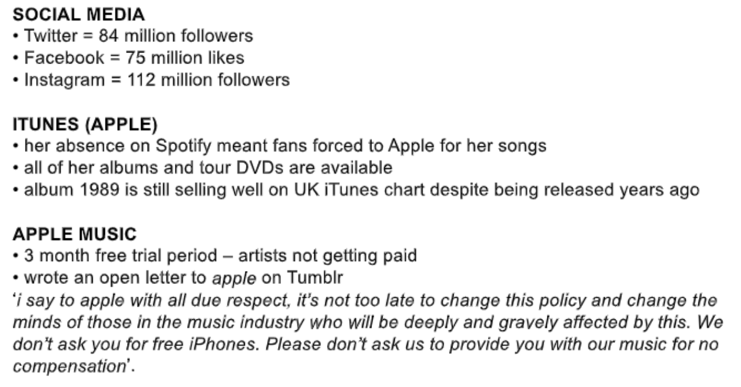
Taylor Swift’s SOCIAL MEDIA STATS

Slide 39
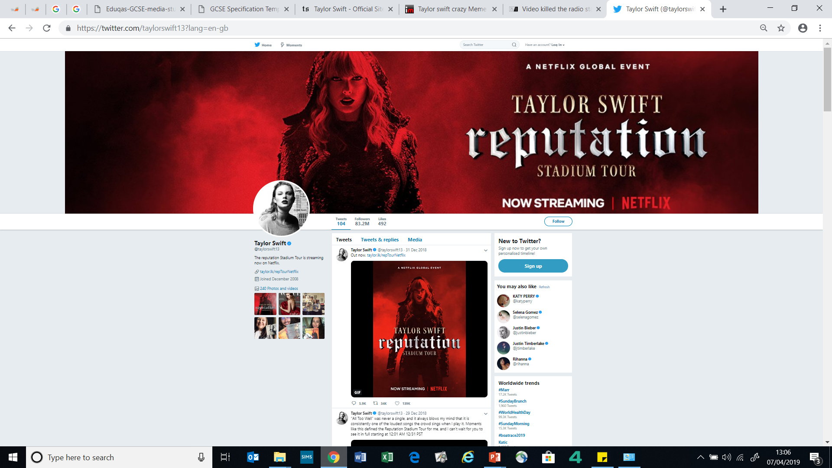
ONLINE MEDIA: WEBISTES AND SOCIAL MEDIA
One way that the Music Industry has had to evolve to compete with streaming sites etc. is by having an online presence themselves.
Official websites, Vevo and You Tube channels along with the use Social networking accounts are now ways to promote your stars daily as opposed to the stars having to be on the road touring or doing interviews etc.
Amazingly, Swift was voted the most influential women on Twitter in 2018… she only tweeted 13 times!
Notes:
SOURCE: https://www.billboard.com/articles/columns/pop/8487115/taylor-swift-most-influential-woman-twitter-2018

Slide 40
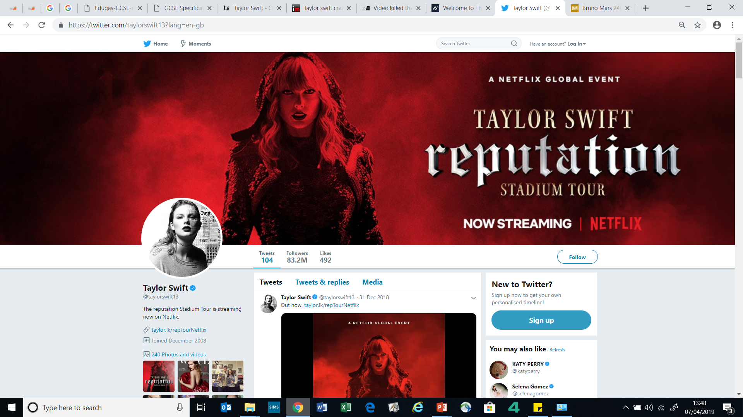

Slide 43
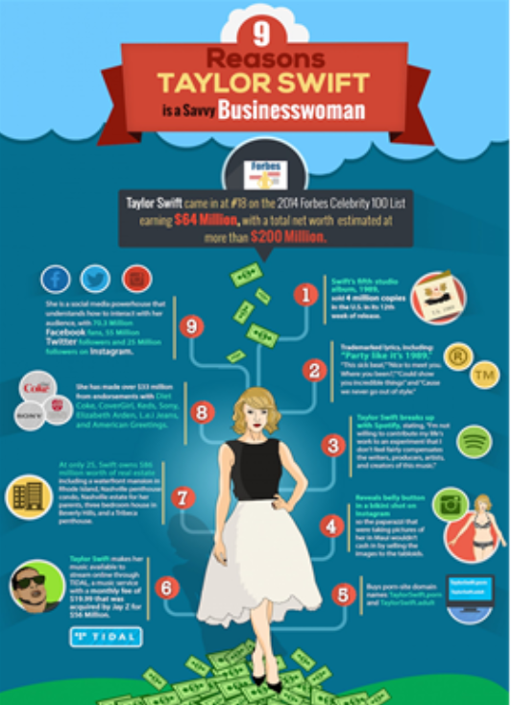
Taylor Swift is a BUSINESS
WOMAN

Slide 44
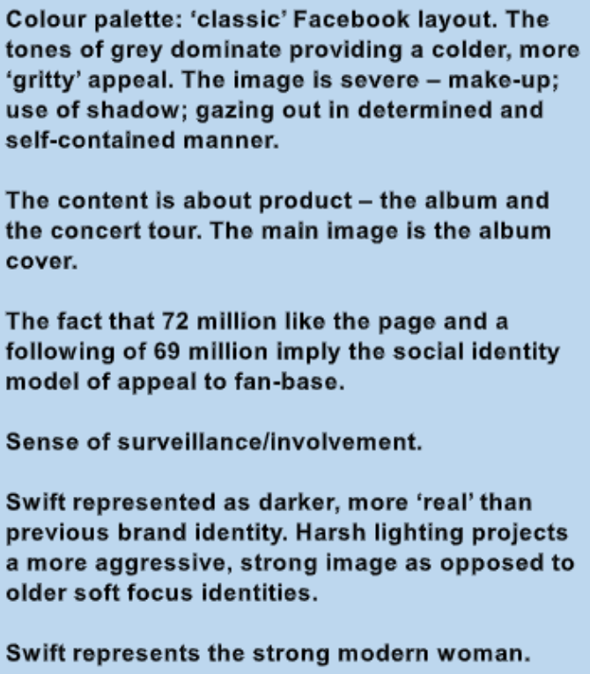
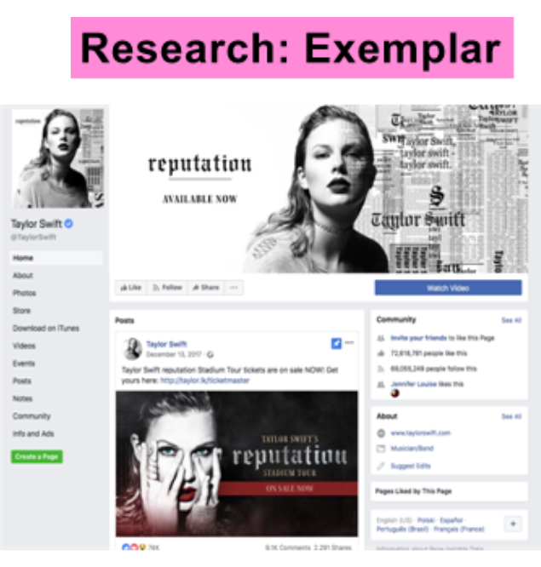
Taylor Swift’s FACEBOOK

Slide 45
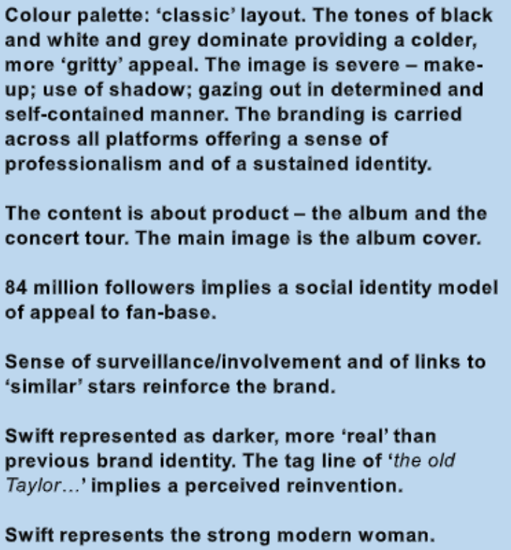
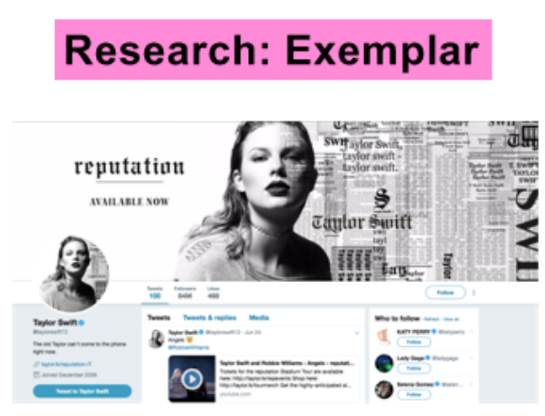
Taylor Swift’s TWITTER

Slide 46
Taylor Swift’s TWITTER part 2

Slide 47
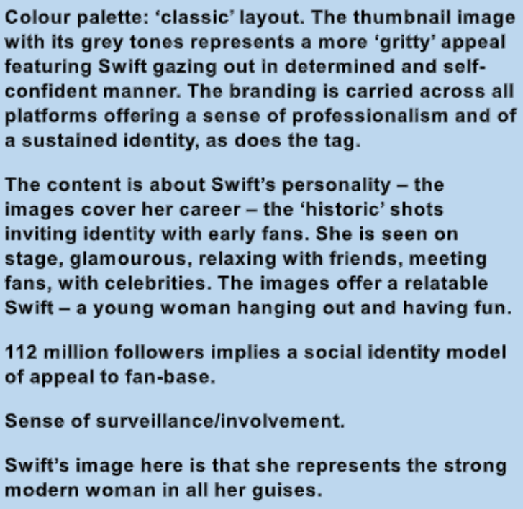
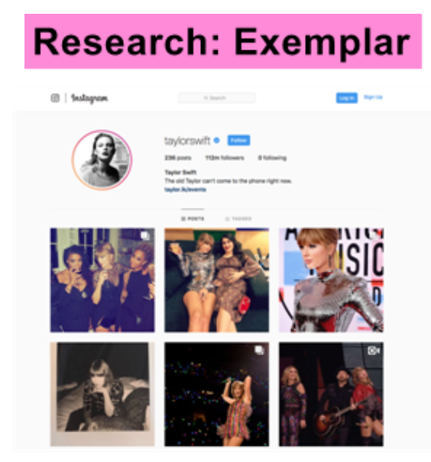
Taylor Swift’s INSTAGRAM

Slide 48
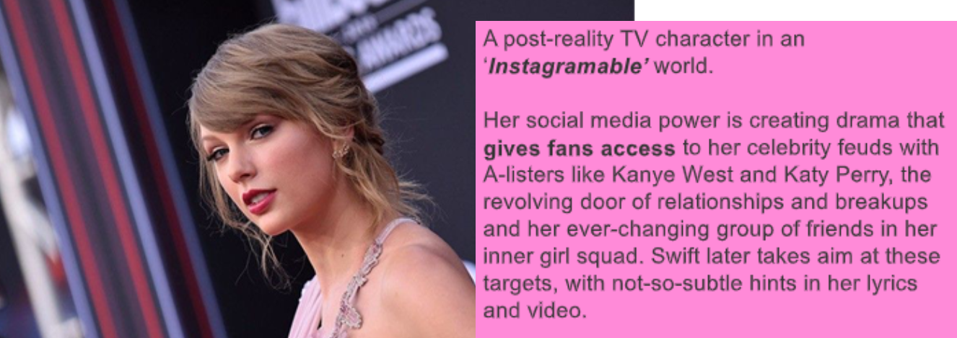
Taylor Swift’s INSTAGRAM part 2

Slide 49
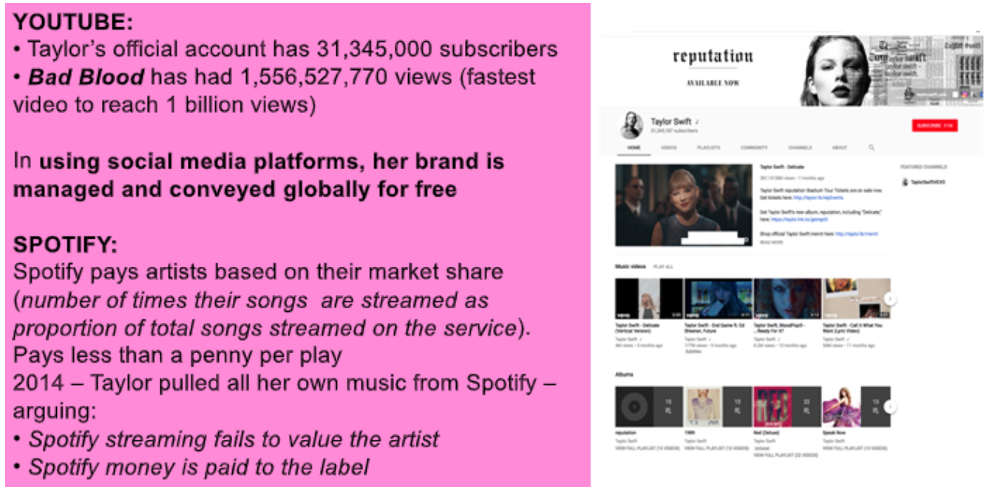
Taylor Swift’s YOUTUBE

Slide 50
Taylor Swift’s SYNERGY

Slide 51
Taylor Swift’s MERCHANDISE

