Slide 1
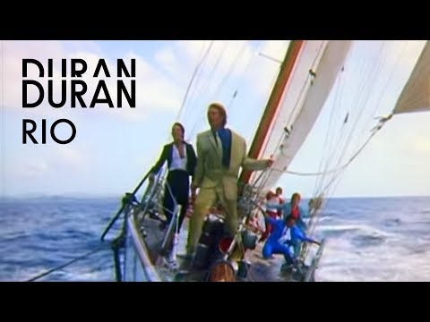
COMPONENT 2: MUSIC VIDEOS
In CONTRAST to Taylor Swift’s Bad Blood, you need to study a historical text.
You need to consider how representations have changed over time.

Slide 2
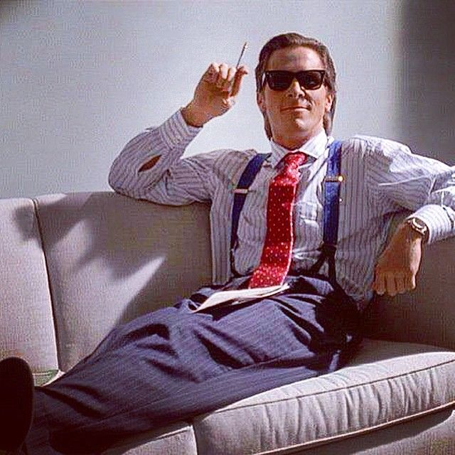
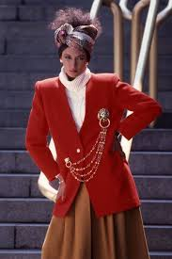
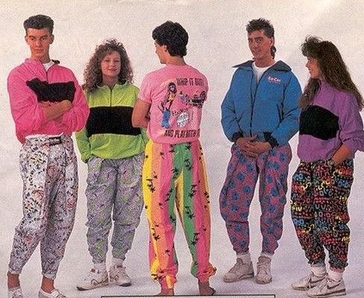
To know the context of music in the 1980s and 1990s.
Period of economic instability in Britain in 1980s
High unemployment rates
Economy grew in mid 80s and this was period of ‘excess’ (yuppie)
Wealthy young people with disposable income spent on luxury goods
Fashion trends were bright colours, bold patterns and shoulder pads
‘Synth Pop’ was popular

Slide 3
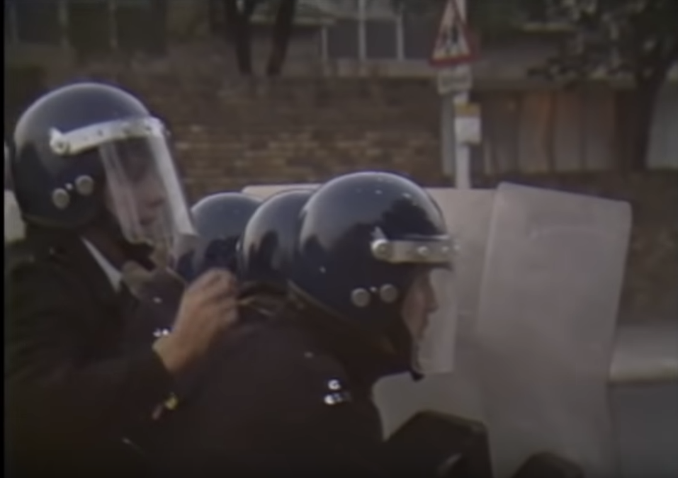
To know the context of music in the 1980s and 1990s.
Feminist movements were developing
Mainstream media was still stereotyping gender
Minor strikes in 80s causes unrest – riots in Brixton and Toxeth due to racial inequality
Ethnic minority groups had low level of income and poor quality of life
How different is the social context in the 1980s to now?
Think about gender and ethnicity.
Notes:
https://www.youtube.com/watch?v=AGrBIwt1YMg
http://www.bbc.co.uk/guides/zcy4bk7

Slide 4
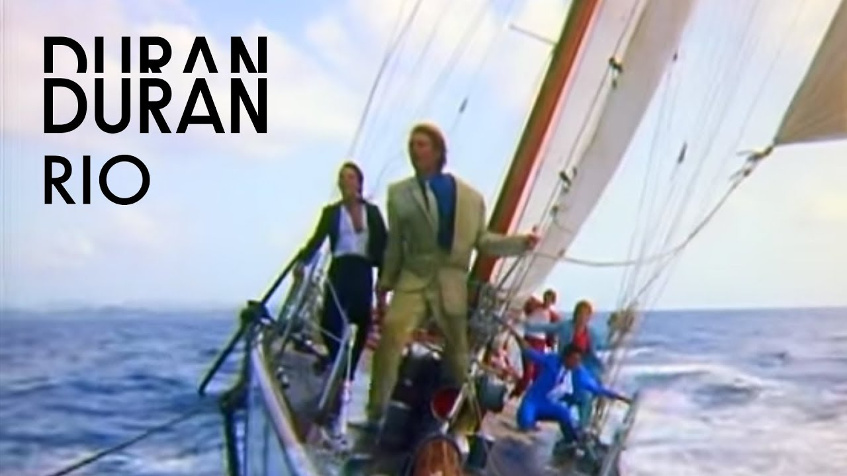
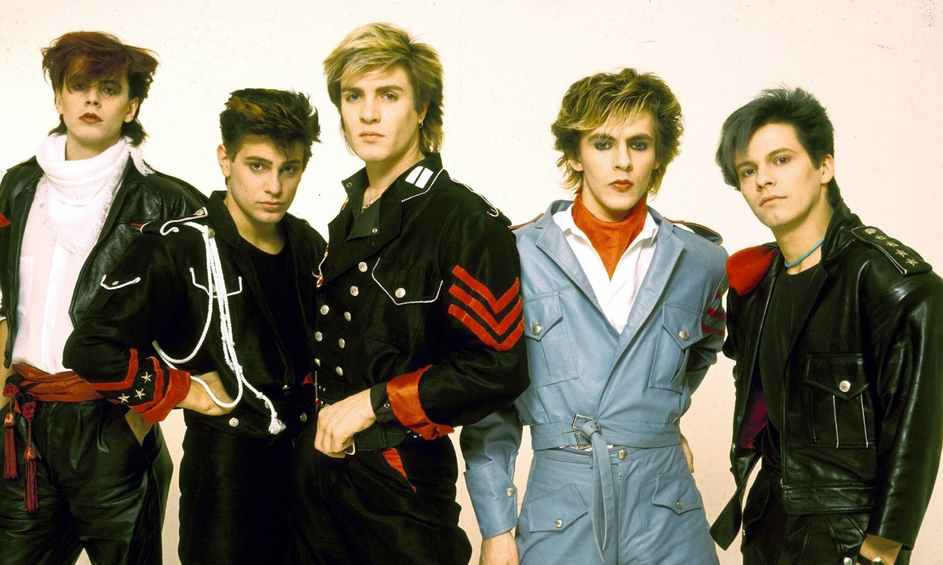
Shot in Antigua
Released in 1982
Uses many ‘cutting edge’ technologies.
Presents luxury lifestyles
Intertextuality of ‘ Bond’ films

Slide 5
To be able to analyse a music video using media terminology.
What is the narrative of the music video?
Technical Codes | Visual Codes | Sound
Notes:
Technical C

Slide 6
USE the information from my slides to answer the following:
What was the slang word given to rich young people in the 80s?
What two visual codes show excess in ‘Rio’? Use specific terminology.
What inequality can you pinpoint from the 80s?
How are women represented (use key words - look at the orange wall)
Notes:
Yuppie
Big boats and beautiful women show terminology of a luxurious life.
Mainstream media was still stereotyping genders.This led to feminist movements developing as well as strikes that cuased riots in Brixton and Toxeth.

Slide 7
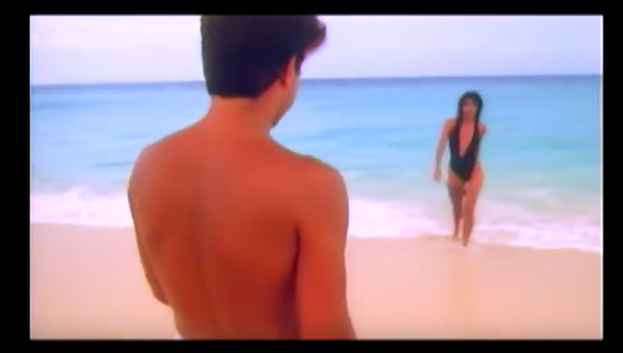
To know the narrative of the historic music video.
What do you think the story is of the music video?
How does the intertextuality of James Bond (Dr No - 1960) 🡪 help us understand the narrative?
How does this appeal to the target audience?
Notes:
https://www.youtube.com/watch?v=m3lAjyUUS1g

Slide 8
To know the narrative of the historic music video.
The band live out their daydreams in paradise
They are teased by a ‘vixen’ on the island.
Does the narrative follow a linear or a non-linear structure?

Slide 9
To understand how technical and visual codes create meaning.
Annotate using media terminology the camera shots and identify:
Camera shot, angle
Visual codes
What these tell us about the narrative or the context
How the video objectifies women – apply Laura Mulvey’s ‘Male Gaze Theory’
The denotation…connotes..

Slide 10
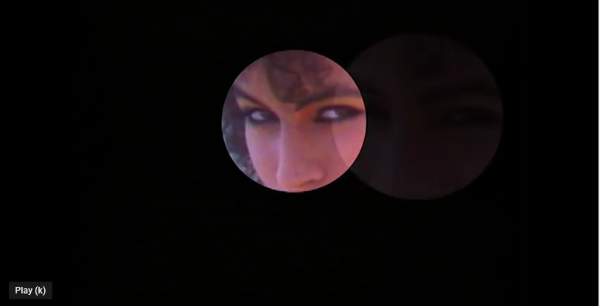
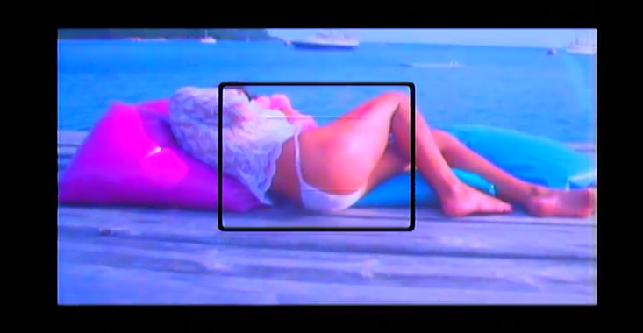
ANALYSIS:
Who’s point of view is this?
Why is she looking at us?
Why has the special effect been used?
ANALYSIS:
Who’s point of view is this?
Why has the special effect been used?

Slide 11
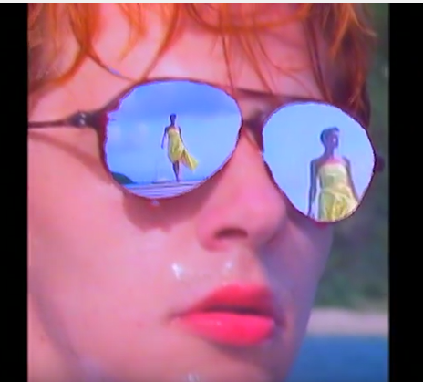
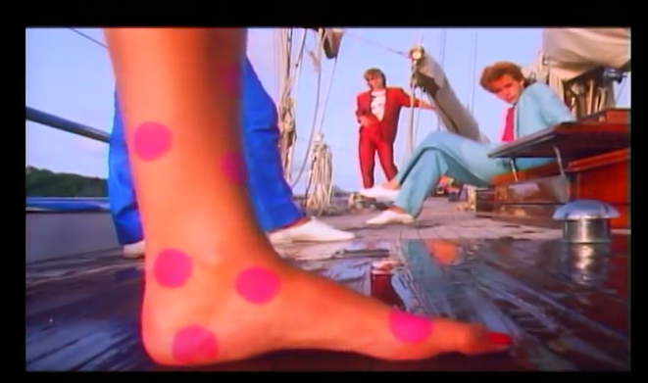
ANALYSIS:
What type of shot is this and why has it been used?
Analyse the meaning (link to Male Gaze theory)
ANALYSIS:
What type of shot is this and why has it been used?
Analyse the meaning

Slide 12
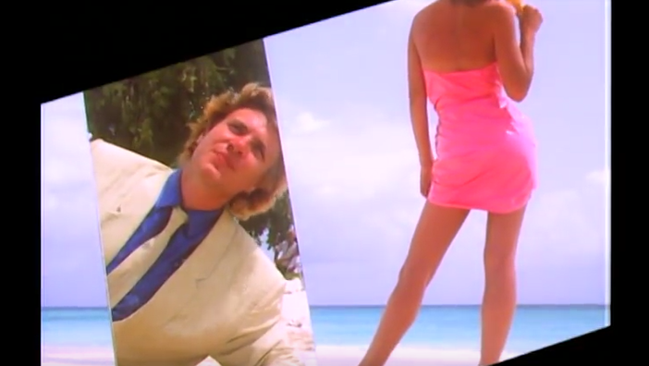
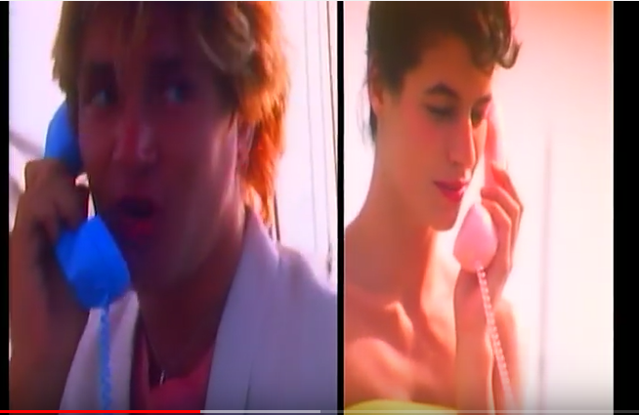
ANALYSIS:
What type of shot is this and why has it been used?
Describe the body language codes of the man
ANALYSIS:
How does this represent men in the 1980s?

Slide 13
To understand how technical and visual codes create meaning.
Laura Mulvey’s ‘Male Gaze’ theory states that:
Male gaze is the act of depicting women and the world, in the visual arts and in literature, from a masculine, heterosexual perspective that presents and represents women as sexual objects for the pleasure of the male viewer.
To what extent can you apply this A-Level theory to this GCSE text?
Discuss.

Slide 14
TECHNICAL CODES
Close up of woman’s eyes in the edited shot connotes that she is ‘watching’ you. Inks to the Voyeurism.
VISUAL CODES
CONTEXT
Black background connote mystery of the woman.
Low angle shot allows audiences to be voyeurs of the fantasies which the band have.
Antigua as a setting for video connotes the lavish lifestyle and celebrity of the band.
Low angle wide shot of the scenery and the woman’s body links to Laura Mulvey’s theory – woman is objectified.
Black box around her thigh connotes this, too.
Pink spots connote the weirdness of the band fantasy but also connote the bright colours of the 80’s and femininity.

Slide 15
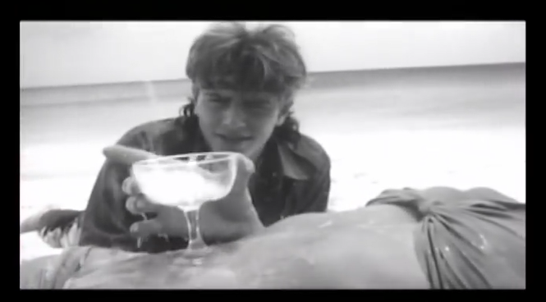
Black and white editing connotes it is intertextuality of the film ‘Rambo’. Champagne glass connotes wealth and excess.
‘Cherry ice cream’ lyrics mirror the low angle mid shot of the woman licking an ice cream. Links to Laura Mulvey’s ‘Male Gaze’ theory.
Lime/yellow silk suits by Andrew Price connote the wealth of the band and excels/style of the 80s.
Intertextuality of ‘James Bond’ with woman walking out from water. Wide shot connotes the luxurious, exotic setting.
Pink and blue phones stereotype gender and reinforce idea women are feminine.

Slide 16
To understand how gender is represented in the music video.
We have looked at women, but what can you analyse about how men are represented?
Are there any stereotypes?
How can you link context?
Men | Women
Do men represent the 80 style? Is this a positive or negative representation? | Explain in a few sentences how women are represented in this video. Is it positive or negative? Is it a mis-representation?

Slide 17
To be able to answer a Component 2 Section B exam question using key examples from the text.
Q: ‘Music videos reinforce stereotypes of gender.' How far is this true in Duran Duran’s ‘Rio’?
explore representations of gender in the music video you have studied
refer to relevant media contexts, such as social or cultural
consider whether you agree or disagree with the statement.
Criteria:
Identify the stereotypes or mis representations
4 examples from the text
Analysis of these examples
Link to the 80’s context
Laura Mulvey’s theory
How the audience would respond.
POINT, EVIDENCE, ANALYSIS, RELATE TO AUDIENCE OR THEORY. USE the WEE writing frame (point = WHAT; EVIDENCE; EXPLAIN)

Slide 18
CULTURAL CONTEXT
“Duran Duran’s cultural timing was perfect. With the launch of MTV, a 24-hour music channel, the band’s promotion was easy - each song came with a lavish promotional video. These videos reached out to the public and gave them five minutes of pure escapism”

Slide 19
The 1980s

