Slide 1
FREEDOM

Slide 2
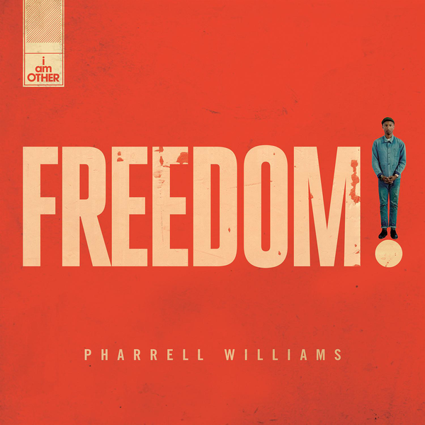

Slide 3
MEDIA LANGUAGE
MISE EN SCÉNE
Mixture of settings. Some positive and joyful. Some oppressive and sad/empty. To show the mixture in the world (those with freedom, those without)
Pharrell maintains a consistent costume throughout in order to make it easy to follow him. Neutral colours allow you to focus on the issues shown
Colour clearly shows the difference between ‘free’ scenes and those who are oppressed
CAMERA WORK & EDITING
Close ups of faces to show their emotions
Lots of wide angle and long shots to show impressive scenes in full
High angle last shot showing oppression of those in poor working conditions
Pace of the editing slows and speeds up to match the pace of the song and reflect the more sombre moments
LIGHTING
Mix of high key and low key.
Low key used in action more sober sequences to reflect the seriousness of the drama.
High key used in more joyful scenes.

Slide 4
MEDIA CONTEXTS
PHARRELL WILLIAMS
Pharrell Williams is a highly successful music artist, music producer & film producer. He also owns a multi media creative collective which develops art, fashion & music.
APPLE MUSIC
Pharrell partnered with Apple Music for the exclusive release of the single in June 2015. A section of the song was used in an advert for Apple Music prior to its release. This is an example of synergy.

Slide 5
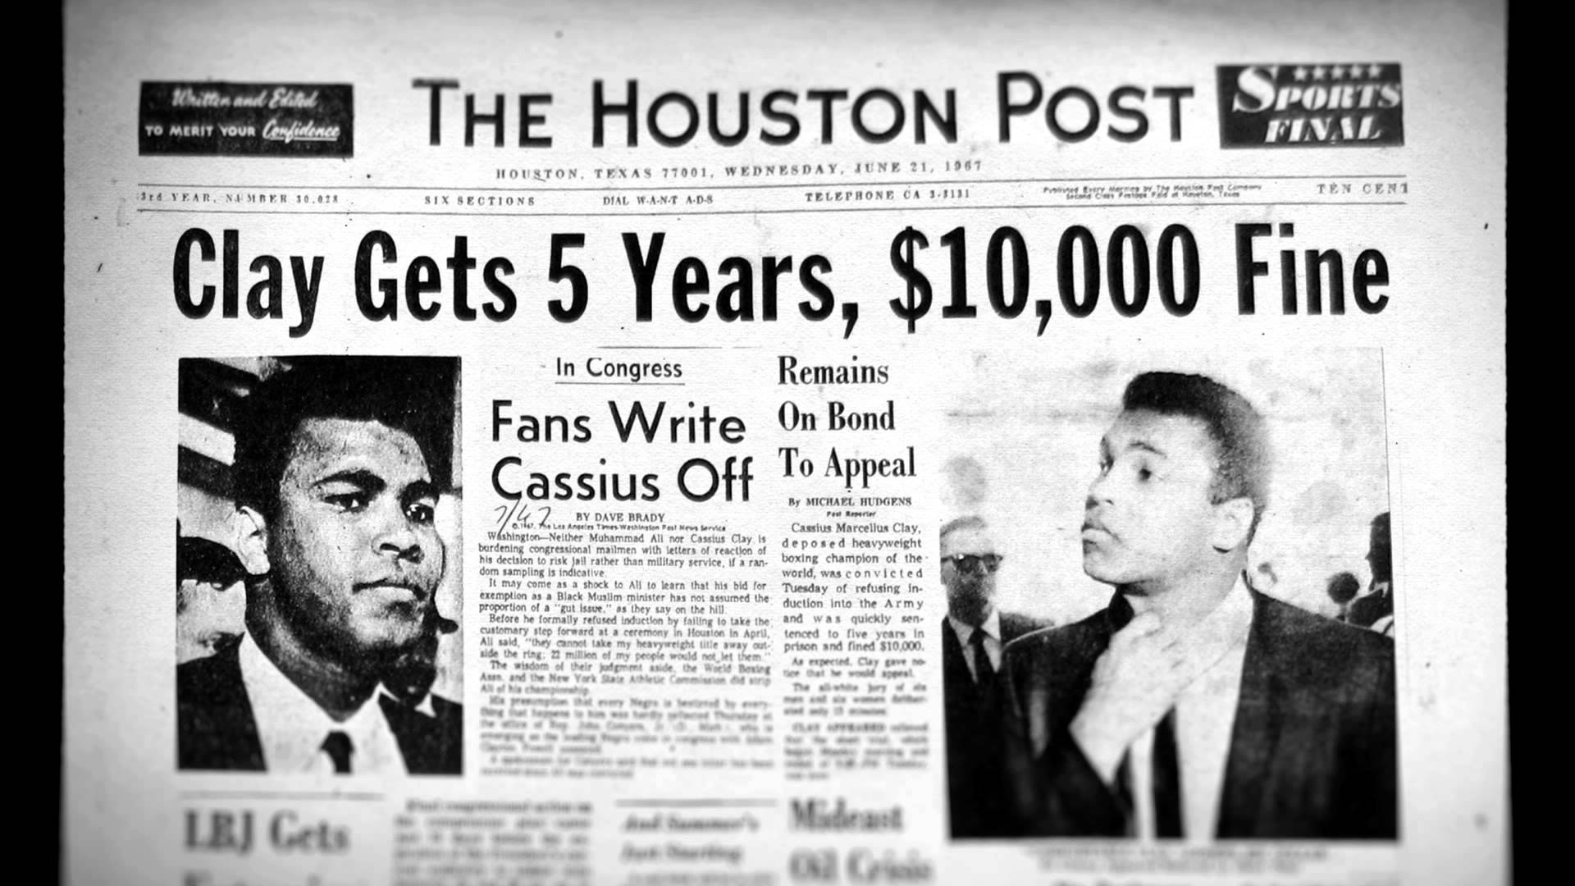
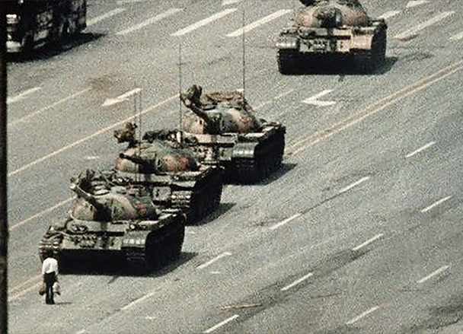
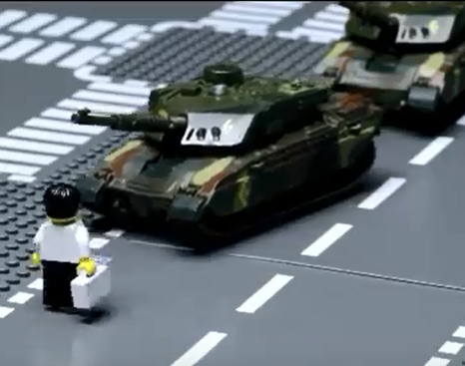
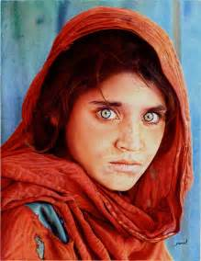
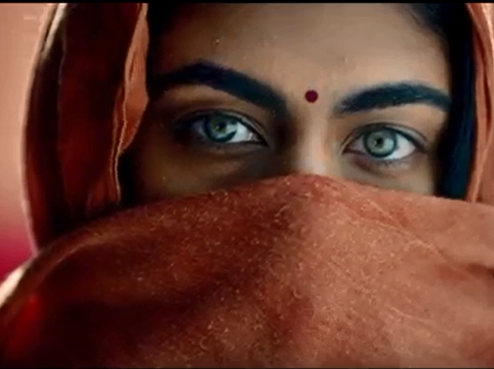
MEDIA CONTEXTS
INTERTEXTUAL REFERENCES
MUHAMMAD ALI
On April 28, 1967, boxing champion Muhammad Ali refuses to be inducted into the U.S. Army and is immediately stripped of his heavyweight title. Ali, a Muslim, cited religious reasons for his decision to forgo military service.
“I ain’t got no quarrel with those Vietcong.”
1989 MASSACRE IN TIANANMEN SQUARE
Several hundred civilians have been shot dead by the Chinese army during a bloody military operation to crush a democratic protest in Peking's (Beijing) Tiananmen Square.
AFGHAN GIRL A 1984 photographic portrait of a student in an informal school in the Nasir Bagh refugee camp. The image became a symbol of "refugee girl/woman located in some distant camp" deserving of the compassion of the Western viewer.
AFGHAN GIRL also suggests that, post 911 when attitudes towards Muslim communities shifted, Pharrell sees them as equal and in need of their own ‘freedom’

Slide 6
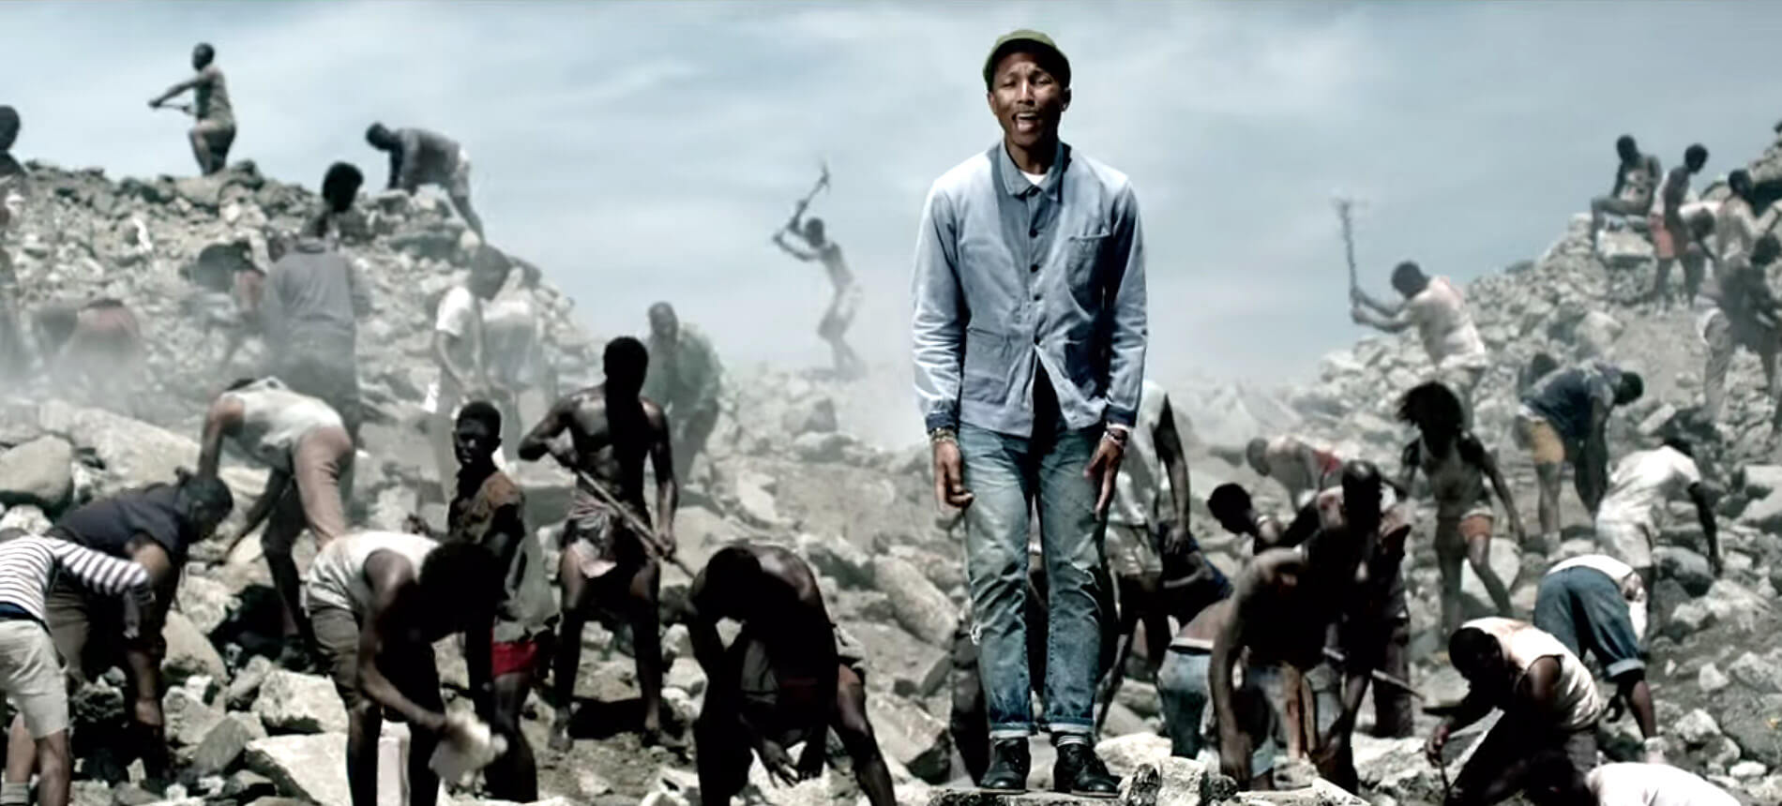
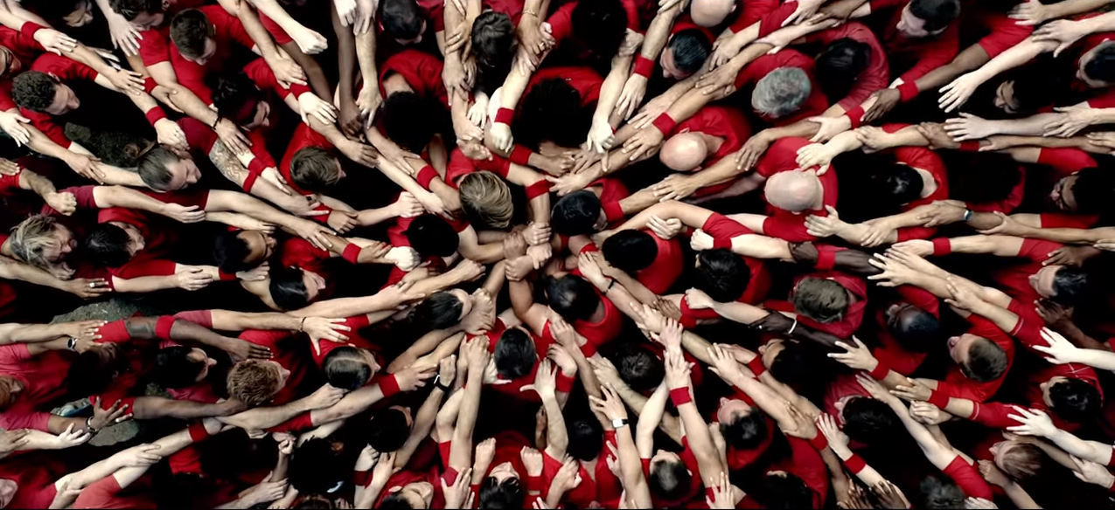
REPRESENTATION
RACE
In this scene we see long shots of black people being forced to carry out physical manual labour under the rule of a white aggressor, an explicit representation of ethnic minorities being oppressed.
This aligns with the video’s overall message of escaping oppression and people or system that restrict people’s freedoms.
The scene has grey cinematography (colour) to represent the negative mood and lack of freedom.
In this birdseye shot, a variety of hands come together. We can see that they are from a variety of ethnic backgrounds, therefore having connotations of global unity and ‘cultural togetherness’ regardless of race.
The cinematography of this scene is more colourful to represent the unity and freedom - this is a juxtaposition with the slavery scene.

Slide 7
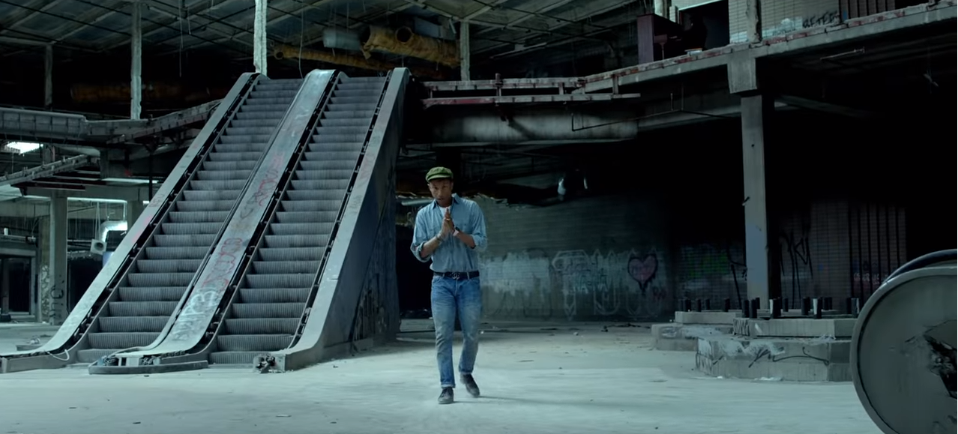
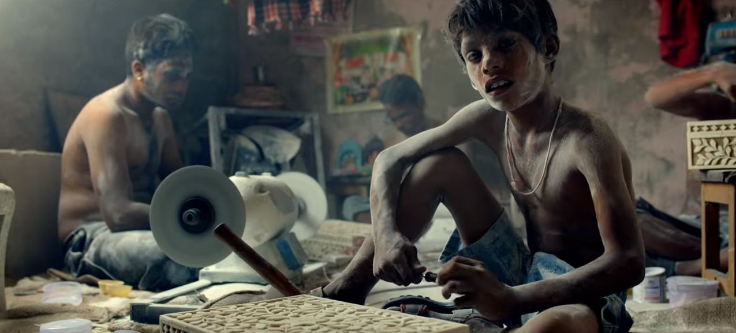
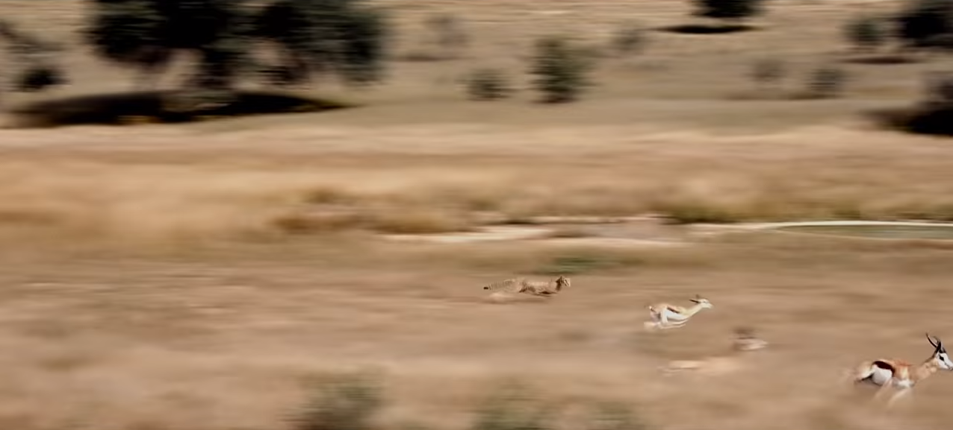
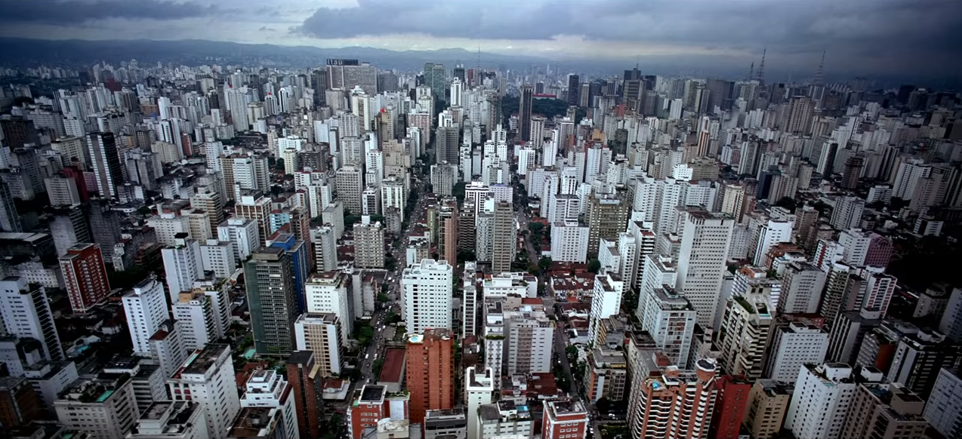
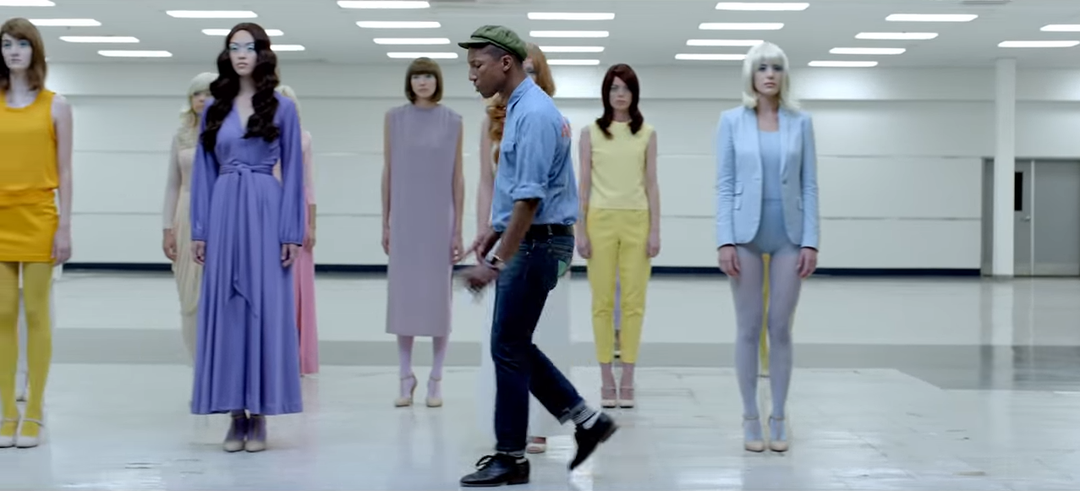
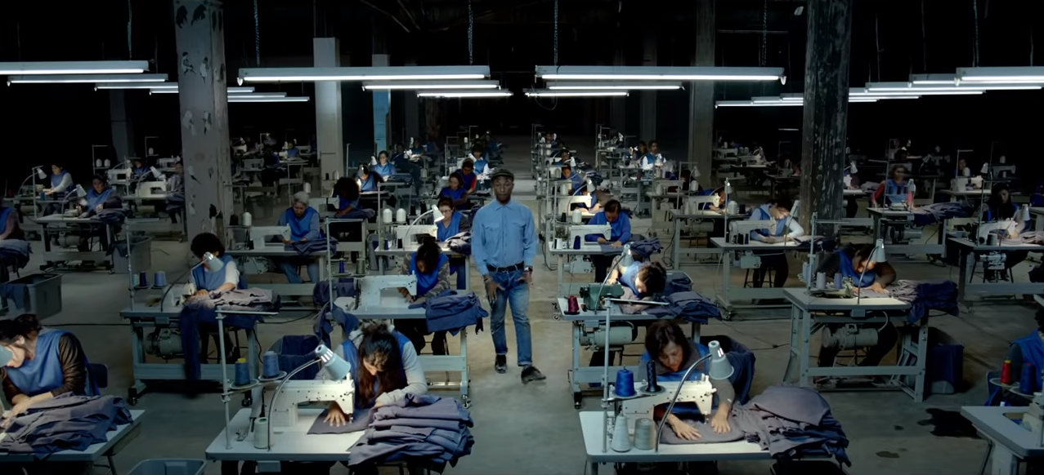
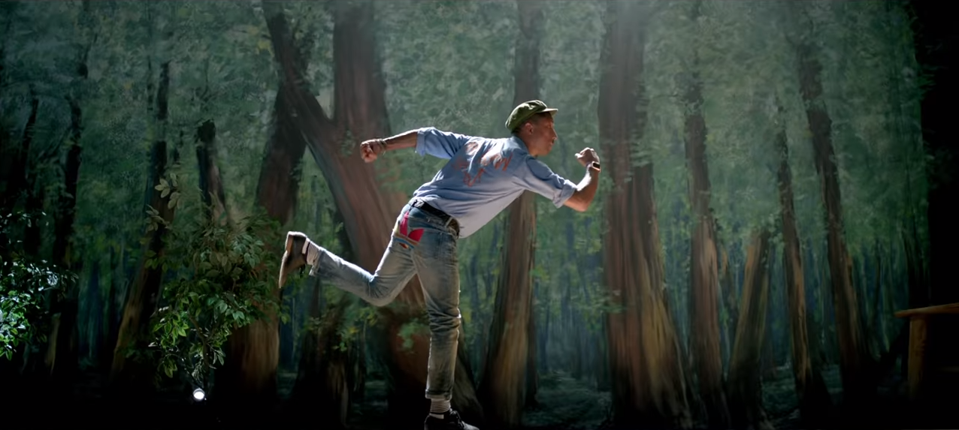
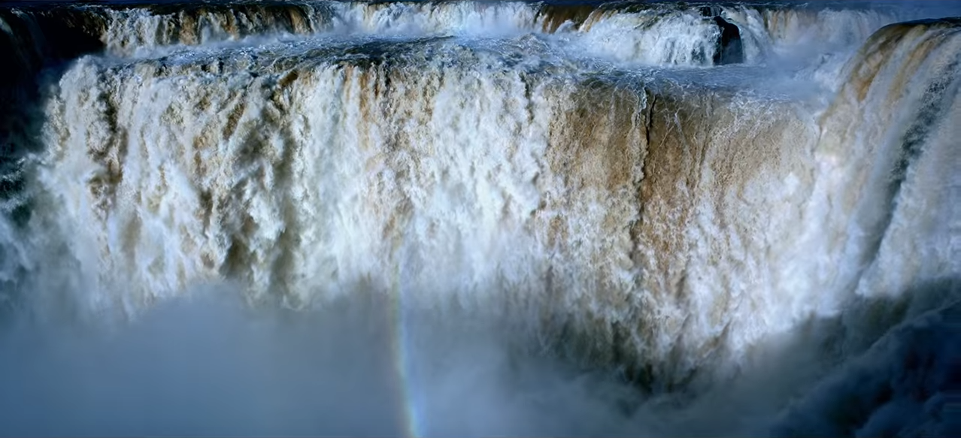
REPRESENTATION
WEALTH/SOCIAL STATUS/NATURE
An emotive shot of child labourers in a third world country working is shown, representing the idea that innocent children are trapped by the slavery of greed in modern society. This is juxtaposed by a shot before showing Pharrell standing on the stage of a school play with characters trapped in a net - a literal representation of imprisonment.
Pharrell is later seen standing amongst a sweatshop - where workers do repetitive work for little pay. He is stood in the centre - ‘standing with’ - or supporting them.
There is a dramatic contrast and another example of juxtaposition when a shot of a large city is shown immediately before a waterfall. The implication is that the waterfall represents freedom, as it is natural and moving freely, while the still, manmade and foreboding city isn’t free.
Pharrell is shown standing in a run down shopping mall, making a criticism of consumerist culture - where you are judged by how much money and possessions that you have. This idea is also explored later in the video where Pharrell walks in front of a group of expressionless models, implying that none of the models have freedom because they are told what to wear and how to behave.
The models are later shown taking off their wigs and walking away, representing them reclaiming their freedom.
Freedom is represented through the animal kingdom at several points in the video, juxtaposed with the images of oppressed humans. For example, a shot of a group of birds is used as a symbol for freedom. We also see a slow motion shot of a man riding a bucking horse, the implication being that the man is oppressing the horse, who is resisting being controlled.
An antelope is shown being chased by a cheetah. Pharrell mimics the movements of the running antelope as he sings the lyric ‘run antelope’, representing his hopes to gain freedom.

Slide 8
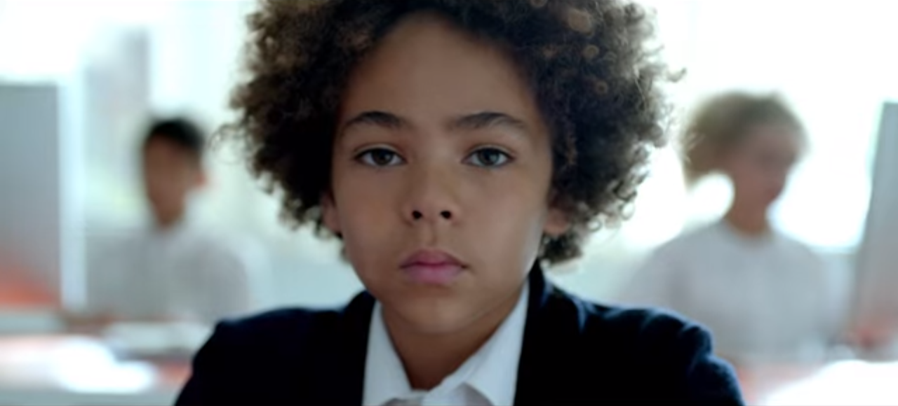
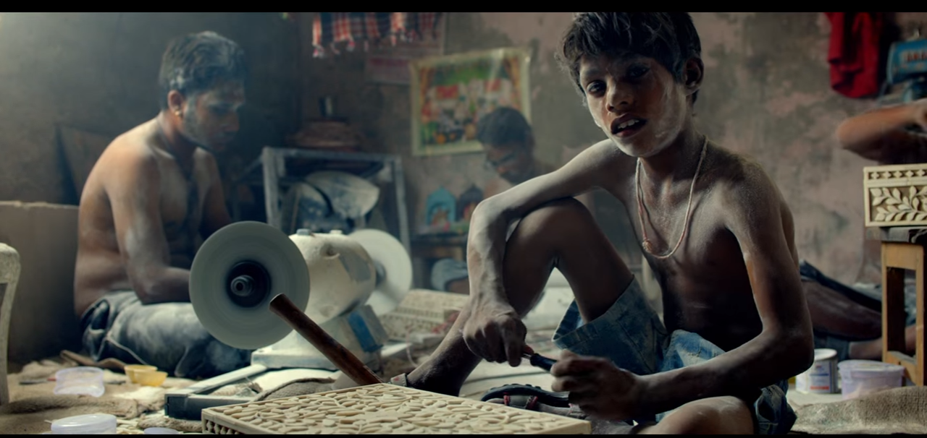
Narrative Theory - Binary Oppositions
Meaning in texts are dependent upon (and produced through) pairs of oppositions
Two images placed side by side for contrast, gives an image a more powerful meaning
Where & why are binary opposites placed side by side in the video? Screen shot & explain three examples.

Slide 9
SOCIAL AND CULTURAL SIGNIFICANCE
MIXED ETHNICITIES/RELIGIONS
Pharrell has purposefully included a large mix of people from different ethnic and religious backgrounds throughout the video, as well as including scenes of different countries. This reflects our modern day multicultural society in a positive way.
CONTRAST IN TREATMENT
The video shows a contrast in the way the different groups are treated. Some clearly have freedom - others don’t. The video is a direct comment on injustice.
HISTORICAL FIGURES & EVENTS
The prominent use of groundbreaking historical figures and events such as Muhammad Ali and the 1989 Massacre in Tiananmen Square allows the audience to easily recognise the important message of the song and video.

Slide 10
TARGETING THE AUDIENCE
So, now we know who the audience are; how do the producers of Pharrell Williams’ products target them successfully?
What ways can they use media to sell him?
Website
Social media following
Advertising online

Slide 11
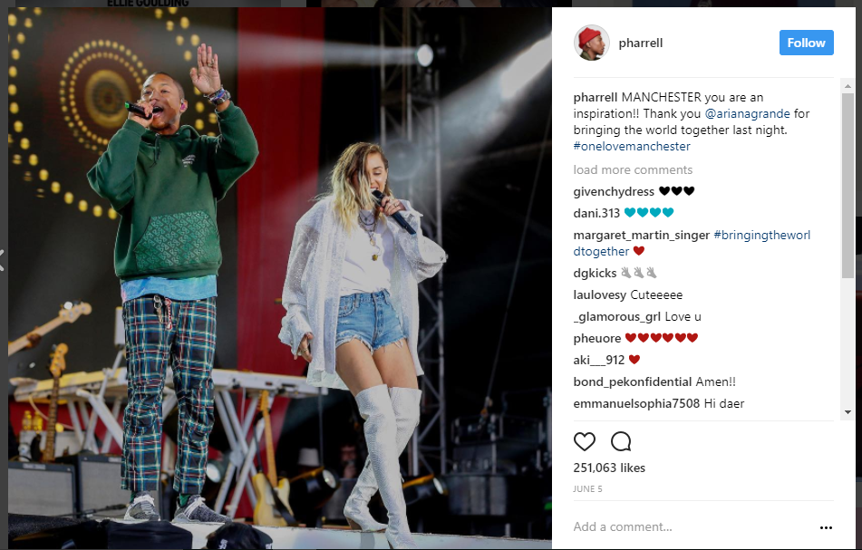
What does this IG post say to Pharrell’s audience?

Slide 12
CARING PERSON
Pharrell is very good at marketing himself as a kind and socially conscious individual. By congratulating Ariana Grande he is seen as kind and supportive. The event itself shows he is charitable.
Update your notes to show this information.

Slide 13
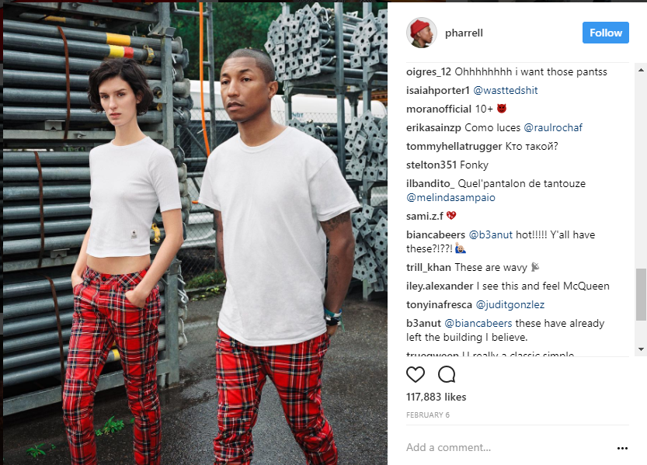
What does this IG post say to Pharrell’s audience?

Slide 14
OPINION/STYLE LEADER
Through PW’s use of social media we can see he is leading trends in fashion and directly advertising brands and fashion styles to his followers. By following this fans may be able to experience identification with the style of their celebrity interest.

Slide 15
ACTIVE AND PASSIVE
Audiences can be passive or active.
Active Audiences
Get involved with media products and brands.
Passive Audiences
Just consume products and could have their beliefs or behaviour affected but they do not DO anything with the products.
What kind of audience does Pharrell Williams and why does this work well for him?

Slide 16
OH SO ACTIVE!
Pharrell Williams’ audience actively engage via social and digital media. This allows them to show their allegiance with the star.
This is especially true with the socially conscious/charitable aspects of PW’s output.

Slide 17
EXAM STYLE QUESTION
Do music artists have the power to change the views of their audience? You should refer to the Uses and Gratifications theory and Freedom in your answer.
[10]

Slide 18
ANSWER
Responses are likely to agree with the statement.
Music videos give entertainment to the audience as a primary purpose. This is done through the variety of settings and characters shown is an aesthetically pleasing style.
However, in the case of Freedom there is a clear social message that is being put to the audience as well.
The long shots that show slavery-like conditions show those in back breaking work or grey monotonous factory conditions. These appear even more contrasted when set against the more joyful parts of the video.
This could provide education to the audience about different cultures and important issues in the world. It may also be a catalyst for social interaction in reaction to the issues.
When made available online this opportunity is even further developed in the use of comment sections and social media.
Through PW’s use of social media we can see he is leading trends in fashion and directly advertising brands and fashion styles to his followers. By following this fans may be able to experience identification with the style of their celebrity interest.

Slide 19
WHY WAS THE ‘FREEDOM’ MUSIC VIDEO MADE? IS IT DIFFERENT TO OTHERS?
Music videos exist as a marketing tool to sell music.
In addition to being a commercial product it also has a social/political message.
It encourages discussion about the worldwide issues of freedom and slavery.
This is very different from most videos that usually focus on more shallow issues.

Slide 20
REGULATION: BBFC
There is no current regulation for all music videos but the BBFC is running a pilot to see if it is effective.
Freedom has not been rated.
If you were to give a BBFC rating what would you give? why?

Slide 21
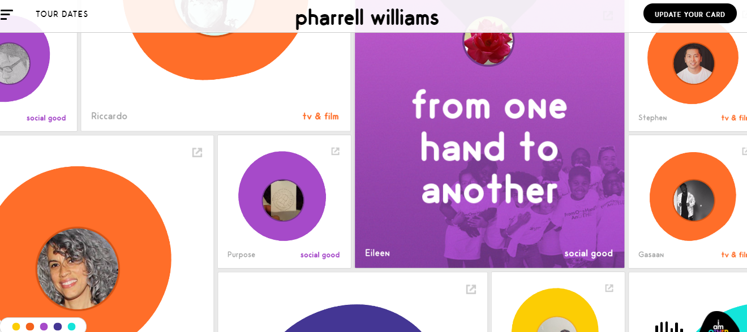
THE WEBSITE: ESSENTIAL REVISION

Slide 22
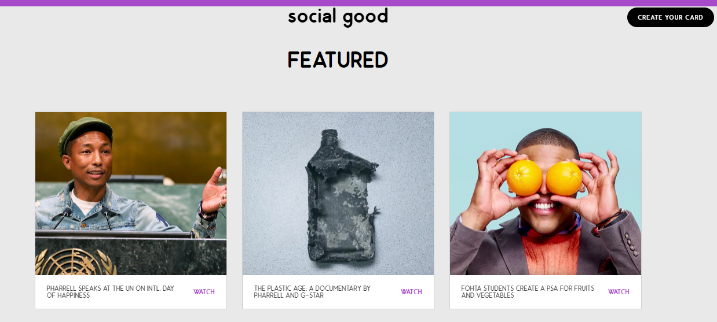

Slide 23
FEEDBACK
The website has a big focus on the audience.
It allows fans to create a customised ‘card’ that allows them to share their favourite Pharrell things..
This is presented in an interactive and vibrant style. Thus reflecting the vibrant community. .
Video content and options to purchase content through iTunes. This shows that PW is still a commercial artist.
‘Social Good’ is a big focus of the site with stories about peace (UN) the earth (Plastic) and Education/Health (PSA). This shows that PW has very unique values compared to other commercial artists.
Update your notes to show this information.

Slide 24
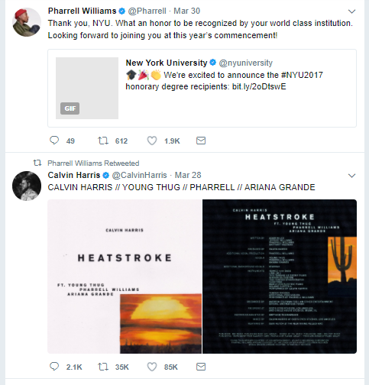
SOCIAL MEDIA: TWITTER
How is Pharrell Williams presented on this platform? Why is this effective?
Well educated and respected.
Not only is he being awarded a degree but is being humble and publicly acknowledging the gesture.
However, he still uses twitter as a publicity machine to promote work and collaborations with other artists.

Slide 25
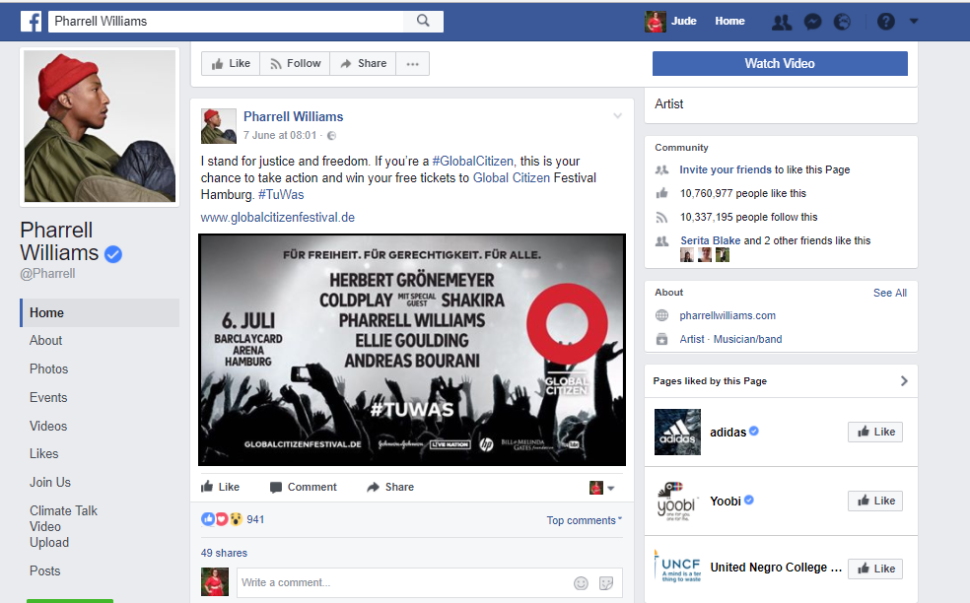
SOCIAL MEDIA: FACEBOOK
How is Pharrell Williams presented on this platform? Why is this effective?

Slide 27
SOCIAL MEDIA: FACEBOOK
How is Pharrell Williams presented on this platform? Why is this effective?
Fashionable – liked clear brand page.
caring/social conscience – two charity pages.
Socially Conscious.
“I stand for justice and freedom”

Slide 28
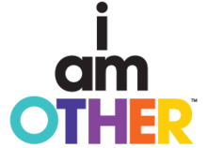
I AM OTHER
i Am Other is a multi-media creative collective and record label that serves as an umbrella for all of Pharrell Williams' endeavours
Billionaire Boys Club
ICECREAM apparel
textile company Bionic Yarn
YouTube channel
Musical creations
The programming on the i am OTHER channel focuses on music, culture, fashion and the arts.
Williams describes the channel as a "cultural movement dedicated to Thinkers, Innovators and Outcasts."
Update your notes to show this information.

Slide 29
EXAM STYLE QUESTION
Explain how Pharrell uses online and social media to share a variety of values with his audience.
[10]

Slide 30
To be able to answer a Component 2 Section B exam question using key examples from the text.
Q: ‘Music videos reinforce stereotypes of gender.' How far is this true in Duran Duran’s ‘Rio’?
explore representations of gender in the music video you have studied
refer to relevant media contexts, such as social or cultural
consider whether you agree or disagree with the statement.
Criteria:
Identify the stereotypes or mis representations
4 examples from the text
Analysis of these examples
Link to the 80’s context
Laura Mulvey’s theory
How the audience would respond.
POINT, EVIDENCE, ANALYSIS, RELATE TO AUDIENCE OR THEORY. USE the PEE writing frame (point = POINT; EVIDENCE; EXPLAIN)

