Slide 2
2019/20 GCSE Media Studies
EXAM REVISION

Slide 3
EXAM: PAPER OVERVIEW

Slide 4
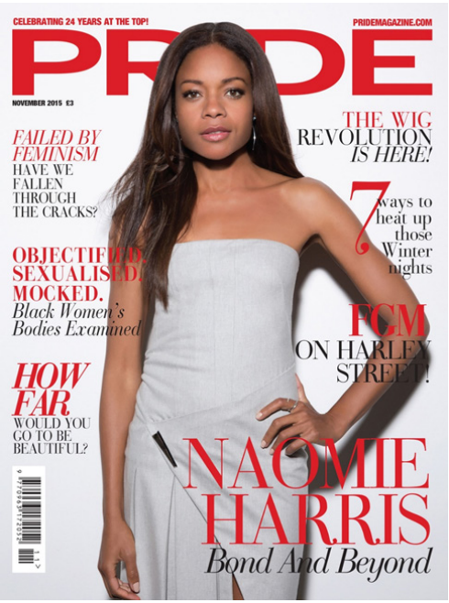
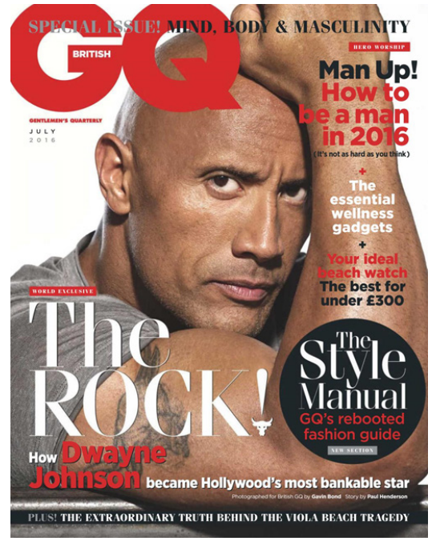
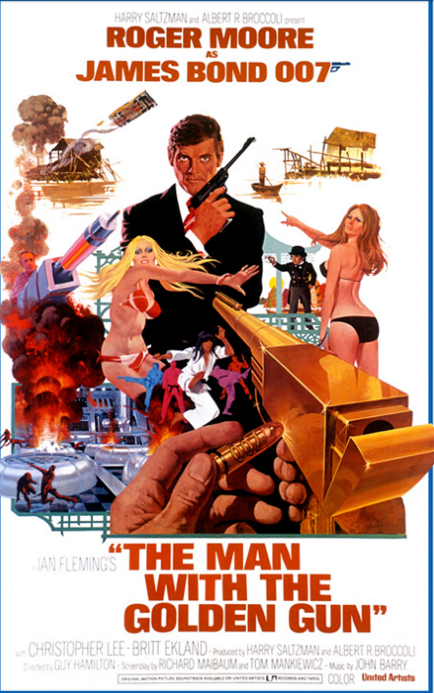
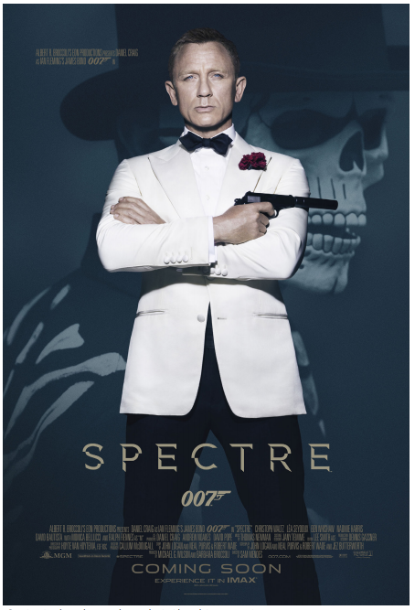
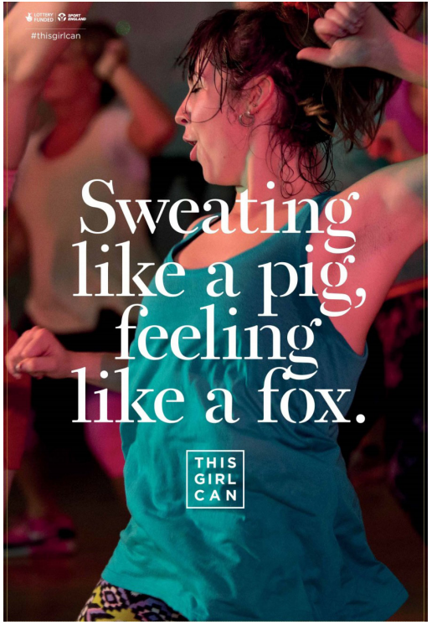
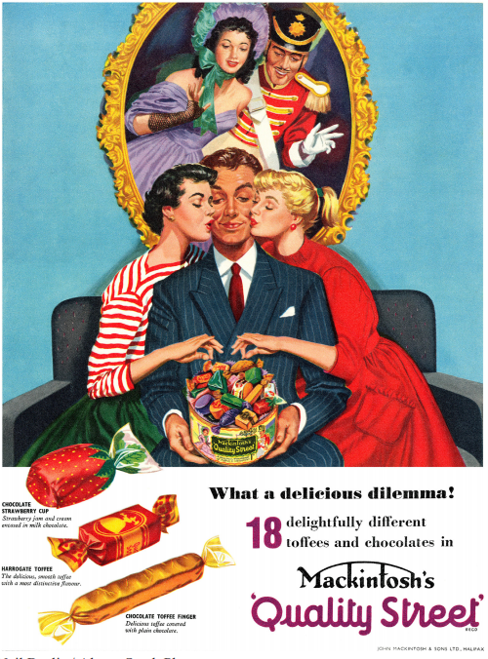
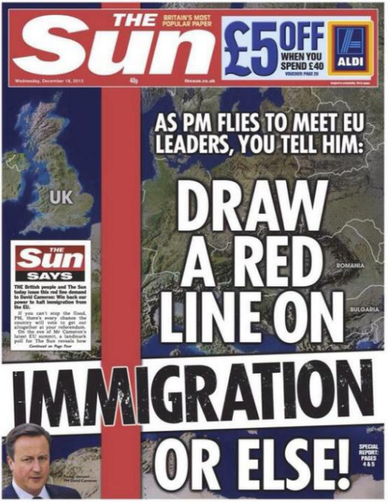
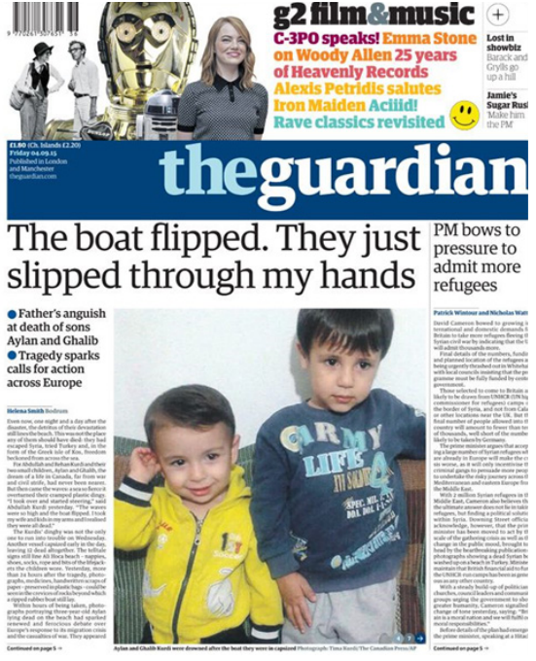
Component 1 (Exam 1): Exploring the Media, Written examination: 90 minutes - 40% of qualification
Component 2 (Exam 2): Media Forms and Products, Written examination: 90 minutes - 30% of qualification
Section A: Exploring Media Language and Representation
You need to know the following for ALL Set Products:
Historical context
Social and Cultural context
Political Context
Section B: Exploring Institutions and Audiences
In this section you will also need to study:
The Sun newspaper website;
A full issue of The Sun newspaper
The Guardian Newspaper Website;
The 007 James Bond Official Website
Section A: TELEVISION - You will be asked about EITHER Media language or Institutions or Representation or Audiences
You will study:
Luther, Series 1, Episode 1 (2010),
Plus a ten minute extract from: The Sweeney, Series 1
Section B: MUSIC VIDEOS- You will be asked about EITHER Media language or Institutions or Representation or Audiences
You will study:
Taylor Swift, Bad Blood (2014): Music video AND website
Pharrell Williams, Freedom (2015): Music video AND website
You will also study:
Duran Duran, Rio (1982)

Slide 5
EXAM: PAPER 2

Slide 6
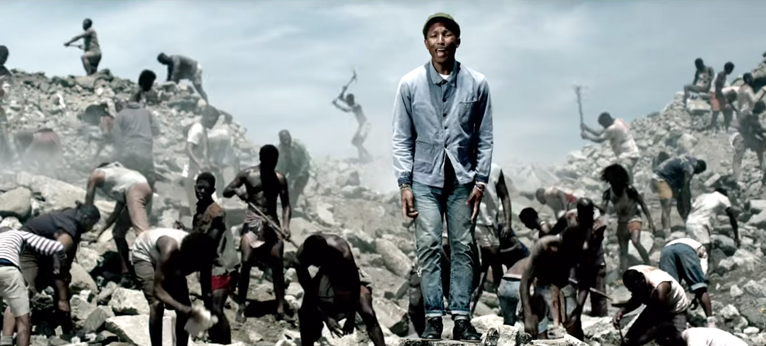
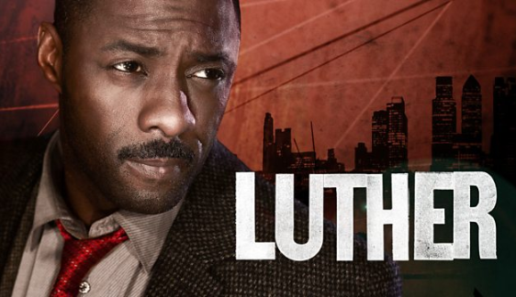

Slide 9
EVERYTHING I NEED TO KNOW
The following slides are all of the BASICS you need to know to analyse media texts in your exam. You need to be able to RESPOND to these ideas using media language and theory.

Slide 10
LUTHER and THE SWEENEY

Slide 11
CONVENTIONS OF CRIME GENRE
LIGHTING AND COLOUR
Low-key lighting: signifying crime and danger
“Gritty realism” to create verisimilitude (making it REAl and BELIEVABLE)
Flashing police car lights/red lights signify danger
CHARACTERS
DETECTIVES/Crime Solvers
CRIMINALS
VICTIMS
FAMILY/FRIENDS of victims
PROPP’s THEORY
The Hero (Detective: Luther)
The Villain (Criminal: Alice)
The Helper (Partner: Ripley)
The Princess (Victims: someone who needs to be saved, could be his wife, could be the child in the opening scene)
The Donor (Gives the hero something: Could be his female boss giving him his job back)
False Hero (looks good, turns out to be evil)
General Crime Drama “STOCK” CHARACTERS
The eponymous hero – a central figure detective who is so crucial to some crime dramas that the show is named after them i.e. Luther, Inspector Morse, Scott and Bailey. These characters are often bad tempered, flawed but brilliant detectives! Stereotypically these are white, male characters
A maverick cop who disobeys orders and breaks the rules to try and achieve justice.
A ‘sidekick’ or helper (Propp’s characters) who works alongside the maverick cop or main law enforcement character (Detective RIPLEY in Luther) this character is often a ‘rookie’ and new to the police force. This character can act as an audience surrogate positioning the audience in their shoes (vicariously) and share their sense of mystery about the crime – this supports the Uses and Gratifications theory because the audience can identify with this character.
Partnerships – stereotypically these are male/male detective/sidekick, but recently, as society has changed and female characters have become stronger, there have been female/female partnerships. Often these characters are binary opposites – the opposites come from: gender, ethnicity, age, experience, social class.
Characters who work independently from the police like Sherlock Holmes. These characters do however often help the police and are sometimes are used to demonstrate the inadequacies of the police force.
PROPS
Weapons
Police banner tape
Police cars
Gloves (Black gloves for villain)
Forensic kits (finger prints, magnifying glass, laboratory equipment)
NARRATIVES IN CRIME GENRE
Crimes to be solved, and a hero with a backstory (maybe a troubled relationship, like Luther, that is a continuing story across a series).
ENIGMAS to be solved
Cliffhangers at the end to keep audiences watching
TODOROV’s THEORY:
Equilibrium: (ordinary life)
Disruption (crime is committed)
Recognition (detective finds the crime)
Repair (detective tries to solve the crime)
New equilibrium (crime is solved OR criminal escapes = cliffhanger)
BINARY OPPOSITIONS
Good Vs Evil
Detectives vs Criminals
Innocent Vs Guilty
Truth/Justice Vs Lies/Injustice
CAMERA SHOTS, EDITING and MOVEMENT
SHOTS: Close-up, Extreme close-up, mid-shot, long-shot, point-of view (often of killer), two-shot (for conversation), shot/reverse shot (for conversation): “Luther is often framed centrally in close-up or mid-shot to reflect his dominance and status”
MOVEMENT: Pan, Tilt, Tracking, Hand-Held: “Whip pans are used in the opening of Luther to add excitement and speed to the chase”
EDITING: jump cuts are used to show Luther’s desperation in the opening scene as he shouts “where is she, where is she!”
Parallel editing and intercutting show two different events happening at the same time
SOUND
DIEGETIC: Sounds in the world of the TV show, for example Police Sirens
NON-DIEGETIC: Sounds the characters can’t hear like MUSIC
“Non-diegetic music is used to create a tense and uncomfortable mood for the audience”
SYNERGY with the band Massive Attack for theme song

Slide 12
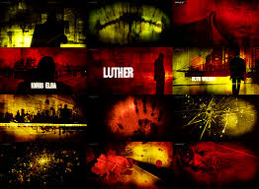
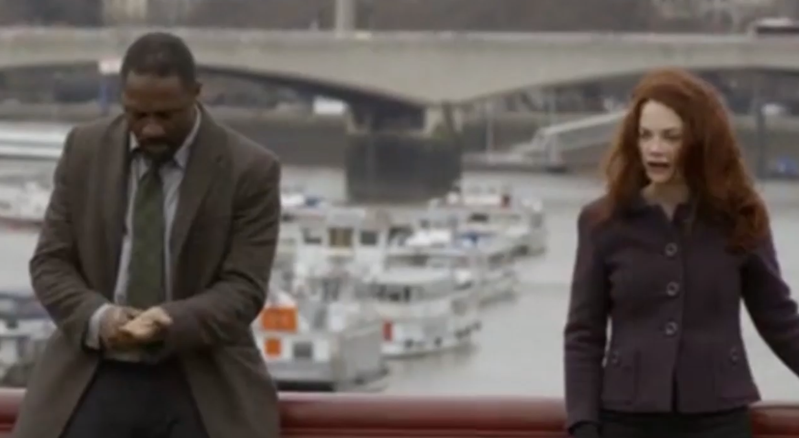
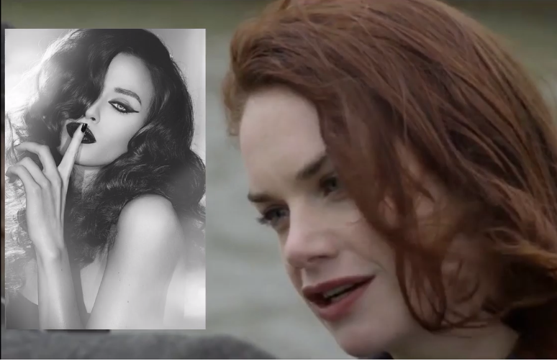
LUTHER CONTEXT
a BBC produced psychological crime thriller drama
began in 2010 and has been renewed for four seasons, with a fifth currently in production
contains a lot of the conventions of crime and psychological thriller films
relates to the iconography and visual style used in thrillers with bleak settings and colour schemes, heavy themes and dark, morally ambiguous characters
Idris Elba (Luther) is known for another crime series, The Wire - appealing to fans of the genre
PRIMARY AUDIENCE: Men, 25-45, MAINSTREAMERS and ASPIRERS C1/C2/D
SECONDARY AUDIENCE: Women, 45-60, BC1C2DE, Strugglers and Reformers
LUTHER TITLE SEQUENCE
background is red and distorted, connoting confusion, anger and violence.
character is show in silhouette, mysterious.
London skyline used, but frequently from low angles, making the buildings seem looming and imposing.
Close up of Luther distorted by the bloody/stylistic background.
More information given to the viewer as the sequence goes on, like uncovering a mystery.
Shots of fingerprints and barbed wire typical of genre
Luther is always alone
CONNOTATIONS OF COSTUME: LUTHER and ALICE
Luther: shabby, shirt unbuttoned, tie unbuttoned- he has a wild side, unconventional, does not conform to the rules. He doesn't care about how he looks, he just cares about getting the job done.
Luther removes wedding ring in the episode as his relationship breaks down. But after Alice tries to hurt his wife, he puts it back on to show Alice he will protect her. HE IS HONOURABLE.
Alice: Dressed smart in CONTRAST to Luther (Binary oppositions). She looks professional, she takes her crimes seriously. She dresses smart reflecting her vanity and evil personality. Dark colours signify her evil personality. Her outfit make her appear quite masculine in smart trousers and a jacket: murder is stereotypically regarded a male act.
Alice Morgan’s long, red hair connotes that she is volatile, dangerous and sexual.
Alice’s costume is gentle and innocent at the start (when she’s the victim) in contrast to the business , efficient and ruthless criminal look towards the end
HOW DO CRIME DRAMAS REFLECT THE TIME THEY ARE MADE? Using LUTHER and THE SWEENEY
The Sweeney reflects 1970s culture and social context through the visual conventions of the mise-en-scène (the vehicles, including Regan’s iconic Ford Consul Granada, the costumes, the areas of social deprivation in London).
The Sweeney represents the police as violent and willing to bend or break the rules in order to gain a conviction.
The Sweeney reflects 1970s values in relation to gender, especially gender roles in the workplace – the Flying Squad is male-dominated, patriarchal and characterised by a stereotypically macho culture of drinking, violence etc.
Luther reflects contemporary London culture through the use of media language – shots of the London skyline, sleek office buildings, period town houses etc. represent the city as a prosperous and diverse place.
Luther reflects contemporary attitudes to policing and constructs both positive and negative representations – Luther is a maverick who is brilliant at solving crimes, but breaks protocol in the way he deals with suspects e.g. threatening Alice and breaking into her flat. His boss is extremely logical and insists that proper procedure is followed, reflecting the institution of the police and balancing Luther’s more extreme approach.
Luther reflects the diversity of contemporary British society in the representation of Luther as a high-ranking black police officer, communicating a message of racial equality.
Luther reflects some degree of gender equality in contemporary society in the representations of strong, powerful females (Luther’s boss is female, his wife Zoe is a successful lawyer, Alice is a prodigiously intelligent astrophysicist). However, these females are not all represented positively or as being totally independent – Alice is a narcissistic murderer and Luther’s boss has a patriarchal male superior for example.
INTERTEXTUALITY:
FILM NOIR: a classic crime genre where the heroes are usually dressed shabbily (like Luther) and the women are FEMME FATALES like Alice.
FEMME FATALES are known for being dangerous women. They are often represented with hair over their face (like Alice) creating mystery and enigma. They are shown wearing red lipstick signifying seduction and danger (like Alice).
Luther’s name could be an intertextual link to Martin Luther King: strong black icon who fought against racial inequality.

Slide 13
REASON AUDIENCES LIKE CRIME DRAMAS
Enigma – Audiences watch for the mystery of trying to work out why committed the crime, why they did it, how they did it etc.
More Entertaining than real life – the crimes are more exciting than real crimes, the makers are able to edit out the boring bits, the paperwork etc.
Thrilling action sequences with adrenaline pumping stunts and chase sequences
Special effects such as gory bodies and wounds which will shock and excite audiences
Audiences are sadistic – We often enjoy watching bad things happen to other people because it makes us feel better that our own lives aren’t as bad as theirs and some say we enjoy watching other people suffer!
Allows us to see things we wouldn’t normally see! – In crime dramas the audience is able to see people they would never normally get to see eg criminals and police. We get to see their hidden lives.
Crime Dramas allow us to live vicariously – Audiences watch the shows and are able to experience emotions and feelings like fear, danger, dread, that they wouldn’t normally be able to or want to experience in real life. The shows also allow us to watch things we couldn’t normally do, like shootings, chases etc. It allows audiences experience all these things from the comfort and safety of their own sofas
We like justice! – Audiences enjoy seeing that crime doesn’t pay and that justice is always done. We like the happy endings where the bad guys get caught and are punished.
Identity – Often audiences enjoy being able to put themselves into the shoes of the main characters and imagine “what would I do in that situation”
Information – We can learn a lot from Crime Dramas about science, forensics, laws etc. It is important to note that not all the information given out in Crime Dramas is accurate and a lot is made up for the show
Relationships / Social Interaction – Often we feel like we have personal relationships with the main characters as they reappear every week, and we get to know them. We find out about their personal lives, their relationships, their weaknesses. We start to care about them and if our friends enjoy the same shows we can discuss the show with them and feel like part of a community of fans

Slide 14
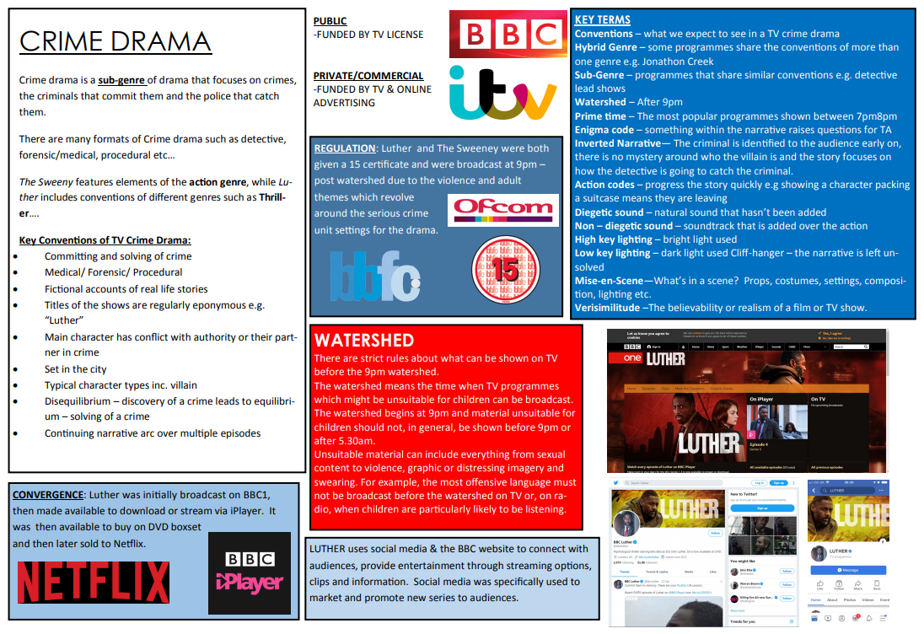
INSTITUTION CONTEXT

Slide 17
Luther and The Sweeney were both given a 15 certificate and were broadcast at 9pm –post watershed due to the violence and adult themes which revolve around the serious crime unit settings for the drama.

Slide 18
WATERSHED
There are strict rules about what can be shown on TV before the 9pm watershed.
The watershed means the time when TV programmes which might be unsuitable for children can be broadcast.
Unsuitable material can include everything from sexual content to violence, graphic or distressing imagery and swearing.
For example, the most offensive language must not be broadcast before the watershed on TV or radio, when children listen.

Slide 19
CRIME DRAMAS: EXAM QUESTION B

Slide 20
CONVENTIONS of CRIME DRAMA
Key Conventions of TV Crime Drama:
Committing and solving of crime
Medical/ Forensic/ Procedural
Fictional accounts of real life stories
Titles of the shows are regularly eponymous e.g. “Luther”
Main character has conflict with authority or their partner in crime
Set in the city
Typical character types inc. villain
Disequilibrium – discovery of a crime leads to equilibrium – solving of a crime
Continuing narrative arc over multiple episodes

Slide 21
Why are they so popular with the broadcasters?
One reason is that they are cheap to produce
They offer a mix of audience pleasures (GRATIFICATIONS) – specifically, laughter, tension, identification etc.
They have a broad, often family, audience, making them popular with advertisers
The multi-episode series’ fills a ‘slot’ in the schedule that can continue for months

Slide 22
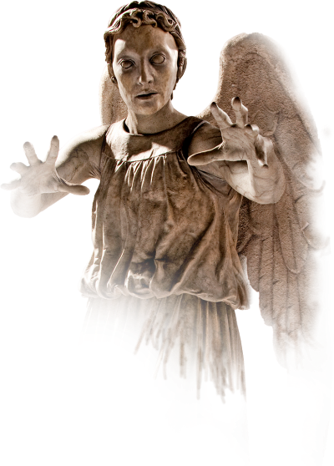
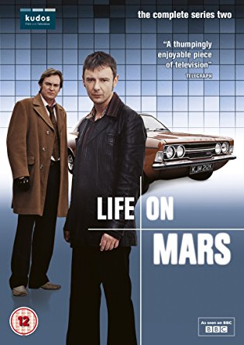
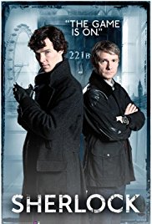
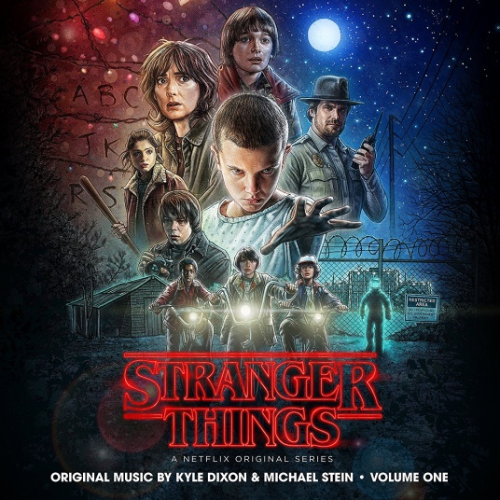
“Watercooler moments”
Shocking
Exciting
A twist in the tale
Controversial

Slide 23
CONVENTIONS of CRIME DRAMA

Slide 24
CONVENTIONS of CRIME DRAMA

Slide 25
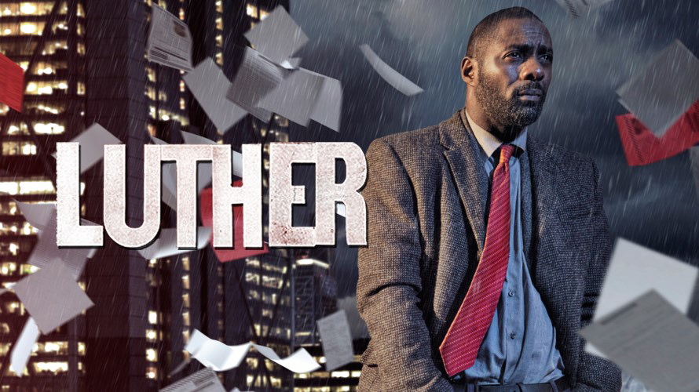
LUTHER
Luther is a British crime drama television series starring Idris Elba as the title character DCI John Luther.
Prior to Luther Elba was well established in the US crime drama The Wire and the US version of The Office.
The first series comprised six episodes which ran in May 2010 on BBC1 in the 9pm timeslot
BBC Studios handles the distribution of the series.
The series has been highly successful receiving numerous awards and critical acclaim for the production, writing and the stars of the show.

Slide 26
LUTHER: STYLE
50s Noir conventions are borrowed e.g. dark lighting and long overcoat Alice Morgan is pale and wears red lipstick – ‘femme fatale’ again borrowed from the 50s .
This is noted in the opening credit sequence, with its use of reds, blacks and crime-drama genre iconography. Reinforced by enigmatic silhouettes and the whispering, secretive theme tune.

Slide 27
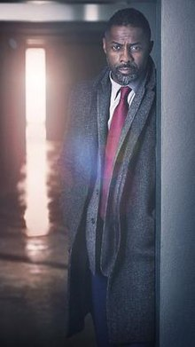
LUTHER: CONTEXT
REPRESENTATION & CONTEXT:
ETHNICITY: Luther challenges stereotypical representations of black men in crime drama which is typically negative. This is further reflected in Luther's highly educated, successful mixed race wife. This reflects the diverse, multi-cultural setting of this contemporary drama.

Slide 28
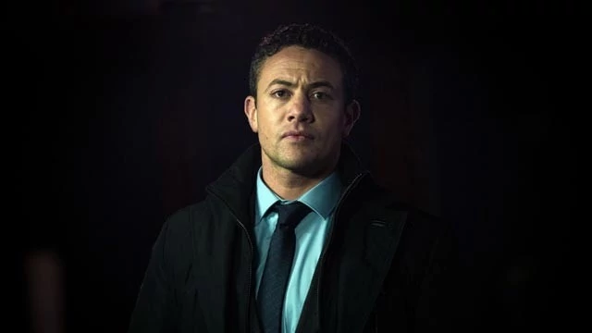
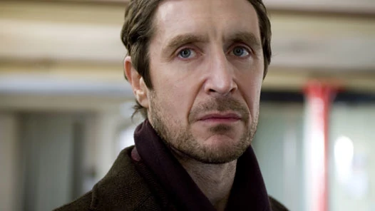
LUTHER: CONTEXT
GENDER:
Masculinity is represented in a very complex way; Luther is represented as an aggressive, alpha male, yet also vulnerable through his psychological instability.
Typical masculine stereotypes are challenged through characters such as Justin who is openly admirable of Luther; and Mark who is gentle and represented as a ‘sensitive’ contrast to Luther.
The representation of femininity challenges stereotypes in all lead female characters; Alice subverts expectations as a manipulative, intelligent villain, Rose Teller is a powerful, authority figure, and while Zoe Luther is by far the most typically ‘feminine’ representation (vulnerable, weak, lead by love), she is also represented as a highly successful humanitarian lawyer. These female representations reflect the contemporary context of the setting.

Slide 29
LUTHER: CONTEXT
GENDER:
CRIME & THE POLICE: Crime is represented as dark & sinister and Luther is represented as a vigilante, rule-breaker who will stop at nothing to stop criminals. Rose is the calm, steady influence who encourages him to stay on the right track.

Slide 30
LUTHER: THEORIES
USES and GRATS: Escapism, Entertainment, Identity
PROPP:
HERO: John Luther, troubled but brilliant detective; a rule-breaker who will do anything to bring criminals to justice.
VILLAIN: Alice Morgan, femme fatale, highly intelligent, manipulative and an obsession with Luther.
HELPER: Justin Ripley, faithful sidekick who idolises Luther and is eager to learn. Ripley asks questions that the audience need to follow Luther's thoughts and processes of detection.
DISPATCHER: Rose Teller, Luther’s boss, keeps him focused , tough but fair – see’s Luther’s brilliance and willing to put her job on the line for him.
DONOR: Both Ripley and Benny provide Luther with the means to achieve his goal

Slide 31
The Conventions of TV Crime Drama
Notes:
Print off for students

