Slide 1
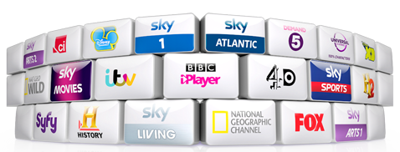
2019/20 GCSE Media Studies
EXAM REVISION

Slide 2
What Does The Exam Look Like?
Your course is made up of three parts:
Component 1: Exam - 40% of GCSE
Component 2: Exam - 30% of GCSE
You will study different aspects of media in different sections of your exam.
So what will we be studying? We can separate Media Studies into the following four elements that we call ‘The Theoretical Framework’. Mr Davies uses MIRA to help remember what we need to talk about:
M = Media Language
I = Institutions (media industries)
R = Representation
A = Audience
[NOTE: Remember that I made MIRA up! So don’t write ‘MIRA’ in your exam, instead refer to it individually as Media Language, Institutions, Representation or Audience!]

Slide 4
EXAM: PAPER OVERVIEW

Slide 5
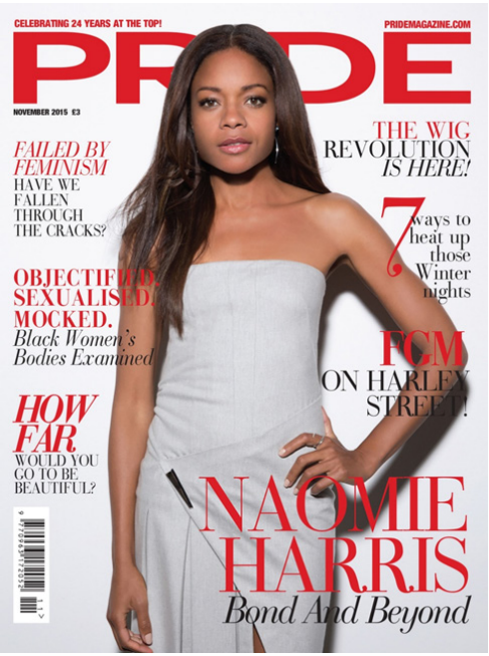
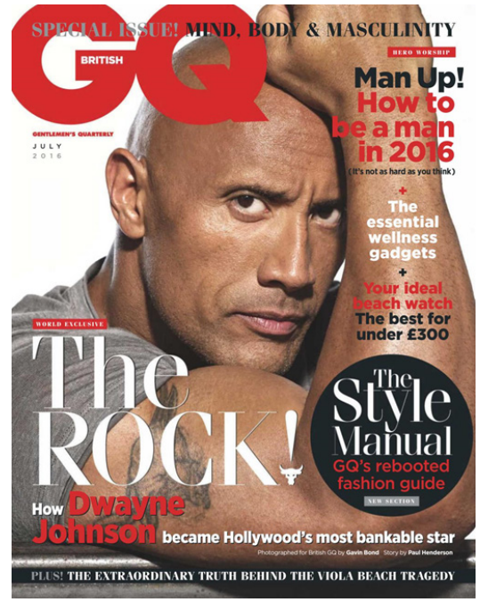
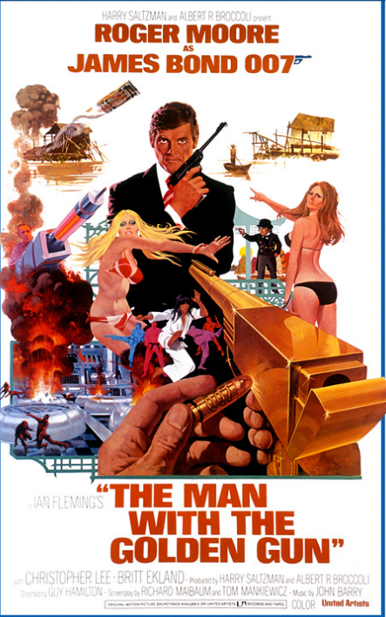
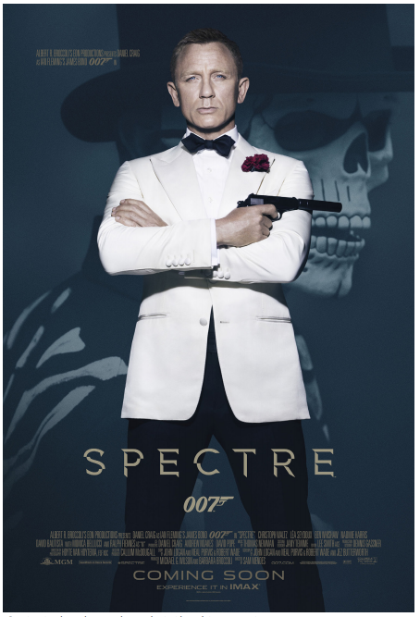
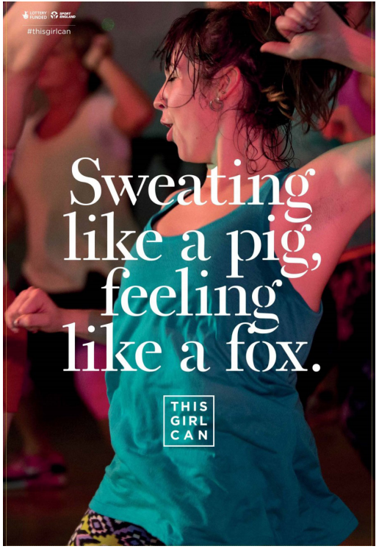
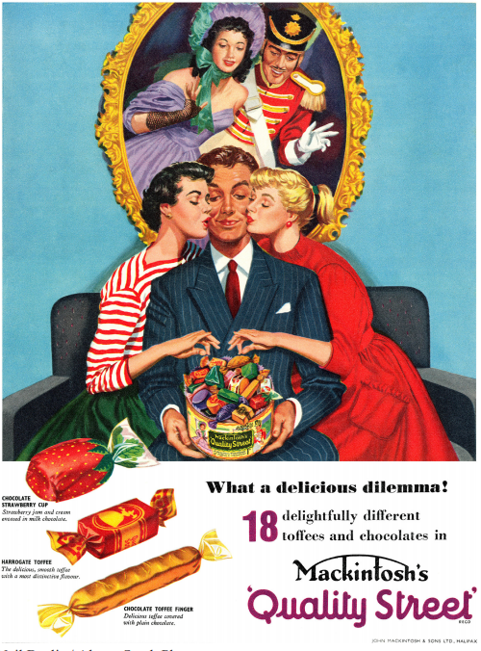
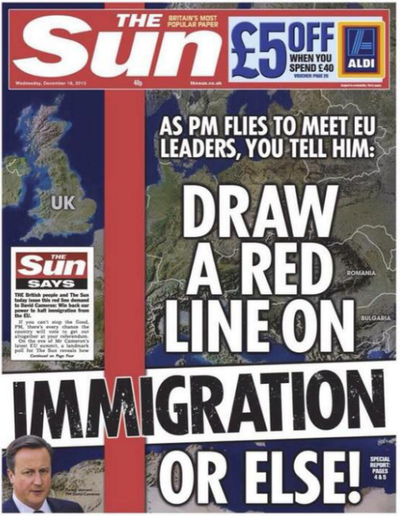
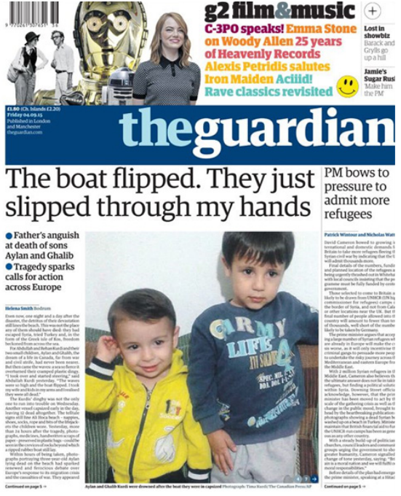
Component 1 (Exam 1): Exploring the Media, Written examination: 90 minutes - 40% of qualification
Component 2 (Exam 2): Media Forms and Products, Written examination: 90 minutes - 30% of qualification
Section A: Exploring Media Language and Representation
You need to know the following for ALL Set Products:
Historical context
Social and Cultural context
Political Context
Section B: Exploring Institutions and Audiences
In this section you will also need to study:
The Sun newspaper website;
A full issue of The Sun newspaper
The Guardian Newspaper Website;
The 007 James Bond Official Website
Section A: TELEVISION - You will be asked about EITHER Media language or Institutions or Representation or Audiences
You will study:
Luther, Series 1, Episode 1 (2010),
Plus a ten minute extract from: The Sweeney, Series 1
Section B: MUSIC VIDEOS- You will be asked about EITHER Media language or Institutions or Representation or Audiences
You will study:
Taylor Swift, Bad Blood (2014): Music video AND website
Pharrell Williams, Freedom (2015): Music video AND website
You will also study:
Duran Duran, Rio (1982)

Slide 6
EXAM: PAPER 1

Slide 7
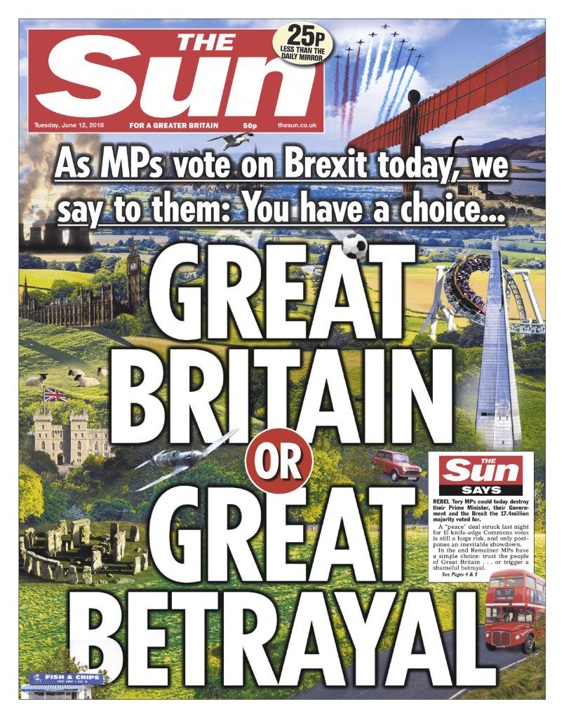
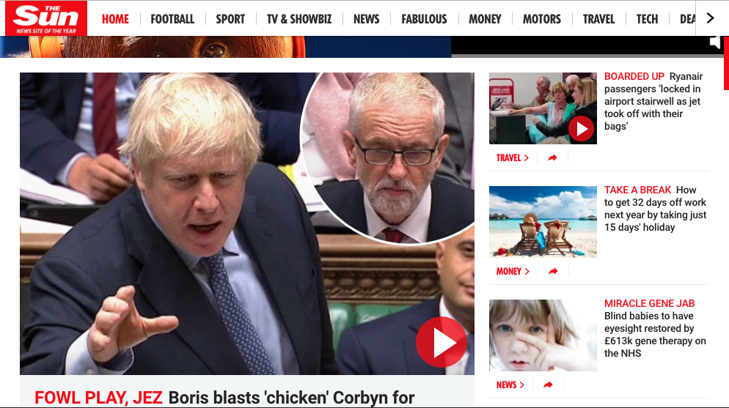

Slide 10
EVERYTHING I NEED TO KNOW
The following slides are all of the BASICS you need to know to analyse media texts in your exam. You need to be able to RESPOND to these ideas using media language and theory.

Slide 11
IMPORTANT! You should use CONTEXT in all of your exam responses. So, what is context?
Historical context: relates to time period it was made and events happening at the time.
Social context: relates to society at the time. It will affect the representations in media.
Cultural context: concerns the elements such as style, genre and technology.
Political context: how a media text is affected by politics at the time.

Slide 12
Key Terminology and ideas you MUST know...
VISUAL CODES:
MISE-En-SCENE
Costume
Lighting and colour
Actors (expression/proxemics)
Make-up
Props
Setting
TECHNICAL CODES:
Camera Movement
Camera Angle
Editing
Diegetic sound (sounds the characters could here from the world of the media text - eg: footsteps, cars, talking ect)
Non-Diegetic sound (sounds added for the audience: music soundtrack, voice over ect. - the characters can’t hear non-diegetic sound)

Slide 13
Key Terminology and ideas you MUST know...
GENRE:
Genre is a type of media, it includes:
Visual iconography—visual codes associated with a genre.
Technical codes—different genres use different codes in specific ways.
Narrative—the way in which the story is told.
Characters—most genres have an expected type of character.
Key Genre Terminology:
Conventional: elements that we would expect to see in a particular genre.
Unconventional: conventions we would not expect to see in a genre.
Technological developments: new technologies that enable media producers to create products in a different way.
Subgenre: a more specific genre with two different genres (Rom-Com)
Hybrid: a combination of two or more different genres.
Linear narrative: a narrative structure where all of the events happen in logical order, one after the other.

Slide 14
Key Terminology and ideas you MUST know...
NARRATIVE:
TODOROV’s Narrative Theory:
Equilibrium: at the beginning, everything is calm and balanced.
Disruption : an event or problem occurs to upset the balance.
Recognition: the characters realise that there is a problem.
Repair: they try and fix the problem
New equilibrium: everything returns to a state of balance.
What if it is a non-linear narrative?
It might include:
Flashbacks—Flash-forwards –creates suspense.
Enigma code: a mystery or puzzle, media products often don’t tell all elements at once but withhold information to keep audience guessing and asking questions.
Transformation: a major change. Characters are often transformed.

Slide 15
KEY MEDIA LANGUAGE: AUDIENCES
PASSIVE AUDIENCES - audiences who accept what they see and don’t question it
ACTIVE AUDIENCES - audiences who do question and challenge what they see
TARGET AUDIENCE - the specific audience the media is targeting
PRIMARY AUDIENCE - the main audience
SECONDARY AUDIENCE - other audiences who may be interested
RECEPTION THEORY -
Stuart Hall suggests all media products are ENCODED with meaning that audiences can DECODE. He says audiences can respond to texts three ways:
Preferred reading
Negotiated reading
Oppositional reading
This is HIGH LEVEL theory! USE IT!

Slide 16
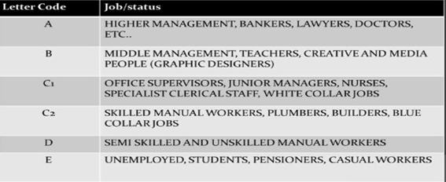
AUDIENCE DEMOGRAPHICS - ABC1 and C2DE:
WE TEND TO BREAK AUDIENCES INTO TWO GROUPS (OR ‘CLASSES’): ABC1 and C2DE
You need to reference these when discussing how a media text appeals to an audience...

Slide 17
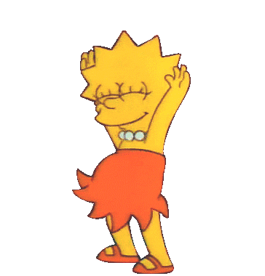
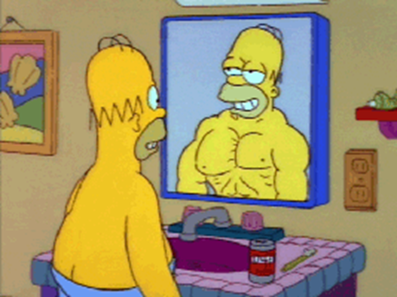
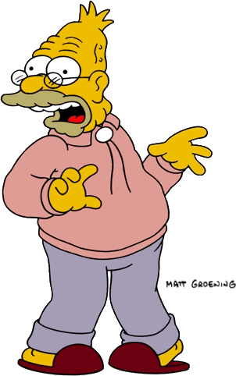
AUDIENCE PSYCHOGRAPHICS (LIFESTYLE
GROUPINGS)
You need to reference these when discussing how a media text appeals to an audience...
Succeeders – people who are successful and self confident, follow their own ideas of what is a good product
Reformers – Creative, caring, not brand conscious
Aspirers – People who want to better themselves, to have the best brands
Mainstreamers – the largest segment, conformists
who like to fit in and buy ‘safe’ big brand products
Explorers – want to try new things, likely to be early adopters of completely new products
Constrained – they are struggling because they don’t have much money

Slide 18
YOU MUST KNOW: WHO REGULATES WHAT
MEDIA PLATFORM | THE REGULATOR | WHAT IT STANDS FOR
TELEVISION and RADIO |  | OFfice of COMmunications
ADVERTISING |  | ADVERTISING STANDARDS AGENCY
FILM (and music videos) |  | British Board of Film Classification
VIDEO GAMES |  | Pan European Game Information
NEWSPAPERS/MAGAZINES |  | Independent Press Standards Organisation

Slide 19
THE EXAMS

Slide 20
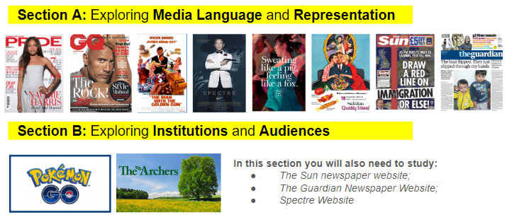
SECTION A: Component 1
In Section A of exam 1 you will ONLY be asked about MEDIA LANGUAGE and REPRESENTATION for these set products:

Slide 21
SECTION B: Component 1
In Section B of exam 1 you will ONLY be asked about MEDIA INDUSTRIES and AUDIENCES for these set products:

Slide 22
EVERYTHING YOU NEED TO KNOW FOR THE SET PRODUCTS FOR COMPONENT 1: SECTION A
The following slides give you the basics needed for a LEVEL 7 + analysis of ALL your set products! All you need to do is write as much information as possible in your responses using the P.E.E writing frame. You must ALWAYS link to CONTEXT.

Slide 23
SECTION A: Component 1

Slide 24
PRIDE

Slide 25
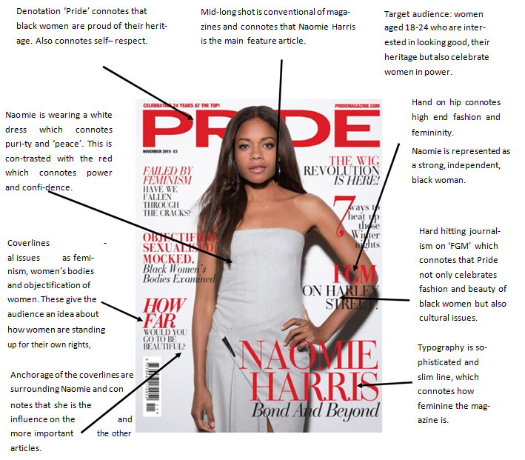
SET PRODUCT 1: PRIDE MAGAZINE
Context of pride:
Pride is a UK monthly women’s lifestyle magazine that targets women of colour.
• Published since 1990
circulation of over 300 000 copies per month and a readership of over 146 000.
• Pride is distributed in the UK by COMAG, part of Condé Nast.
• It’s easy to see how people may mistake Pride for a gay magazine, as this word has become synonymous with the gay community over recent decades. In fact, the modern gay movement has its roots in the black liberation movement of the 1960s with Gay Pride borrowing its name from Black Pride

Slide 26
PRODUCT CONTEXT
- Monthly, woman’s lifestyle magazine
- first published in 1990,
- circulation = 30,000 a month
- readership (including online) 146,000+
- Still in BLACK ownership.
- Name links to black liberation and Black lives matter
TARGET AUDIENCE
- Females of colour
- aged between 24 - 35
- ABC1 middle class or higher (good education, interested in fashion and beauty, spend a lot of money on fashion and beauty products
- A niche audience (smaller than average with specific interests)
MEDIA LANGUAGE: Technical and Visual
Masthead - behind Naiomi, brand confidence, makes Naiomi powerful (black pride!)
Strapline - best magazine of its kind
Colour palette - red suggests strength, white is purity and femininity
Pose - confident, chocolate box/invitational (ferguson), direct address - communicating with audience.
Costume - tight, built not sexualised, aspirational, body confidence
Facial expression - serious, confident
SOCIAL/CULTURAL CONTEXT
- Modern magazines focus more on beauty, less on homemaking.
- Women’s magazines used to stereotypically keep women in the home as part of the patriarchal society. The magazines were more about making clothes, not wearing them
- Pride encourages us to feel bad about ourselves but promote that they will make us better!!
- BLM (Black Lives Matter) - campaign against police racism, big on Twitter as is Pride (lots of followers)
REPRESENTATION: Ethnicity, Gender and Issues
Successful Black woman = role model
From similar audience to Target Audience = Identity
PRIDE represents black people as confident and ambitious, Naiomi is shown as ASPIRATIONAL (Lifestyle Groupings) = slim, successful, fashionable = fits stereotype for lifestyle magazines; women are still judged on their looks.
“How far would you go?” coverline encourages women to improve themselves suggesting they are inadequate and should aspire to be better - and PRIDE magazine will show them how!
FGM - hard hitting issue, appeals to an intelligent audience, not just conscious with fashion but also social issues.
Key Message (positive) - be proud of who you are, your culture, be confident, aspire to be like Naiomi Harris.
Secondary Messages (negative) - straight hair is conforming to European ideas of beauty, looking beautiful is important, focus on body image is a stereotype
WRITTEN CODES
Personal pronouns - makes it personal (IDENTITY)
Hyperbole
Alliteration - “Bond and Beyond” emphasises her success as a (sexy) Bond girl
KNOWLEDGE ORGANISER: PRIDE
Pride’s Unique Selling Point is that it is the only black media company that still remains in black British ownership! So this certainly forms an IDENTITY with the black audience
HISTORICAL/POLITICAL CONTEXT
- The term Pride come from the Civil Right Movement that encourages/ celebrates black culture
- wanted people to be proud of being black and having afro hairstyles
LINK TO THEORIES (LEVEL 7+)
Uses and Gratifications: Audiences may IDENTIFY with Naomie Harris and aspire to be like her. They may also be INFORMED and ENTERTAINED.
Gender Representation - Laura Mulvey talks about the male gaze and how women are shown (behaviour and looks) in a way that men would like. Cover does reinforce some gender stereotypes e.g. looks but challenges others e.g. she is strong and powerful.
ENIGMA CODES - Roland Barthes and the use of enigma codes - cover lines tease us to want to read more.
“to provide readers with a sense of community, comfort, and pride in this mythic feminine identity” (Bignell).
FERGUSON's FACIAL EXPRESSION THEORY: Chocolate box, Invitational, super-smiler, romantic/sexual. Naoimi Harris conforms to the Chocolate Box expression. She appears sweet and innocent, and has a half-smile. This innocence is reinforced by her white dress, connoting purity.

Slide 27
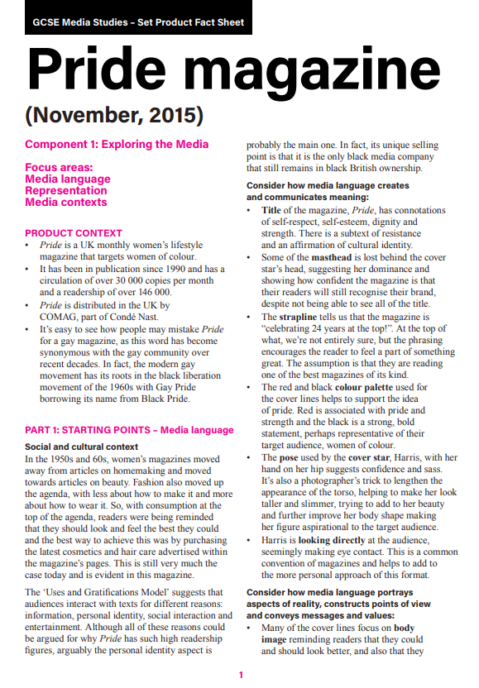
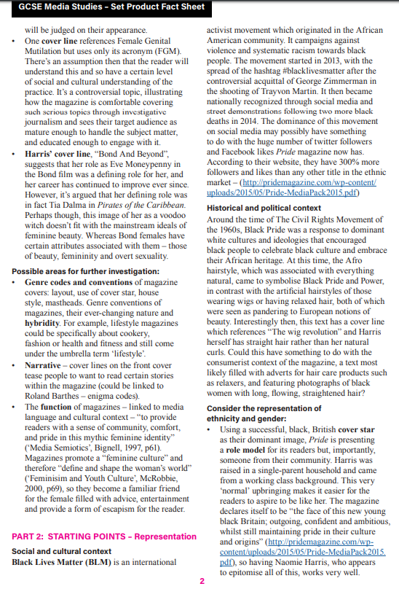
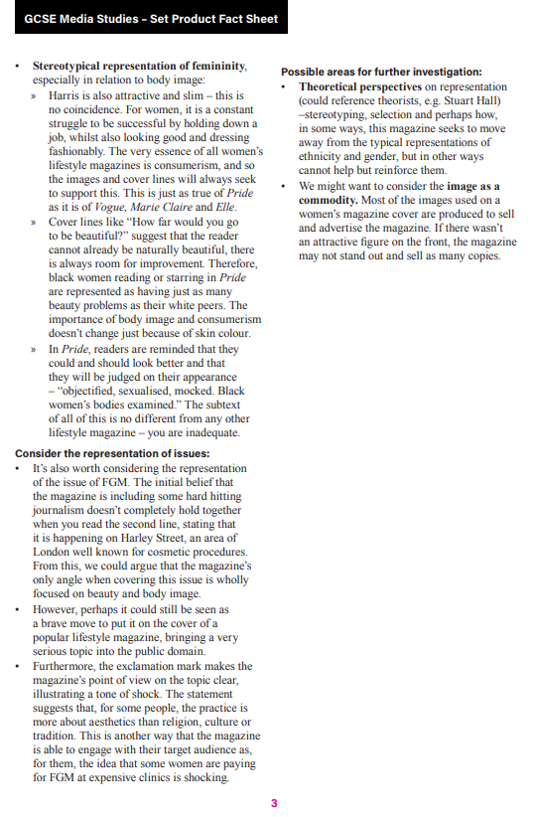
LINK TO ALL THE INFORMATION ON PRIDE
CLICK HERE TO SEE THE EDUQAS FACT SHEET ON PRIDE

Slide 28
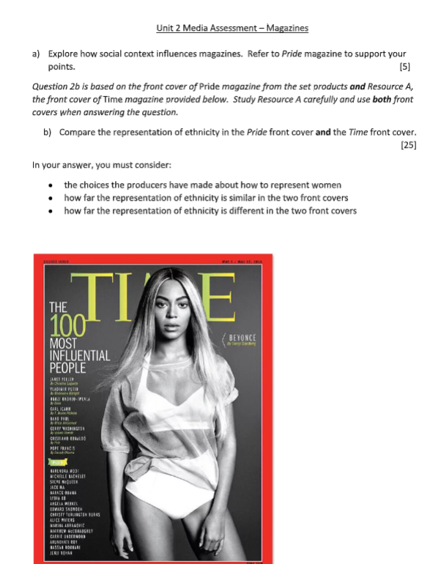
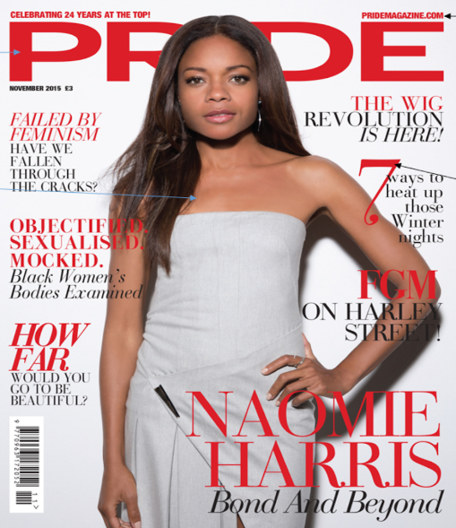
HOME LEARNING - POSSIBLE EXAM QUESTIONS FOR PRIDE MAGAZINE.
YOUR TURN: Write an exam response to this exam question using the slide above as a guide...

Slide 29
EXAM RESPONSE: PRIDE
Q (a)
5 MARKS

Slide 30
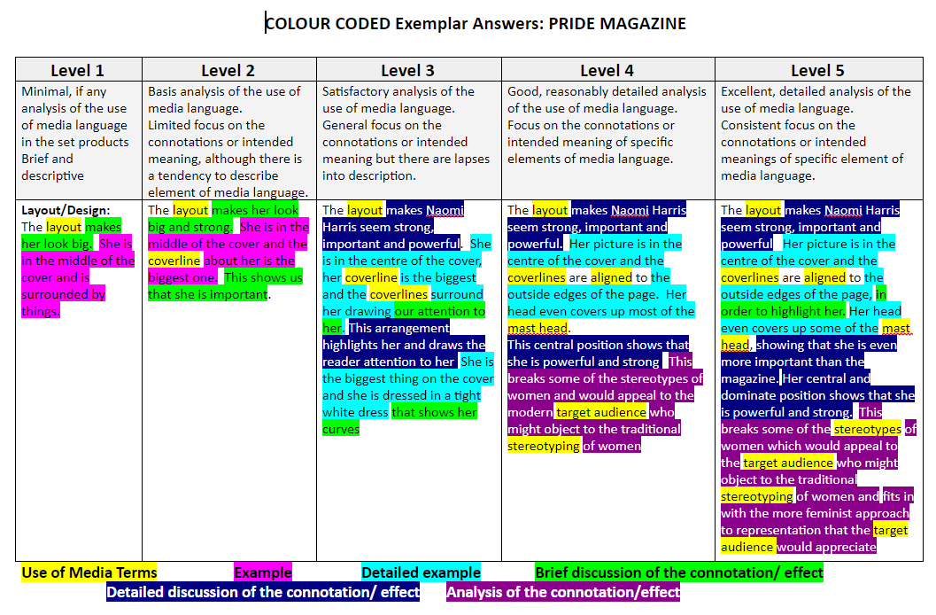
This is a colour coded response to the following question: How does the magazine Pride uses images and layout to convey messages? It is worth 5 MARKS

Slide 31
EXAM RESPONSE: PRIDE
Q (b)
25 MARKS

Slide 32
GQ

Slide 33
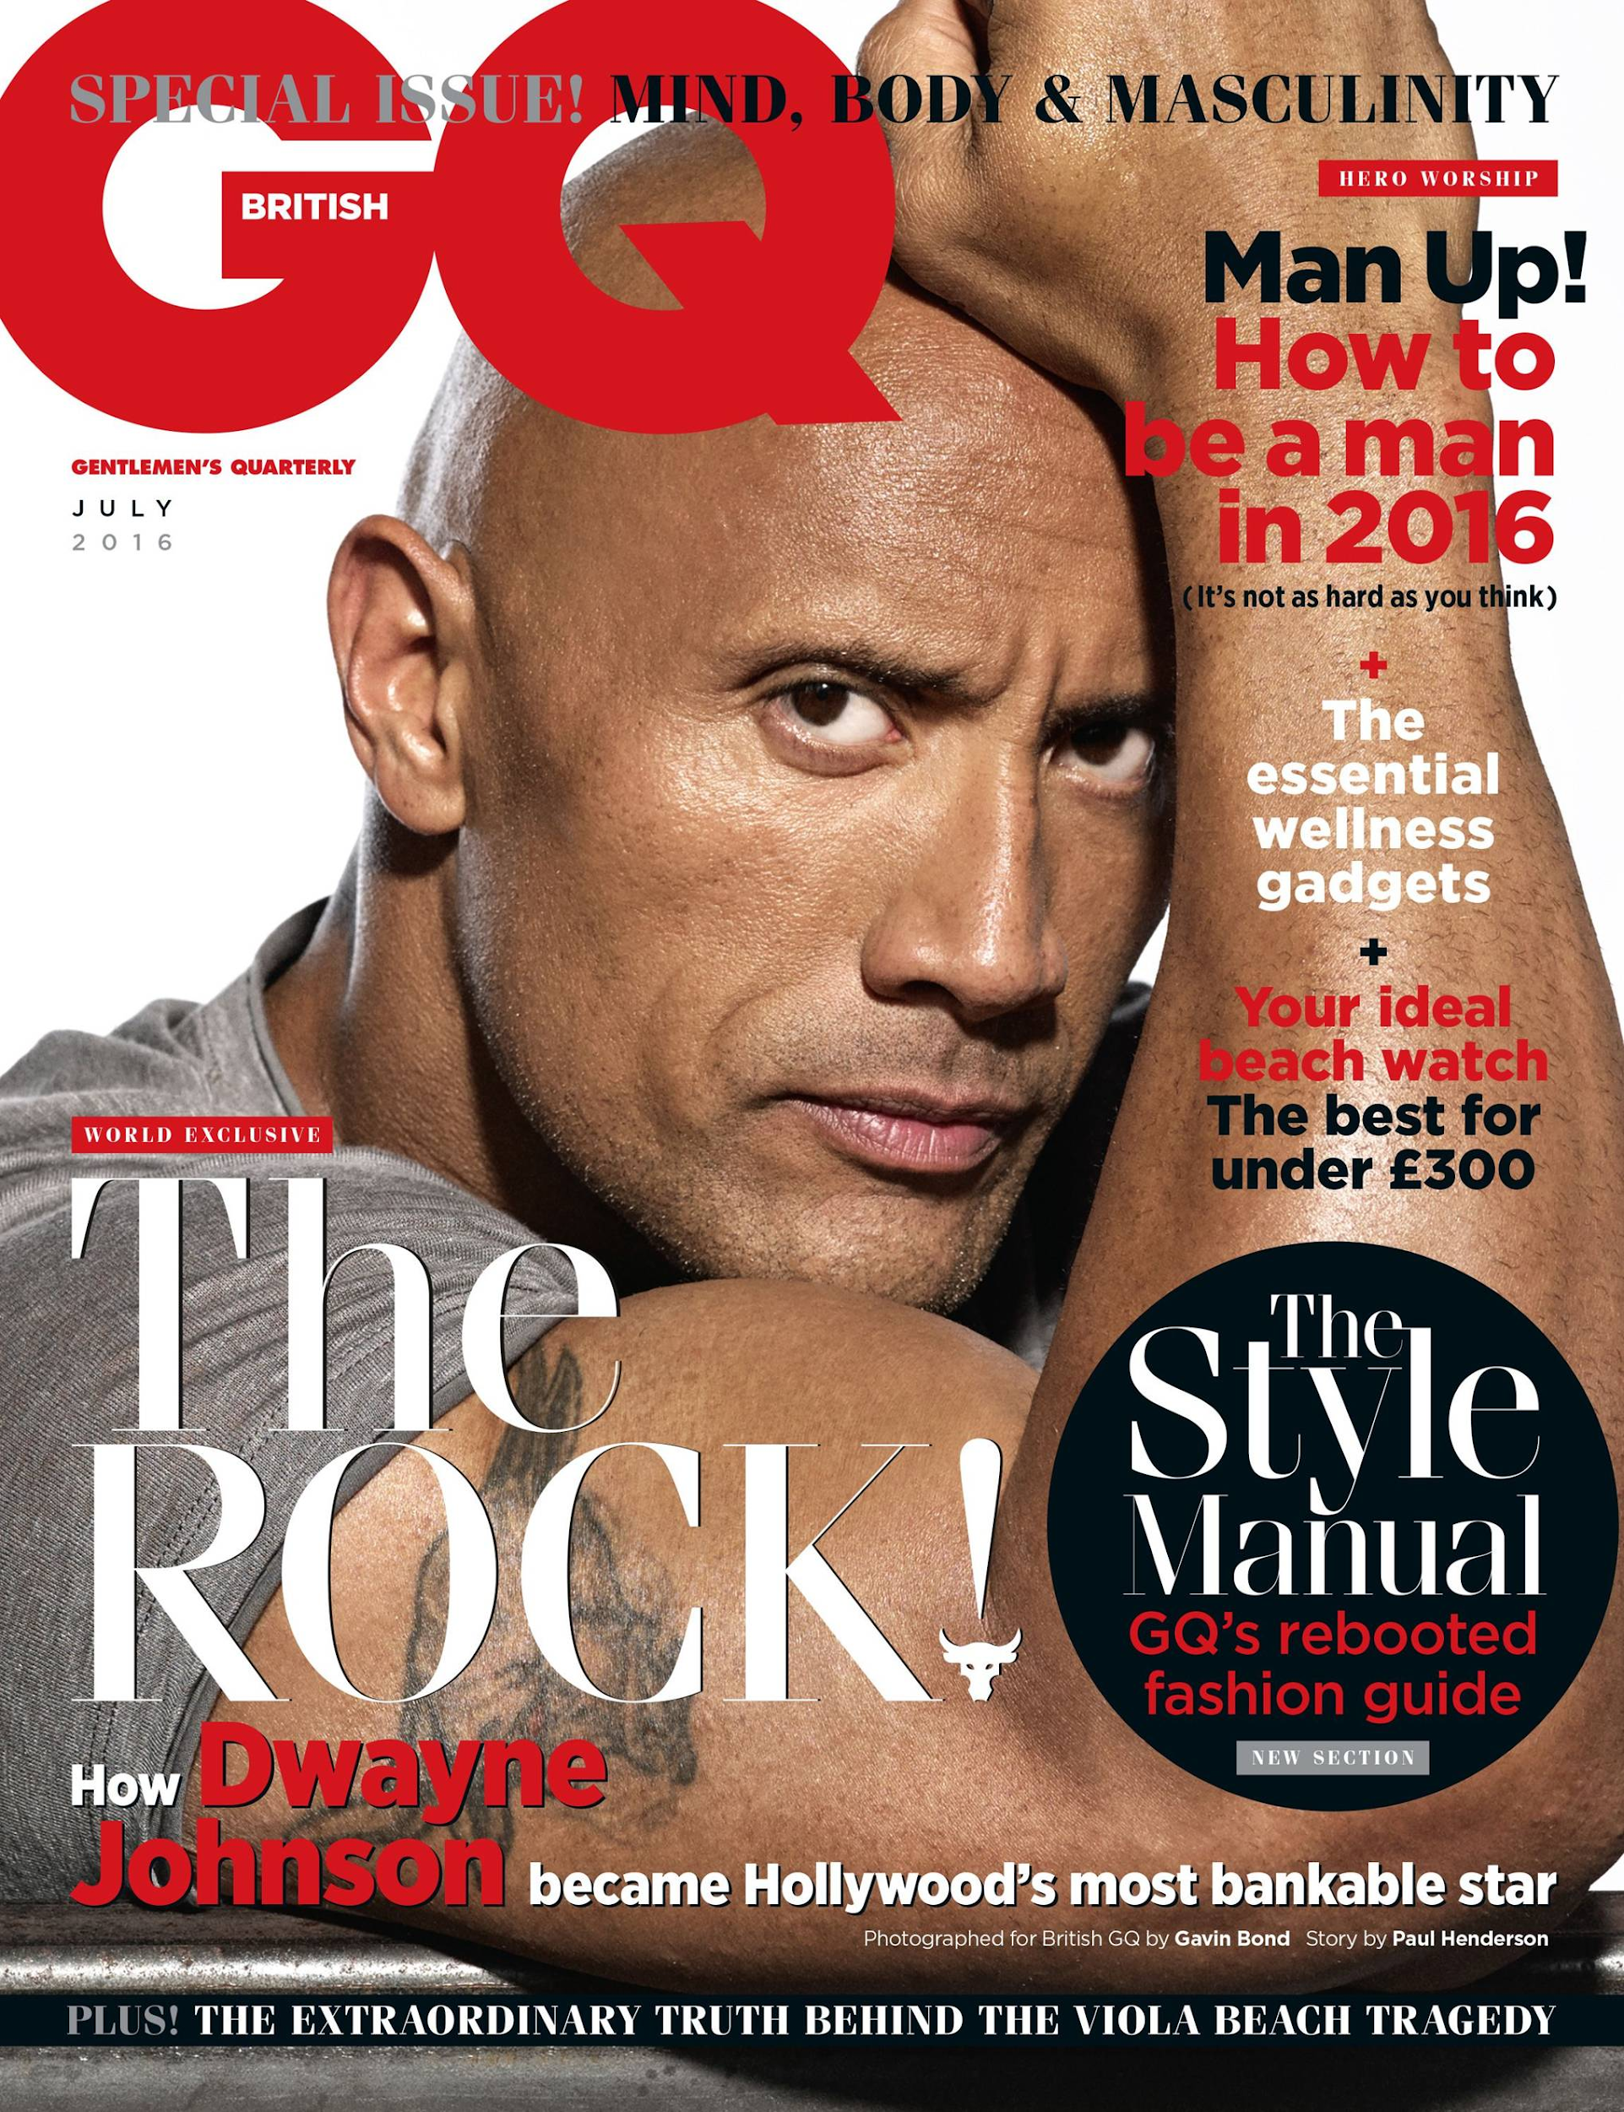
Size and colour of masthead is big and bold, stereotypically masculine- title GQ short and catchy - Originally ‘Gentlemen's Quarterly’ which now sounds old fashioned, the abbreviated title shows appeal to modern audience
Colour palette with red and black connoting strength, masculinity
Target audience: men, 25-45, with high income, into fitness, fashion, technology, want to know hard hitting stories, like to buy brand names
Direct address - expression and body language are confident and determined, tensing his bicep - he is strong, powerful. Johnson fills the cover in this mid shot, making him look dominant
“Man up!” - imperative, command - we have to follow this guide. “How to be a man” suggests the reader is not good enough as they are, but buying this will make them better
“The Rock!” cover line is largest, most important
Rock is presented as a role model - strong successful, powerful, kind - breaks negative stereotypes of African American males - aspirational
“The extraordinary truth behind the Viola Beach tragedy” strapline hints at serious journalism - this is an ABC1 audience who are interested in important news
Latest gadgets and watches - suggests you must have them to be better - links to ASPIRERS and SUCCEEDERS
“Most bankable star” highlights his success through money = aspirational

Slide 34
PRODUCT CONTEXT
- GQ = Gentlemen's Quarterly
- Monthly, men’,s fashion and lifestyle magazine, first published in 1931,
- GQ = Gentlemen's Quarterly
- circulation = 400, 000 readers
- For intelligent, fashionable, successful men (Succeeders)
- The theme appears to be masculinity:
TARGET AUDIENCE
- Men aged between 25 - 45
- ABC1 middle class or higher with high income (evidence = £300 watch) = good education, interested in fashion, spend a lot of money on clothes, technology and health
- Like brand names (mainstreamers/succeeders) evidence in coverlines
MEDIA LANGUAGE: Technical and Visual
The strapline tells us it is a special issue dealing with “Mind, Body & Masculinity” linkin gto theme of masculinity
extreme close up of Dwayne Johnson with his huge bicep in the foreground = representation of masculinity
The cover line to the right tells the reader to “Man up! How to be a man in 2016” = clearly a decision to link ideas of masculinity with physical strength, in other words, “real men are strong men” (STEREOTYPE!)
Media Language
REPRESENTATION: Ethnicity, Gender and Issues
Masculinity - strength, close up of muscle= stereotype
Target Audience = Identify and aspire to be like The Rock
Rock as a role model for men, someone to aspire to be like - strong, powerful, determined, successful (wealthy), good work ethic, kind, does not do bad things (breaks the stereotype drug dealer).
Shows a male representation that is hyper masculine, strong and muscular (bicep) - men should be like him
Men must have it all like the Rock -power, wealth, heath, fancy watches, the latest fashion etc.
Most bankable star = he is successful because he has a lot of money.
The mag is also tell men ‘how to be a man’ suggesting that they are not good enough as they are. Focus on making yourself better.
Media Language: Technical Codes, Visual Codes
CU of bicep = strength The Rock is staring out at us - Direct address = identity, Rock = strength, stability, large font
Layout - Strapline at top = what a man should be Facial expression and body language = Man up! - Imperative/ command/motivational?
Rock cover line is biggest = important
Most bankable star - hyperbole,
Colour Palette - Red, Black, White = strength, sophistication
Typography - size and colour used to
Cover lines are varied = lifestyle magazine convention Mise en scene - causal costume, show importance, highlight, style of Left third = most important info face/hair look good, tattoos = brave, real man font is classy. GQ - short and catchy Main image = most important, appeal to Target Audience
WRITTEN CODES
TAGLINE- “for men with an IQ” not just about girls, but for cultured, intelligent men!
=makes it personal (IDENTITY)
Hyperbole
Alliteration - “Bond and Beyond” emphasises her success as a (sexy) Bond girl
SOCIAL/CULTURAL CONTEXT
- Mettrosexual - it’s okay for men to care about thier looks
- Spornosexual - extremely body focussed, muscles, aspirational, men should ‘have it all’ = health, wealth, strength, success.
- Brand built around ‘traditional’ ideas of masculinity = serious, focussed, conservative
- Patriarchal society = men in charge
KNOWLEDGE ORGANISER: GQ
HISTORICAL/POLITICAL CONTEXT
- April 2015 #OscarSoWhite hashtag because the Oscars film awards were branded racist for not including more minority groups = GQ has the Rock on the cover to show how black Americans are successful
- African Americans are stereotypically represented in negative ways, the Rock is represented as a role model
LINK TO THEORIES (LEVEL 7+)
Uses and Gratifications: Audiences may IDENTIFY with Naomie Harris and aspire to be like her. They may also be INFORMED and ENTERTAINED.
Gender Representation - Laura Mulvey talks about the male gaze and how women are shown (behaviour and looks) in a way that men would like. Cover does reinforce some gender stereotypes e.g. looks but challenges others e.g. she is strong and powerful.
ENIGMA CODES - Roland Barthes and the use of enigma codes - cover lines tease us to want to read more.
“to provide readers with a sense of community, comfort, and pride in this mythic feminine identity” (Bignell).
FERGUSON's FACIAL EXPRESSION THEORY: Chocolate box, Invitational, super-smiler, romantic/sexual. Naoimi Harris conforms to the Chocolate Box expression. She appears sweet and innocent, and has a half-smile. This innocence is reinforced by her white dress, connoting purity.

Slide 35
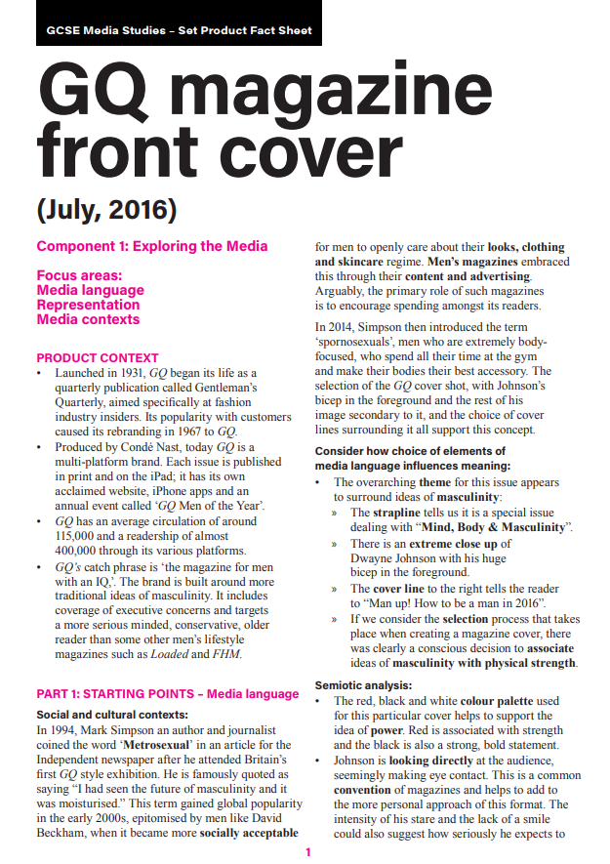
LINK TO ALL THE INFORMATION ON GQ
CLICK HERE TO SEE THE EDUQAS FACT SHEET ON PRIDE

Slide 36
HOME LEARNING - POSSIBLE EXAM QUESTIONS FOR PRIDE MAGAZINE.
YOUR TURN: Write an exam response to this exam question using the slide above as a guide...
Media Language ANSWER USING PEE
1. Explore how the GQ front cover uses the following elements of media language to create meanings:
(a) images [5]
(b) language [5]
(c) layout and design. [5]
Starter Sentence: There are many ways in which media language has been used to create meaning for example…
Audience
2) Who is the main audience for GQ and explain how they have tried to appeal to their readers [10]
Starter Sentence: The audience for GQ are…………………………… GQ have used many techniques to appeal to them for example……………………………………………

Slide 37
Quality Street

Slide 38
Production Context Quality Street made by Mackintosh in 1936. In the 1930’s chocolate was expensive. This product was cheaper for families. The tin was introduced in the 1950s. | The Target Audience People in the 1950s - very different from today’s audience. Women at hoe, men provided at work Men could buy this for their wives and girlfriends Working, educated families - new techniques made it cheaper to make, big words used in the copy Women - fits the idea that all women like chocolate (stereotype) Adults - features adults in the advert - this is a grown up’s treat |  | Messages and Values Aspirational message linked to class - this product was symbolic of elegance and higher class but now working men can buy it for their families as a treat. Brand identity - The chocolate is luxurious even though it is now cheaper = references to the Regency Era, use of gold and purple, pose of people in the frame
Social/ Cultural Context Luxury and high class things were now more available (chocolate). Very traditional gender roles - men worked, women stayed at home and had to make husbands happy The 1950s saw working class families have money to spend Quality Street had to appeal to a broad demographic (audience) Quality Street had to appeal to working class without losing their original, wealthy audience | Media Language Technical Codes Visual Codes Written Codes Composition - Triangular arrangement Costumes look like sweets (girls), Man is in a suit = PERSUASIVE LANGUAGE of people, halo effect around man, professional/working. Use of Gold = wealth/ luxury Alliteration = delicious dilemma- ANCHORED to image product is framed in the central = attention is he choosing the chocolates or the women? Making them Geometric triangle shape = like the hierarchy OBJECTIFIED. THEY ARE DRESSED IN COLOURS OF SWEETS! of the class system. Reach the top with Quality Street! Rich warm colour palette =attention, wealth Superlatives=delicious, delightful, Camera - Mid shot of people so we can Facial Expressions = excited by chocolates (treat) distinctive see what they are doing. Lower third - Body language (Kiss) = girls stealing sweets, man happy! Description of new sweets = we where all the text is found (less important) Typography - bold, strong, colourful (purple = royalty) need to buy and try Logo - at the bottom but in colour (stands out) Hand drawn images - lack of technology Formal - educated audience. The central, dominant male appears to be choosing between the two females. It is suggested that by purchasing Quality Street the girls will be all over you! This is anchored by the text “delicious dilemma” which The gold picture frame signifies “quality” and wealth, anchoring the image to the text. The gold also links to the history of Quality Street and how in the 1930s it was originally for a wealthy audience. The formal clothing of the man suggests a high-earning professional, therefore able to afford the product and attract women. This may be ASPIRATIONAL for the working class target audience. The contrast of the BLONDE and BRUNETTE women is anchored by the text “delightfully different”, which itself links to the sweets. The woman on the left is dressed in the color as the Strawberry chocolate; the woman on the right is dressed as the Harrogate Toffee. This objectifies the women, a trate often found in 1950s society.
Historical/Political Context Rationing had ended= more sugar available. People could treat themselves The Regency Era(elegance) is referred to (Major Quality Miss Sweetly) - the 1950s was a similar time post war. Makes it aspirational! | Representation Male dominated - he is in control (chocolate/women), he is higher in class, the ‘provider’ (suit) and high status (central dominant image), traditional stereotype that was common at the time of the advert. He is rewarding the women with chocolate. Major Quality - of higher class than Miss Sweetly, has power (military uniform) and status (aspirational) Women - love of chocolate, subservient body language suggest that they do as they are told, please the man (implies that this is what all women need to do to be successful). Women are also shown as manipulative - distracting the man to get to the chocolate. Miss Sweetly - very typical feminine colours and showing of skin. Even her name is suggesting a stereotype. Age - makes young people look fun and exciting (ad with old people show them knitting - less fun )
Key Terms and conventions Structural features, slogan, logo, copy, central image, typography, lines of appeal, superlative, alliteration, brand identity, rationing, Regency Era, patriarchal, intertextuality, rule of thirds, Z line composition, Triangular composition, Male Gaze |  | Link to Theorists and theories Intertextuality - the people in the frame are from Quality Street ads from the 1930s. Narrative/ Propp - male is the ‘hero’ choosing between two ‘damsels in distress’ (distressed over the dilemma of which chocolate to choose), he has a more serious dilemma to solve. Patriarchal Society - This adverts is showing that men are seen as having more power and status than women. Laura Mulvey and the male gaze - the two women are shown in a way that men would like. They are slim and pretty, acting like they really like the man and are being subservient.
KNOWLEDGE ORGANISER: QUALITY STREET

Slide 39
Geometric triangle position is a conventional design, but also reflects the hierarchy of the characters. Women at the bottom, man in the middle, and the high classes at the top. This is the aspiration!

Slide 40
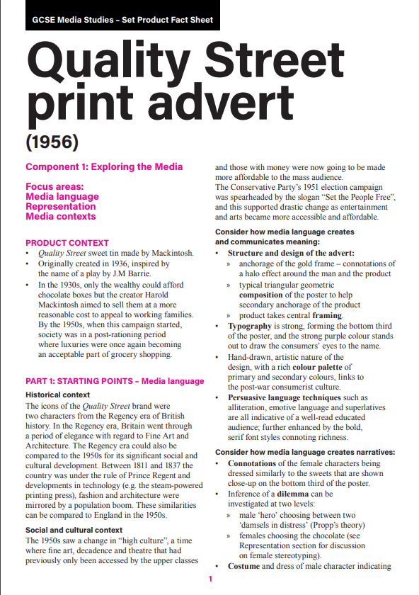
LINK TO ALL THE INFORMATION ON Quality Street
CLICK HERE TO SEE THE EDUQAS FACT SHEET ON Quality Street

Slide 41
READ THE EXAM RESPONSE! LOOK AT HOW THEY COMPARE TO THE UNSEEN TEXT...

Slide 42
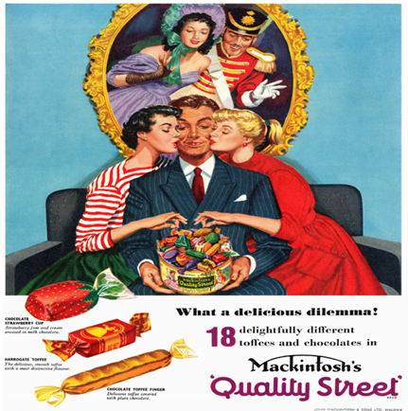
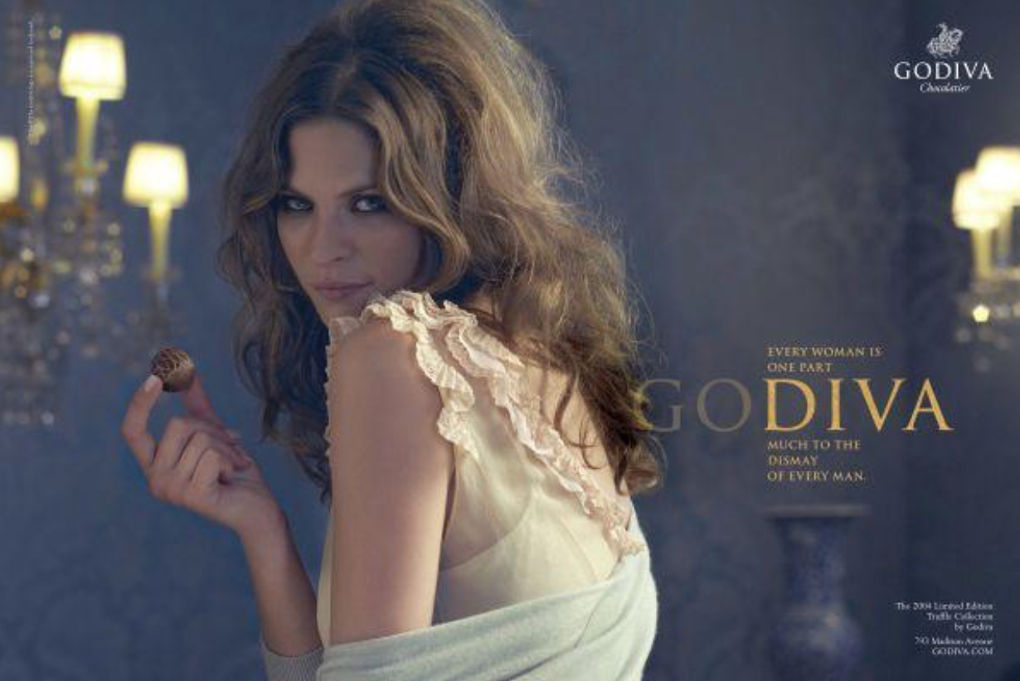
EXAM RESPONSES
Band 4 (12-20 marks)
- Good, reasonably detailed analysis of the set and unseen products, which engages with complex aspects of the representations.
- Good, reasonably detailed and appropriate comparisons between the set and unseen products.
- Good, secure use of the theoretical framework, and appropriate use of subject specific terminology.
- Good, reasoned judgements and conclusions regarding how far the representation of women is similar and different
CANDIDATE A
The representation of women in the quality street advert is different that the representation of women in the godiva advert. One difference between the adverts is that in the quality street advert there is a man with the women but in the godiva advert there is no man. This is due to the context of the quality street advert. During the 1950s, it was expected that all women had a man with them. At this time women either worked at a job with little income or didn't work. This meant that the male was usually the provider for the family the same way he is the provider in this advert providing the women with chocolates.
This is opposite to the godiva advert which represents her as a strong woman. This is because of the context of this advert. The advert more reflects a modern women in society. The advert also uses the style of a beauty advert to attempt to sell this by also pushing towards the more 'treat yourself' generation.
The representation between the two adverts are also very different. The godiva advert trys to sell the lifestyle of feminism and uses this to sell the chocolate. There is also some sexual objectification through clothing. This would appeal to the females and the males. The woman also trys to sell the lifestyle of a diva by saying 'freshly manicured finger' to show that she has the time to pamper herself.
The quality street adverts representation contrasts this of the godiva advert. The advert features a man in the middle choosing between the two females, showing him as a dominant. The use of 'delicious dilema' may be refering to the women or the chocolate. The similarities in Colour be the women and the sweets make them seem like consumables.However between the two adverts we do have a few similarities, both adverts play on the stereotype that women like chocolate by having them either having a chocolate or trying to get one. In both adverts the women seem sexual to attract a larger audience. In the godiva advert she is wearing sexual clothes and in the quality street advert both women are kissing the man while wearing red lipstick which has connotation of being very sexual.
Altogether both of the adverts are represented in different ways with a few similarities. In the quality street advert we had the man being the provider and being dominant by choosing over the two women and in the godiva advert we have a woman by herself in a rather royal looking place with her 'freshly manicured fingers' being powerful

Slide 43
This Girl Can

Slide 44
Production Context Developed by Sport England. Funded by Lotto. Purpose was to break down the key barrier that stopped women from doing sport (fear of being judged). Wanted to celebrate active women. Included TV adverts as well | The Target Audience: Females aged 24-40. This group were identified as least likely to take part in sport for fear of being judged because of their appearance. Appeal – young woman as the model, appearance, not a celebrity (IDENTITY – she’s just like us!), she is clearly enjoying being activity, group working out together, bright colours, positive slogan (fox), Use of hashtag = appeal to modern audience, way to get info, create social cohesion by bring people together |  | Messages and Values Key message is that women should be proud of what they look like and therefore not be afraid of being judged when doing sport or physical activity. Values woman not based on looks (she does not look typical), instead the value is not being healthy and happy. Brand name/Identity - ‘This girl can’ suggests that anyone can get active.
Social/ Cultural Context Research showed that there was a massive gender gap in participation. As a result of the campaign 1.6m got involved. Numbers of women joining teams is now increasing faster then men. Nike copied this idea. | Media Language Technical Codes Visual Codes Written Codes Mid shot =focus on action (enjoying it) Costume – ordinary = anyone can do this, bright Mantra – made up of two similes, turning a Central Image – centre= important = eye-catching, not stereotypical negative into a positive -change attitude about Logos at the top/small = less important Hair/Make up – messy = she does not care sport Simile 1–sweating like a pig = unladylike. Slogan – Large/ central in front of image) Body Language – full movement/ enjoying it Simile 2- feeling like a fox = sexy doing exercise. = very important (covers the woman) Facial Expressions – eyes closed/ singing, happy Language =Informal simple but positive. No Photoshop = looks are not important Colour – red (passion/happy), text is white = Typography bold, unusual font. “GIRL” = wide Colour Palette – bright and eye catching stands out appeal. #thisgirlcan – encourages involvement
Historical/Political Context The campaign was run by ‘Sport England’ who are a government organisation. There is no commercial aspect to the campaign – they were not aiming to make money. | Representation Challenging dominant ideology that women can’t do sport by portraying physical activity for women in an extremely positive way. Counter-stereotype – She is enjoying sport, doesn’t care about being judged on how she looks, she is not weak or unsuccessful at sport. She is independent, confident and happy (body language and facial expression) Aspirational role model – she is not a famous sports person, shows that anyone can do this Focusing on what ‘real’ women –no airbrushing, photoshopping, no glossy not perfect but happy. Other adverts don’t do this ‘Girl’ use to represent all women but some women may not like this word as it has negative connotation (childish, silly, too young) How is our hero represented? Positive (joyous, “lost in the moment” facial expression) Breaking stereotypes - stereotypically women are thought of as the “weaker sex”, this advert challenges this stereotype Represents women as independent, happy, confident, this is challenging sexism in the mainstream
Key Terms and conventions Copy, Slogan, Logo, Central Image, Typography, Brand Identity, Propp, Rule of Thirds, Mantra, Protagonist, Dominant Ideology, Stereotype, Counter-Stereotype, Hashtag, Social Cohesion, Enigma Code, Use and Gratification Theory, Personal Identity, The Male Gaze (Laura Mulvey), objectify/ objectification |  | Link to Theorists and theories Propp - Dominance of image suggests she is the ‘protagonist’ / hero as she has overcome fear Laura Mulvey Male Gaze- this images does not objectify woman, it is not focused on how they look or portraying them in a way that men stereotypically would like. Use and Gratification - Personal Identity, the audience can see themselves in this person because she is not a celebrity. They can identify with her because she is ordinary, normal and like her they too could learn not to fear being judged and get active. Enigma Code (Barthes) - ‘this girl can’ - what can she do? Creates a sense of mystery, wonder
KNOWLEDGE ORGANISER: THIS GIRL CAN

Slide 45
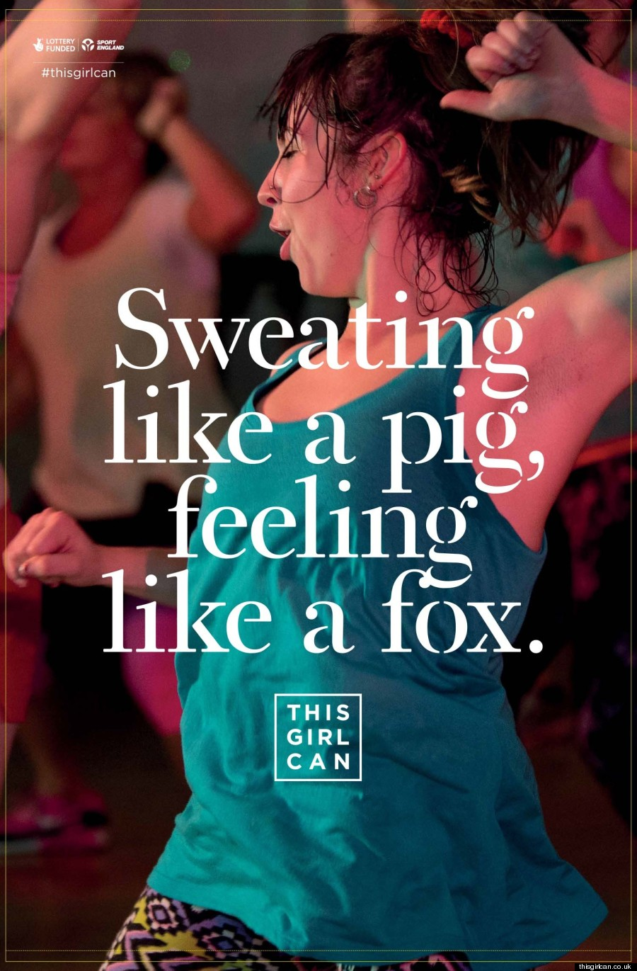
TOP LEVEL THEORY: Reception Theory!
Preferred: Exercise has a positive impact on women’s lives.Sport can still be a feminine activity which can make you (the woman) feel attractive and empowered.
Negotiated:Exercise can have a positive impact on women’s lives, but I don’t want to get all sweaty, I don’t like that.
Oppositional: Exercise is not positive. It is hard and horrible. In fact, exercise and sport should be for men, not women.
Feminism: The belief that men and women should have equal rights
Dominant ideology – Hegemonic view
Encoding – The message which has been put into the image
Decoding – The message the audience can take out of the image
Male Gaze theory – When characters within a media are positioned to make the male audience look at them in a voyeuristic way
Voyeurism – Taking pleasure in watching something or someone

Slide 46
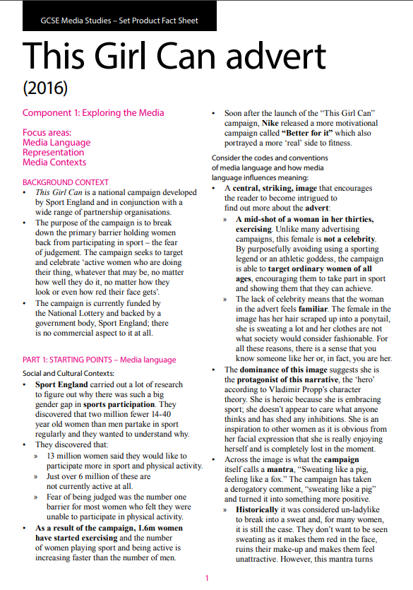
LINK TO ALL THE INFORMATION ON This Girl Can
CLICK HERE TO SEE THE EDUQAS FACT SHEET ON This Girl Can

Slide 47
The Man With The Golden Gun

Slide 48
Central mid-shot of James Bond holding a gun with confidence across his body. The dominance of the image suggests he is the protagonist and so probably the ‘hero’ according to Propp..
The poster uses direct address with Bond making eye contact with the audience. His lack of smile and intense stare suggests he is serious and remains calm among the surrounding chaos. This suggests one of Bond’s strengths to the audience - how he never fails to perform under pressure.
His suit connotes and professionalism, and the gun which is an iconic symbol of Bond’s character or ‘uniform’ signifies action and danger.
GENRE CONVENTIONS
Surrounding Bond are more images of explosions and destruction, weapons and violence. There is also evidence of exotic/foreign locations, suggestive of Asia - clearly indicating a sense of travel and thereby indicating a genre genre of Action Adventure/Thriller. THIS is also a link to the SOCIAL situation of the GLOBAL ENERGY CRISIS.
REPRESENTATION
A typical Bond film with highly sexualised females flanking him. Although both are suggestive in their bikinis of links to Bond in a sexual way - there is a contrast in their body language and positioning. One looks towards the golden gun as she points towards Bond, suggesting she is directing the shooter to him as a FALSE HERO; whereas the other appears to be shielding him from harm as a HELPER. Possibly a sense of confusion for Bond over who to trust - another Enigma to be solved!
They are stereotypical BOND GIRLS as they are underdressed. The BLONDE vs BRUNETTE suggests contrast and BINARY OPPOSITIONS.
The women are smaller and beneath bond. They appear weaker, less important, a trate of the 1970s patriarchal society. There nakedness is sexualised, reducing them to objects to be looked at!
The film was released in DECEMBER but has a summery feel - offering escapism during the winter
The actor’s name ‘Roger Moore’ is clearly displayed as an additional way of enticing the audience - he was a popular and well-known actor after appearing in The Saint and previous Bond film Live and Let Die. His name is directly above the image of Bond to reinforce the link.
The title appears alongside the author of the James Bond books to further reinforce the fact the film is based on a novel; and the title is in close proximity to the large image of the golden gun to anchor meaning.
The credit block and other industry info is smaller and tucked away at the bottom of the poster so as not to distract, It is legible but clearly less influential in enticing the audience to see the film.
INTERTEXTUALITY
There are links between texts to appeal to fans of the Bond franchise.
The iconic 007 logo
The name James Bond at the top
ENIGMA CODES and AUDIENCE POSITIONING
The audience are positioned as THE VILLAIN holding the golden gun! Who is he? Why is he trying to kill bond? = ENIGMAS to be solved!

Slide 49
Exam style response
BAND 7, 8 and 9 MUST consider the following:
Historical, Social and Cultural context (1970s, patriarchal society etc)
Intertextuality (links to Iconography and what is iconic of the Bond franchise?)
Representation (Gender Roles and Stereotypes)
Mise-en-scene: Costume, lighting + colour, actors (body language and expressions), make-up, props and setting
Mode of address
Enigma Codes
Narrative (Conventions of the Spy/Action genre)
MEDIA THEORY: Binary Oppositions and CHARACTER ROLES (Propp)
Bond is the dominant character. This is conventional for a hero in Propp’s theory.
The mid shot shows the iconic James Bond costume of a suit, signifying he is professional and powerful.
The direct mode of address appears to have Bond looking calmly at the audience, again reinforcing he is confident and in control. However, when you look closely the audience have been positioned as the Villain (Propp) as we appear to be pointing the gun at Bond.
LEVEL 9: The protagonist being in danger is conventional of the spy genre. This links to the disruption in the narrative.
This is a HEGEMONIC representation of masculinity.

Slide 50
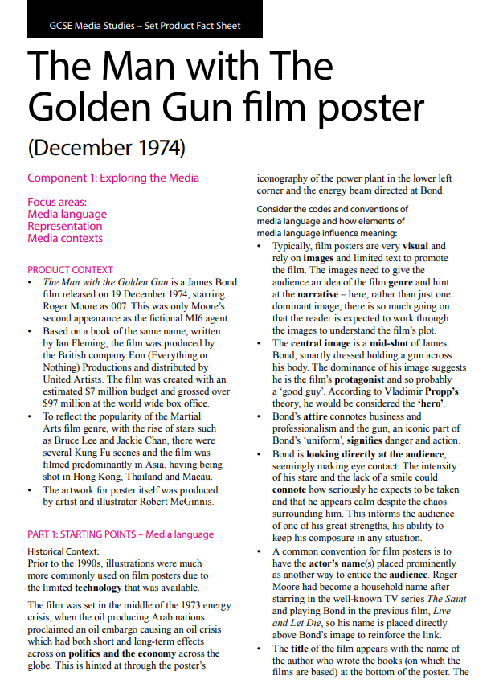
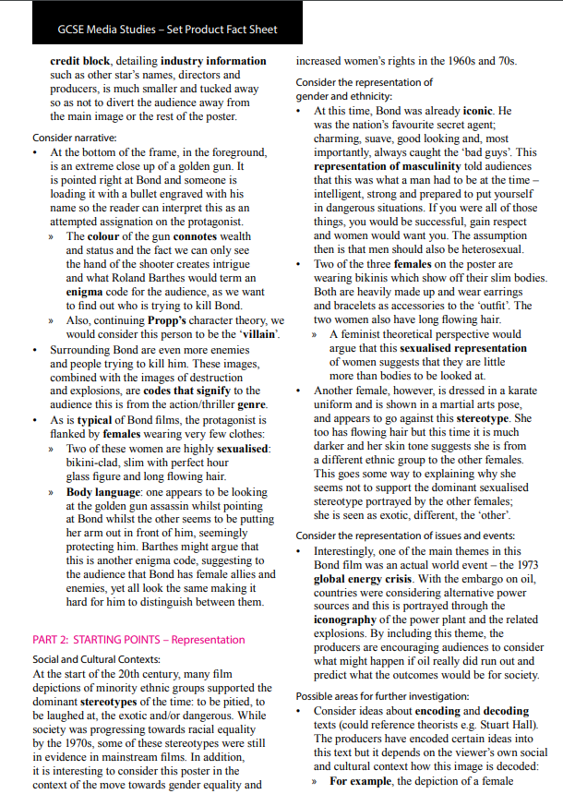
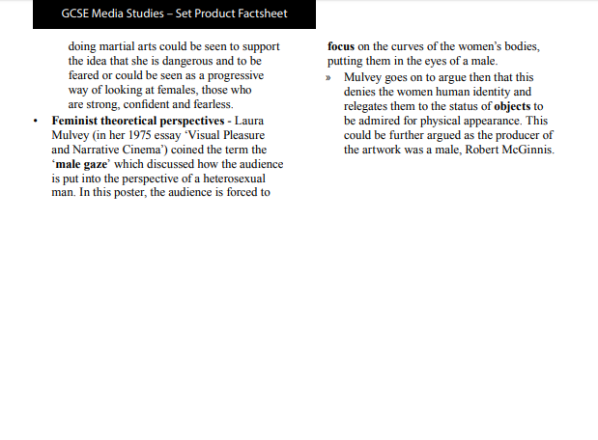
LINK TO ALL THE INFORMATION ON TMWTGG
CLICK HERE TO SEE THE EDUQAS FACT SHEET ON The Man With The Golden Gun

Slide 51
SPECTRE

Slide 52
The masked man in the background is wearing a skeleton mask used to symbolise the Mexican festival of the ‘Day of the Dead’. The opening scene shows a ‘Day of the Dead’ parade in Mexico City – this was staged for the film.
However, the interest in the film, and the government’s determination to promote pre-Hispanic Mexican culture, meant that one year later the local authorities decided to organise a parade (Dia de los Muertos) in Mexico City on October 29th 2016. At least 250,000 people attended.
The villain in the background is also male, reflecting the male-dominated nature of the franchise – the main protagonist and antagonist who drive the narrative are both male
The absence of a female character on this poster reflects a feminist perspective, as women are still under-represented within action film franchises. There are stronger female characters in Spectre, however this poster does not feature them and so we can infer that much of the marketing prioritises Bond as an iconic figure who will appeal to audiences.
His posture is strong and dominant, his arms are folded in a stereotypically masculine stance. His closed body language reinforces stereotypes that Bonds lack emotion, his stance reinforces his independence and his professional role as a rational, ruthless assassin
The use of key light on Bond highlights his chiselled features, this reinforces his inscrutable masculinity
The gun suggests danger but this is conflicted by his relaxed stance which leads us to believe he feels comfortable and unphased by danger
This hero archetype is typical of the action genre and audiences are lead to believe, through representation, that this is how a man should be
In the background, behind Bond, there is an image of a man wearing a skeleton mask and bone design on his jacket. The skeleton has connotations of death and danger and the mask is covering up someone's identity, someone who wishes to remain hidden, someone lurking in the shadows.
The white Tuxedo intertextually references earlier Bond movies (previous Bonds including Roger Moore, have worn the white tuxedo, however this poster specifically references Goldfinger), providing a sense of familiarity, nostalgia and pleasure to fans who recognise the link.
Bond films have often deliberately referenced earlier films in the franchise, for example the ‘Bond girl’ emerging from the sea (Ursula Andress in Dr No and Halle Berry in Die another Day). Daniel Craig also emerged from the sea in Casino Royale, his first outing as Bond, however it was denied that this was in reference to earlier films.
This is Daniel Craig’s 4th film playing James Bond
The poster features him wearing a white Tuxedo. A ‘Tuxedo’ jacket has the connotation of wealth and class. All the actors who have played Bond have worn one.
White tuxedo’s were considered as out-dated although after Craig sported this one made by Tom Ford, the trend has been revived and celebrities such as David Beckham and Benedict Cumberbatch have been photographed wearing one – this shows the cultural significance that the Bond films still have.
The representation of women in the franchise has evolved over time – to an extent – to reflect the changing social context. (Compare to the Man with the Golden Gun)
Craig’s Bond is not as sexist and overtly stereotypical as the earlier Bonds, and reflects some contemporary notions of masculinity.
Craig’s Bond is older in comparison to other Bonds, he is also represented as more thoughtful and shows signs of vulnerability.
Though the poster itself DOES NOT reflect this and rather represents Bond as the familiar action hero to ‘sell’ the film.
The title Spectre is an intertextual link to classics of the Bons franchise as this is the villainous organisation that tries to take over the world.
However, deeper analysis can be applied, as the word ‘spectre’ means ‘ghost’. This could foreshadow a death in the narrative (disruption), or link to the image of death behind bond (death is coming for him, death is over his shoulder!)
Bond is an action hero who, since the 1960s, has been constructed to embody many masculine stereotypes of strength, independence and sexual prowess.
The representation of women in the franchise has been similarly stereotypical: the ‘Bond Girl’ who is the beautiful ‘love interest’ for Bond, insignificant to the narrative and ultimately disposable.
KEY WORDS:
Masculinity
Enigma codes
Iconic
Intertextuality
Propp’s Hero/villain
Binary oppositions

Slide 53
SPECTRE: INSTITUTIONS/INDUSTRY
Mr Davies imagines if you are asked about Spectre, you are likely to be asked about the film INDUSTRY - the people who made it! Here are some key points to consider:
On April 9th 2010, a year and a half into the making of the 23rd Bond film (subsequently titled Skyfall), the producers decided to suspend production due to MGM spiralling towards bankruptcy. It wasn’t until the end of 2010 when the new owners of MGM were able to secure a $500 million revolving credit line that the film could continue. Luckily, it made $1.1 billion at the global box office, more than any other Bond film. This allowed the Bond franchise to continue.
• Bond has always been well known for its exotic locations across the globe and Spectre was no exception. Buoyed on by the success of Skyfall, Spectre used Pinewood studios in London as its base, but then was also shot in Mexico City, Rome, Solden, Morocco and Austria. Consider the functions and types of regulation of the media:
• Film and video releases in Britain are amongst the most tightly regulated in the Western world. Age restrictions are placed on all commercially released films by the BBFC and some are even expected to make cuts or alter the film in some way to conform to the guidelines.
• Sony had to cut some violence from Spectre in order to secure a 12A UK rating instead of the 15 classification the BBFC originally recommended. This may seem like a sensible decision in order to secure a much wider audience, however, it could be argued that it is no longer the original movie that Sam Mendes, director, wanted the audience to see. Consider how the media operate as commercial industries on a global scale and reach both large and specialised audiences:
• The long-running Bond franchise has an established fan-base and Spectre, a US/UK co-production, received global distribution (theatrically and on DVD/ Blu-ray) to reach a very large audience.
• Unlike many media products, it is difficult to specify a specific target audience for Bond. The reason for this being that it has spanned so many decades, so many leads and so many directors. However, it is clearly intended for mass audiences and has great commercial appeal: » Bond is iconic and has universal appeal – he is charming, suave, good looking and, most importantly, always catches the ‘bad guys’. Arguably, men want to be him and women want to be with him, providing a form of escapism from their everyday lives.
Bond also provides a narrative we feel comfortable with (‘bad guy’ does something wrong, ‘good guy’ catches him and wins the day) and reinforces dominant messages and values about ‘good’ and ‘bad’

Slide 54
Production Context Film released 26/12/2015, starred Daniel Craig(4th time as Bond), based on the books by Ian Fleming, film produced by Eon Productions and distributed by United Artists, Budget=$245mill, box office=$880 mill, Poster by Empire Designs a British company | Intertextuality The white tuxedo references earlier Bond films – Roger Moore wears one as does Sean Connery in Goldfinger. Sense of familiarity and nostalgia. The pose is very similar to the pose of Roger Moore in The Man with the Golden Gun and many other Bond films. The logo (the 007 with the 7 shaped like a gun) is an iconic symbol of the franchise and instantly recognizable. Names like Ian Flemming and Albert R Broccoli are well known for their connect with Bond films of the past. Even the name Spectre (which means ghost) is intertextual as it refers to the ghosts/ enemies from James Bonds past and knowledge of the other Bond films Daniel Craig has been in will help you to understand the plot of this film.
Social/ Cultural Context The masked man is Bond from the opening scene, symbolising The Day of The Dead festival parade in Mexico City. It was not a real event until the success of the film. It now happens annually. The Tom Ford white tuxedo is a reference to Bonds of the past and was considered dated. After Spectre, celebrities such as David Beckham wore it at events showing what Bond wears has cultural significance. Note the lack of the typical ‘Bond girl’ in the poster. Bond as a character has evolved with the times. Sexual innuendo is no longer a big part of Daniel Craig’s Bond and the female characters in Spectre are strong intelligent women | Media Language Long shot of Bond = central image = he is dominant, he is the hero/protagonist Direct address= he is confident, strong Dark coloured background=connotes mystery / death White Tuxedo = connotes wealth, professionalism, the high life, Red Carnation= connotes love but also danger Common prop of a gun - tells is the genre (action/spy) and that he is always ready for action Credit block at the bottom, small = less important but does includes key info Title in lower third but big, ‘Spectre’ connotes ghosts from Bond’s past, ‘chainlink’ type text connotes that the film links to previous Bond films ( Villains from Daniel Craig’s previous Bond films are/were part of the Spectre organisation) Actor/director/author name at top in gold connotes luxury, important, attracts audience 007 logo under title = recognisable and the audience would watch this film, Serious facial expression tells us about his personality he is cool calm and collected, High Key lighting on Bond = connotes that he is good, important, Low key lighting on figure in the background connotes they are a villain, the skull costume connotes death and danger for Bond, Small font for actors name - so well-known that it does not need to be big
 | Representation Bond = Strongly masculine, closed body language connotes lack of emotion, independence, a professional, a ruthless assassin his pose suggests strength and power Bond’s posture is strong and dominant, his arms are folded in a stereotypically masculine stance. High Key lighting= the strong light on his face shows his rough masculine features but also suggests that he is a good man and will do the right thing The gun =danger, finger on the trigger – ready to kill if necessary and has the skills to do this, the gun suggests danger but his posture connotes confidence with a relaxed attitude toward such dangers. Hero = Typical man hero of the action genre, he is white which is the stereotype in film (white characters are good, bad characters are other ethnicities. Audiences are led to believe, through this representation, that this is how a man should be. Villain in the background is also male, reflecting the male-dominated nature of the franchise, the main protagonist and antagonist who drive the narrative are both male. Lack of female representation - unusual as often Bond is pictured with women to show his popularity and the quality of protection. Women are under-represented in the action genre even though they were featured in Spectre and in powerful roles (e.g. M and Moneypenny)
Key Terms and conventions Equilibrium, disequilibrium, new equilibrium, binary opposites, enigma code, antagonist, protagonist, franchise, Intertextuality, credit or billing block, logo, high key lighting, direct address, low key lighting, costume, props, posture, body language, facial expressions, typography |  | Link to Theorists and theories The skeleton mask depicts someone hiding in the shadows and could be seen as Propp’s Villain / antagonist, but this acts as part of the Enigma Code ( Roland Barthes) because it is really just Bond’s costume but on the poster it creates a sense of mystery as we wonder who is it and what they might do. According to Todorov a film will always have narrative disruption - will that disruption (or disequilibrium) be caused by the skeleton character. It could be seen as another darker side to Bond and act like a binary opposite (Levi Strauss) The skeleton also references the title ‘Spectre’ The dominance of Bonds image suggests he is the film’s protagonist and so probably a ‘good guy’. According to Vladimir Propp’s theory, he would be considered the ‘hero’.
KNOWLEDGE ORGANISER: SPECTRE

Slide 55
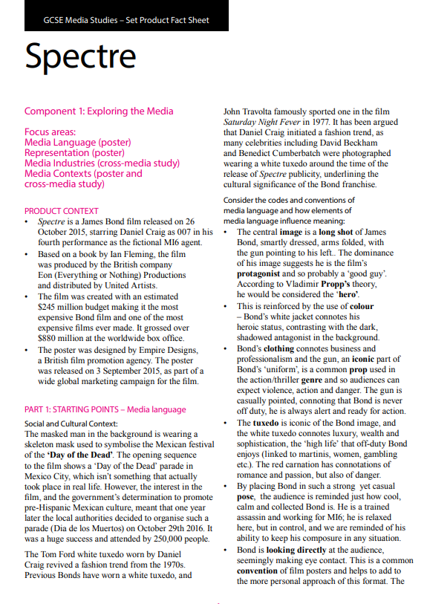
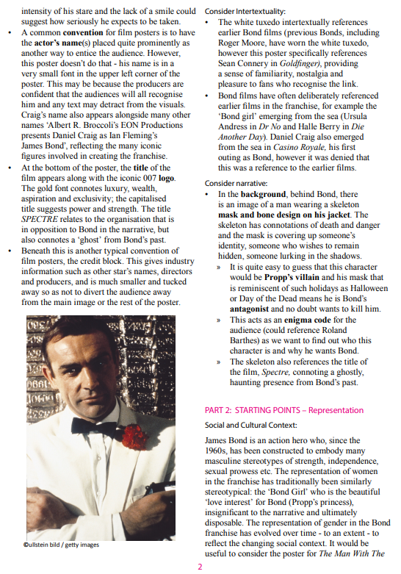
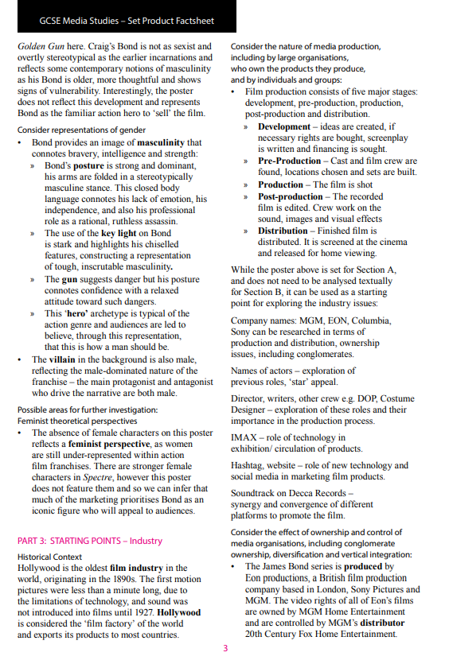
LINK TO ALL THE INFORMATION ON SPECTRE
CLICK HERE TO SEE THE EDUQAS FACT SHEET ON Spectre

Slide 56
THE SUN

Slide 57
SET PRODUCT 1: THE SUN (front page)
The layout is conventional of a tabloid.
It uses large images to make its point to the audience.
There is not much writing, this appeals to the audience who are C2DE and, stereotypically, less educated.
This links to the average reader of The Sun which has a reading age of 8 years old
The image of the UK seems to have been enlarged making it seem bigger and more powerful
The image of the UK is clearer than the Eu, suggesting it will be fine by itself.
The red line is physically separating the Uk from Europe, reflecting the audiences wishes.
Red signifies anger. But it also is a phrase that when you draw a red line it shouldn’t be crossed.
The red line also links to the white line highlighting the word ‘immigration’ which creates the England flag (st George Cross) - a clear symbol that England comes first and will appeal to the audience. This promotes the strong English identity of the conservative, anti-EU readers.
HIGH LEVEL: ‘red tape’ is a term used in governments that suggests rules and regulations that are difficult
Context of pride:
The Sun is a CONSERVATIVE British tabloid
It is a daily newspaper owned by Rupert Murdoch’s News Corp.
The Sun has the largest circulation of any daily print newspaper in the United Kingdom. 1.6 million copies sold a day (average)
Estimated daily readership of around 4.1 million
In addition, The Sun on Sunday is the UK’s biggest selling Sunday newspaper
The cover has been produced based on a YouGov poll where 42% of the people said they thought Britain should limit immigration from the EU
The Sun’s cover suggests its readers want a ban on immigration, which is not wholly true - so some people have argued that this front cover is xenophobic.
Conservatives felt the EU has too much power!
David Cameron felt pressure to do something
The strapline commands the audience how to behave. “You tell him” - this suggests the audience are passive and will do what The Sun says
“Draw a red line” is anchored to the image of a red line dividing the UK and EU.
Romania and Bulgaria have been named suggesting they are where The Sun imagines the immigrants are coming from. This links to previous stories...
The voucher is in line with the demographic of the target audience who are mainly C2DE placing them as lower middle class and below. Aldi is known as a budget brand.
This is an incentive to get people to buy the paper even if they don’t agree with the headline - because they want to get a good deal.
“The Sun Says...” implies the newspaper has influence over the Prime Minister
The standfirst describes immigration as “the flood”. This language suggests immigrants are vast, threatening and destructive, like a real flood.
The headline uses the imperative “or else”. This is targeted at Cameron signifying The Sun’s power. It is a direct mode of address. The tone is disrespectful. This is in-line with the audience demographic who feel the government doesn’t listen to them. This is anchored to the close-up image of Cameron looking worried. The audience will feel The Sun is standing up for them!

Slide 58
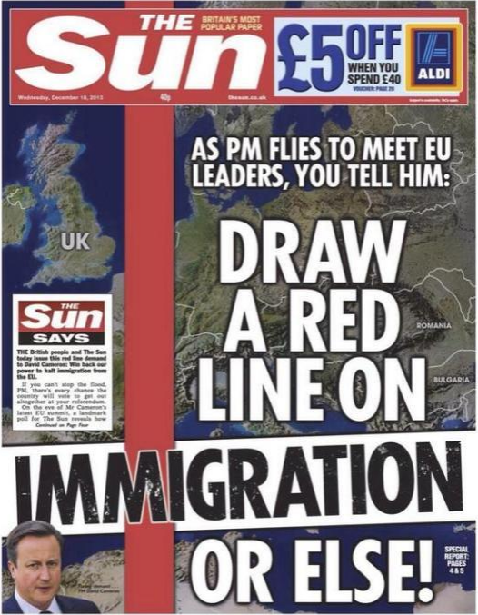
How do I analyse a set text?
WHAT (denotation): The masthead colours are white and red.
EXPLAIN (connotation): These connote the colours of the English national flag
EVIDENCE (theory, audience, context):
This shows it is patriotic to England, linking to its white, male C2DE audience and conservative views. Red also signifies strength and reflects the newspaper’s power in society.
Analyse the masthead:
Colour
IDENTITY

Slide 59
Production Context Tabloid newspaper owned by News Corp. Published 7 days a week. Average circulation of 1.6 million. Readership of 4.1 million. Largest circulation of any print newspaper in the UK. | The Target Audience C2DE – targets middle social classes. Men – 54% of readers are men (think Page 3 Girls and sport) Most readers haven’t attended higher education (Uni) and the average reading age of the paper is 8 (the national average is 9 years old). The product is meant to be accessible to everyone, including those with weak literacy. The formatting (lots of picture and short text) helps this. |  |  | Messages and Values Right wing/Conservative politics linked to class – Today The Sun supports The Conservatives. It has, in the past, switched sides between Conservatives and Labour but is very anti-Corbyn at the moment. Pro-Brexit – The Sun is in favour of the UK leaving the EU. Their headline at the time said “BeLEAVE in Britain” Patriotic – The Sun is very patriotic and considers itself a voice of ordinary working class British people (links to low price).
Social/ Cultural Context 18th Dec is International Migrants Day. Just before this front page was printed, 42% of people in a survey said Britain needed to take back control of Immigration from the EU. Britain voted to leave EU (Brexit) on 23rd June 2016. | Media Language
 | Technical Codes Composition - In thirds. Images – a major part of a tabloid front page Masthead – red, bold, sans-serif House style – large fonts, simple language, money off offers for C2DE social grade (Aldi) Headline – The head is all in capitals and bold sans-serif font. Easy to read and stands out. |  | Visual Codes Map – shows Britain on one side and Romania and Bulgaria on the other side. Pro-Brexit ideas. Dominant Image – the main picture of a map is anchored by the headline as being about the EU. Red Tape – splits UK and the Eastern European countries. Close up shot – of (former) Prime Minister David Cameron in an inset image. He looks stressed and tired showing he is under pressure. (He was anti-Brexit) Red and white – like the English flag. |  | Written Codes Imperatives – commands Informal register – the words used are all simple. For example “or else” Idiom – “red line” means a limit on something (in this case immigrants). Direct address – “You tell him…” tries to make the reader feel empowered to challenge the PM. Ultimatum – “or else” sounds like a threat to David Cameron.
Historical/Political Context First published 1964, became a tabloid in 1969. Sex a major part of marketing strategy (Page 3 girls). Called ‘The Scum’ in Liverpool following Hillsborough disaster.
 | Representation Immigration –map only shows two countries which presents the idea that the paper sees those countries as a threat. Are they implying that they don’t want Romanian and Bulgarian immigrants in the UK? Immigration –headline and front page are reporting a survey by YouGov that said 42% of people want an immigration limit. The Sun has interpreted this as meaning that its readers want a complete ban on immigration. Negative stereotypes – the way the front page has been constructed with a full page, dominant image and headline that takes two thirds of the cover, seems to be continuing the negative stereotype that migrants are people to be feared, are benefit cheats and criminals. Patriotism –colours and idea of Britain ‘taking back control’ aims to make Britain sound powerful against the 27 other EU nations.
Key Terms and conventions Circulation, tabloid newspaper, readership, published, masthead, dominant image, inset image, close up shot, headline, thirds, Brexit, xenophobia, Patriotism, Uses and Gratifications, Identity, Education, News Values, negative stereotypes, direct address, ultimatum, composition, enigma codes, active/passive audiences. |  | Link to Theorists and Theories Roland Barthes –headline written using Enigma Codes to encourage readers to read certain articles. Active/Passive Audiences – People used to believe everything they read (passive) but are becoming more aware of media manipulation and “fake news” (active). The Sun challenges its audience to join them by using Direct Address. Are they treating us as active or passive? Uses and Gratifications (Blumler and Katz) – mainly Identity (direct address including audience in the paper’s views), Education (learning about the news); also Social Interaction, less so Entertainment News Values (Galtung and Ruge) – threshold (story that could impact lots of people), meaningfulness (about something close to home), unambiguity (story with clear implications).
KNOWLEDGE ORGANISER: THE SUN

Slide 60
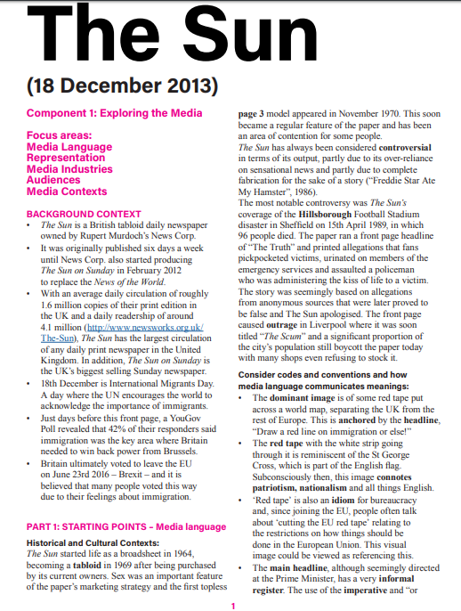
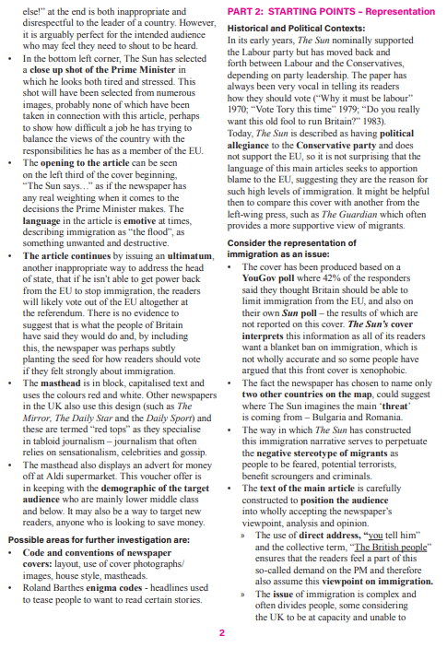
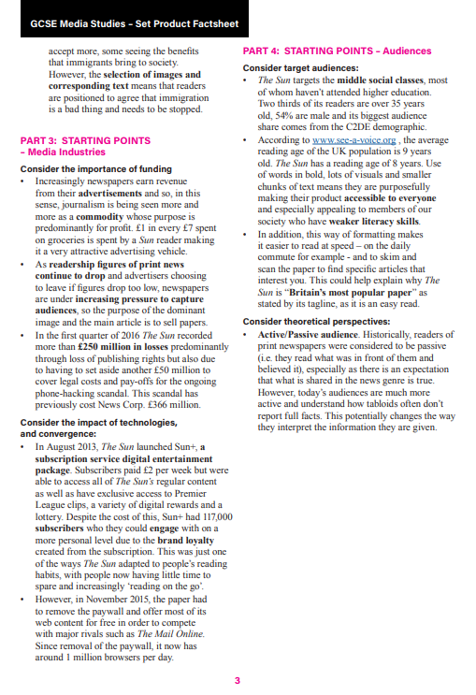
LINK TO ALL THE INFORMATION ON The Sun
CLICK HERE TO SEE THE EDUQAS FACT SHEET ON The Sun

Slide 61
THE GUARDIAN

Slide 62
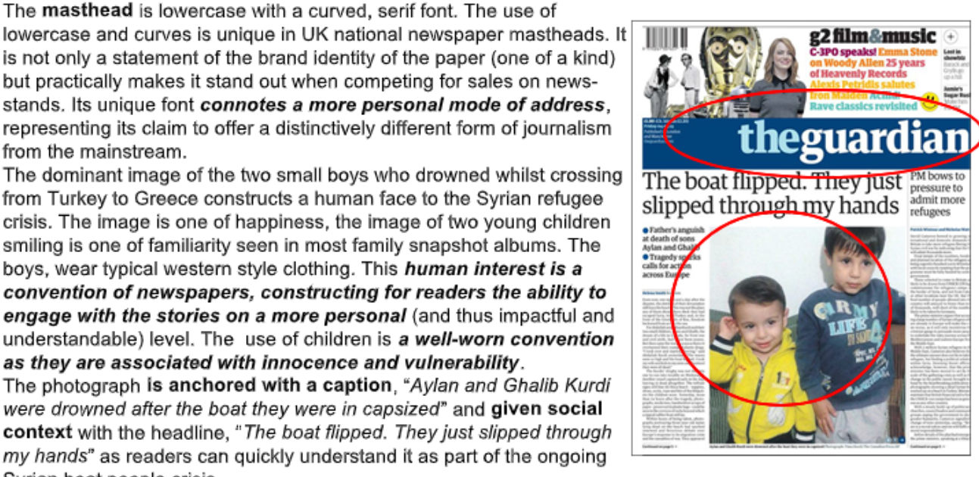
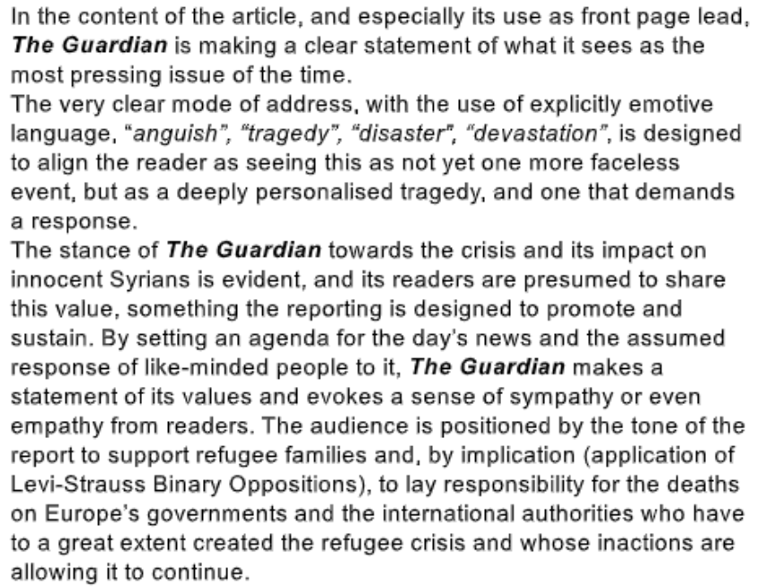
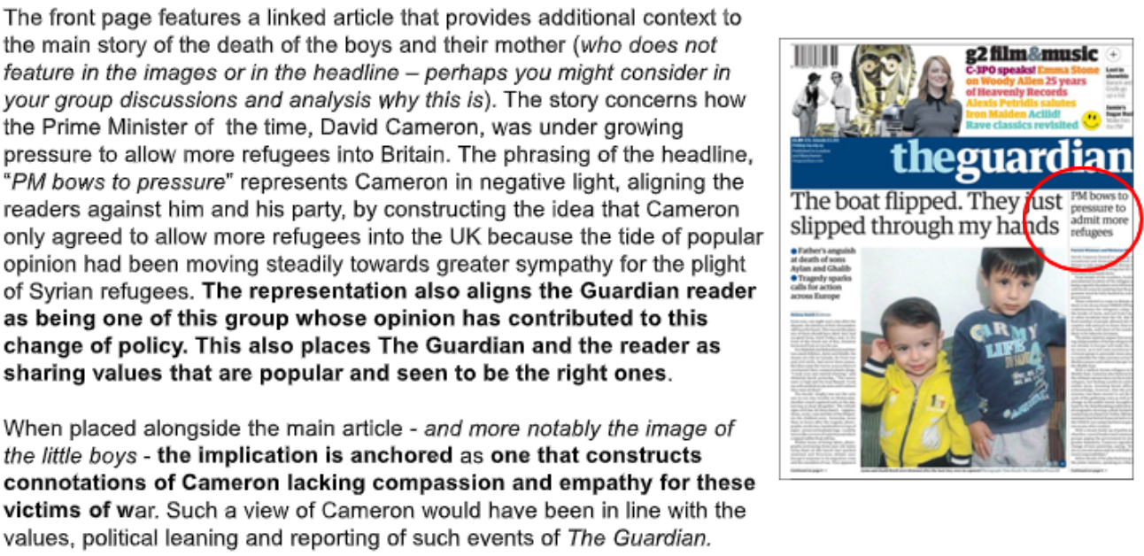
Things to consider

Slide 63
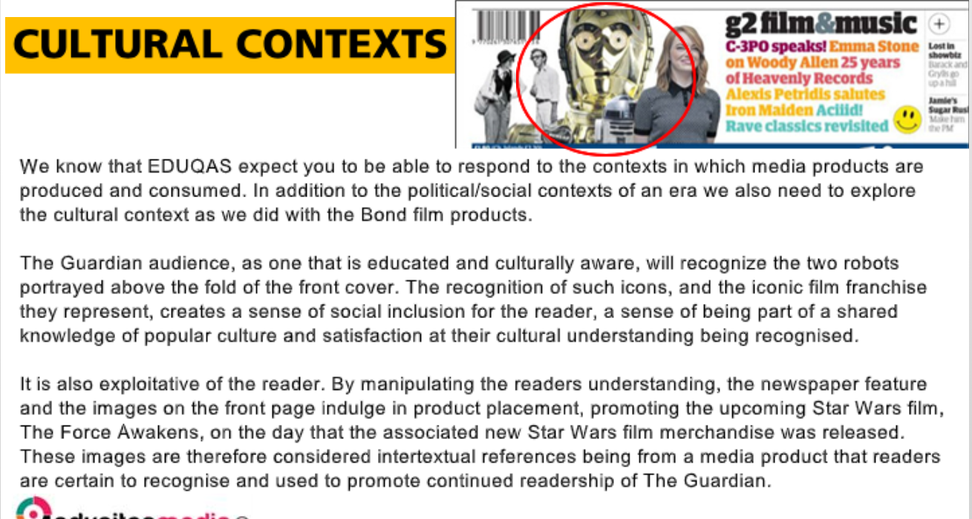
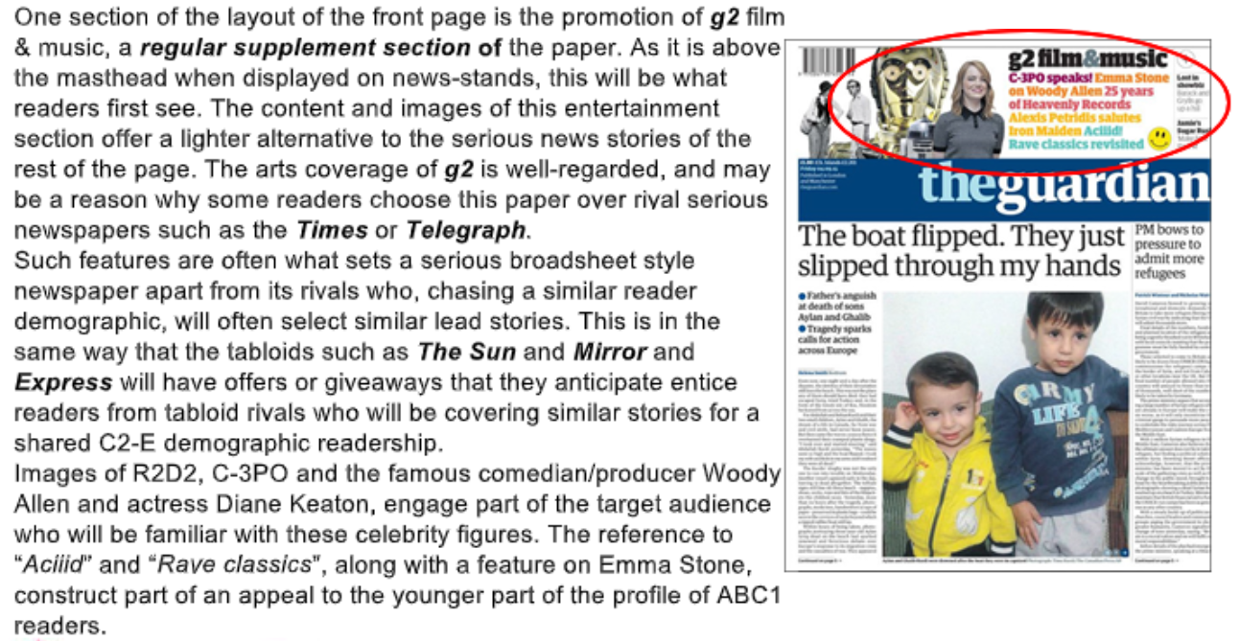
Things to consider

Slide 64
Production Context It is a national, daily paper Circulation- 189,000 Online edition has over 42.6 mill readers and the website is free to access. In 2006 the size of the newspaper changed - it was made smaller but it is still considered to be a broadsheet | The Target Audience Is well educated, relatively young - most aged between 18 - 39 (60%), more men read it than women (59%), they are very liberal (open to new ideas, different opinions, govt support for health, education, welfare etc.) and 89% are middle class or higher (ABC1) | Messages and Values Overall the front cover has a positive bias towards the issue of refugees and immigration, they are showing sympathy to the situation and seem to be suggesting that European govt have allowed this crisis to continue The newspaper has a liberal bias and are more supportive of the Labour party so in this front cover they are critical of the conservative govt response to the crisis. The key message is that we need to do more to help and that refugees and migrants are valued. They are in part blaming David Cameron. The messages and values on this front cover are ones that the target audience will also have. They want use to use the children as innocent victims and see that the father is not to blame.
Social Context March 2011 civil war broke out in Syria, 11 mill people have fled their homes, 1 mill have fled to Europe. The journey is very dangerous and difficult. Opinions on these migrants vary - some want to help but there is also fear and uncertainty Cultural Context The audience will recognise the 2 robots - subtle form of advertising, the film is out soon. They are also intertextual references (link to a different media product). they created a shared understanding | Media Language Technical Codes Visual Codes Written Codes Masthead is lowercase curvy and colourful= unique, Dominant image shows the 2 boys as happy little Quote from father explaining their personal mode of address, informal boys wearing typical clothes, smiling = human face deaths as wholly accidental = Headline - quote, this is not typical, will draw attention to the tragedy = allows reader to IDENTIFY and has anchorage text that tells us how to Caption - explains death, anchorage text that makes us connotations of innocence and vulnerability react, Emotive language - anguish, sympathise with the situation Colourful images at the top - eye catching and tragedy = audience is positioned to Secondary story - linked, the headline attempts to show Happy (change of tone), first thing audience see feel for the refugees and dislike DC is a bad light, he lacks compassion, empathy No image of DC - less important than the boys the govt as they have not done G2 Regular segment placed at the top - selling point Iconic images of R2D2 and C3PO, Emma Stone enough -recognisable to the audience, selling point
 | Representation The text of the main article is constructed to position the audience to accept the newspapers viewpoint - the Kurdi family (and all refugees) are blameless victims. It does not see the father as someone to blame (other papers did). The selection of the image makes the boys look just like any other youngers, their nationality is irrelevant and contrasts with the images used before (of the boy’s body on the beach), using this image might make the audience more likely to pick up the paper as it was not so shocking. This representation of refugees/migrants contracts to the dominant stereotype of middle eastern people (terrorist, criminals, benefit scrounger and ‘stealing jobs’.) The image serves to remind the readers of the reality of the situation and show how desperate many people are to flee their home in search of safety. The boys could represent all migrant children involved in the war, highlighting their innocence, vulnerability and defencelessness.
Key Terms and conventions Masthead, Headline, Caption, Copy, Pug, Standfirst, Secondary Story, By-line, Puff, Turn, Trail, Splash, Left Wing, Right Wing, Liberal, Conservative, Demographics, Immigration, Immigrates, Migrant, refugees, Civil war, Mode of address, stereotype
KNOWLEDGE ORGANISER: THE GUARDIAN

Slide 65
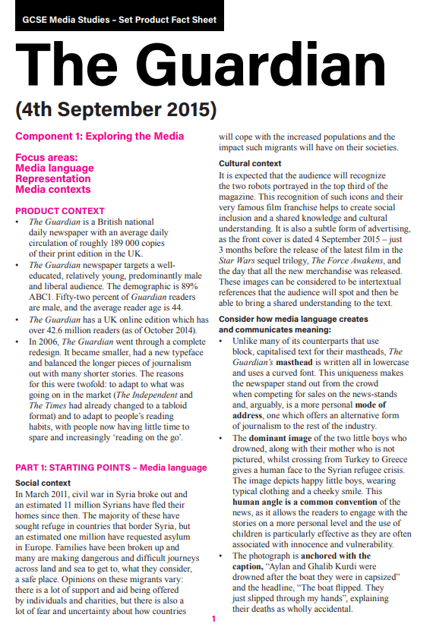
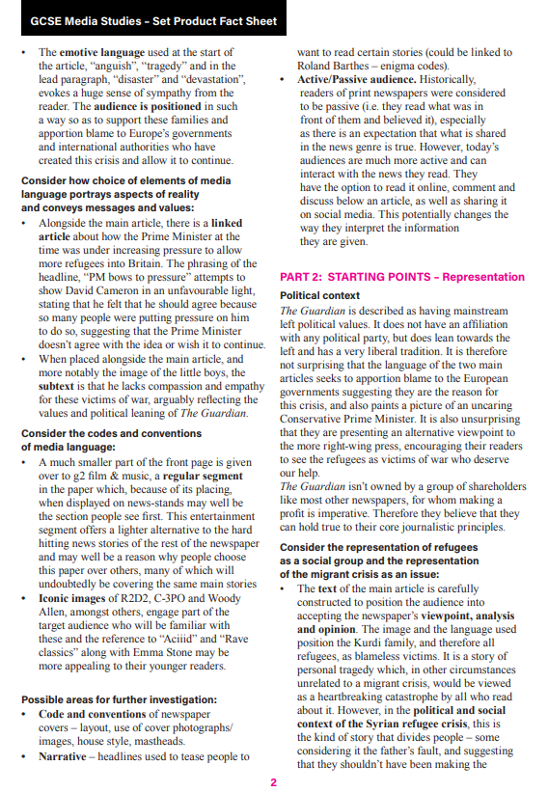
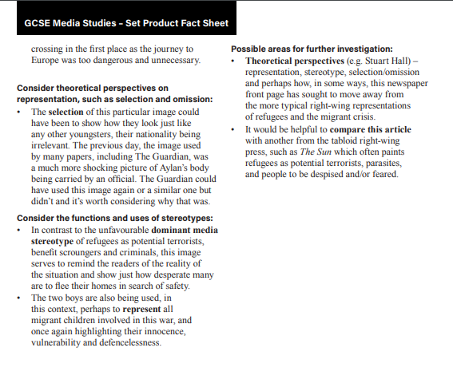
LINK TO ALL THE INFORMATION ON The Guardian
CLICK HERE TO SEE THE EDUQAS FACT SHEET ON The Guardian

Slide 66
SECTION B: Component 1

Slide 67
SECTION B: Component 1
In Section B of exam 1 you will ONLY be asked about MEDIA INDUSTRIES and AUDIENCES for these set products, This means you don’t analyse what you see, but what you know about how they are made and who they are made by:

Slide 68
THE ARCHERS

Slide 69
Listen here for essential Archers storyline!
Some Key facts – The Archers (see product factsheet for more)
On Radio 4, 5 million listeners, run for 65 years, 6 x 13 min episodes a week, omnibus on Sunday. Set in Ambridge, Borsetshire, English Midlands 'contemporary drama in rural setting‘.
Historical – purpose in early 50’s to educate farmers
Socio-cultural - ‘real time’, real events, controversial storylines,
multi-strand narratives (typical ‘soap’ conventions.)
BBC - licence fee, 'educate, entertainment, inform'-charter
Convergence - Facebook, website, twitter, Radio 4 Xtra, download podcast, I-player
Soap audience - traditionally women (originally farmers) some recent complaints-too melodramatic, too 'TV' soap but drawing in new listeners. Older demographic, loyal listeners, higher socio-economic, niche audience.
Uses and gratification - personal identification, escapism/entertainment, social interaction, information ??

Slide 70
Answering The Archers Exam Questions
Exam style questions:
How would you answer these? The ‘ideal’ answers from the exam spec are on next few slides – write your answers then we’ll look at how many marks you might get / how you could get more.
Which radio station broadcasts The Archers? [1]
Identify two audiences for The Archers. [1]
Explain two ways in which they are targeted. [4]
Explain why the audiences you have identified may listen to the program.
Refer to the Uses and Gratification theory in your answer. [12]

Slide 71
ANSWERS

Slide 72
ANSWERS
Explain why the audiences you have identified may listen to the program.
Refer to the Uses and Gratification theory in your answer. [12]

Slide 73
Production Context Produced by the BBC, publicly funded broadcaster. Aired on Radio 4 the main spoken word station. Convergence with other technologies. Available on iPlayer and has presence on social media with websites/Twitter etc. | The Target Audience Original audience was agricultural workers. Now audience mainly female ABC1 demographic Older demographic 40 plus listeners who are targeted with storylines which they can relate to | Messages and Values Strong community values. Set in fictional village where everyone knows each other. Family values: based round the Archer family Specific messages delivered through storylines. For example introduced gay marriage and surrogacy and issues of drug supply in rural communities
Social/ Cultural Context Covers contemporary issues which are in the news. Helps shape national debate on issues such as domestic abuse with the Helen & Rob story. Would include real events like the death of Princess Di, foot and mouth outbreak, and 9/11. They would often re-record episodes to do this. In the 1950s it was seen as a way of bring people together and even now people will discuss it but now that happens mostly online | Uses and Gratifications Simple entertainment – Story lines are designed to entertain the audience with trivial events like the ‘Flower and Produce’ show, they would be engaged by the ongoing storylines, reflect that their relationship was better than Rob and Helen’s Information and education – Many storylines are designed to inform the public about current issues in agriculture such as intensive farming. The plots educate the audience about issues like domestic violence. Gave information out about domestic abuse - warning signs and helpline, info about ‘Battered Women’s Syndrome’ Personal identity – The audience relates their own lives to those of the characters, see Helen as a role model as she stood up to Rob Social Interaction – By using social media outlets, the audience can share their reactions to the programme with other listeners Escapism – Many listeners wish they lived in an ‘idyllic’ English village and use the programme to imagine that they live in Ambridge.
Historical/Political Context Oldest ‘soap opera’ has been running for 65 years. Originally for farmers to gain information on crop developments. Broadly neutral politically but covers issues of political interest to rural communities | Representation The tagline of ‘An everyday story of country life’ positions the listener to believe that the characters are typical of those found in rural communities. A number of stereotypical representations are used. The large scale farmer, the small contractor, the village busybody. These simplify the characters for the audience Increasing representation of gay and minority ethnic characters used to increase audience and to reflect the diversity of British life Clear use of victims and villain following gender stereotypes
Key Terms and conventions Radio Soap Opera, Public Service Broadcasting, Convergence, OFCOM, licence fee, remit, omnibus, market share, brand identity. cliff-hangers, on going narratives, multi strand narratives, melodrama | Industry Information The radio industry was considered under threat from digital media like Youtube but has embraced change and found new ways of attracting listeners through digital platforms. The BBC especially has been at the forefront with the introduction of the Radio IPlayer which The Archers can be accessed on. Radio 4 has maintained its position as the UK’s flagship spoken word station. Radio is regulated by OFCOM. There are two type of radio - commercial (has adverts) and Public Service (govt money, licence fee), not for profit, to benefit people and this is BBC Radio 4. BBC remit - education, inform and entertain. There is a tight production schedule that includes biannual meeting (pre-production) monthly recording session that last for 6 day (production) and the shows go to air 3-6 weeks after recording (post-production/ distribution)
KNOWLEDGE ORGANISER: THE ARCHERS

Slide 74
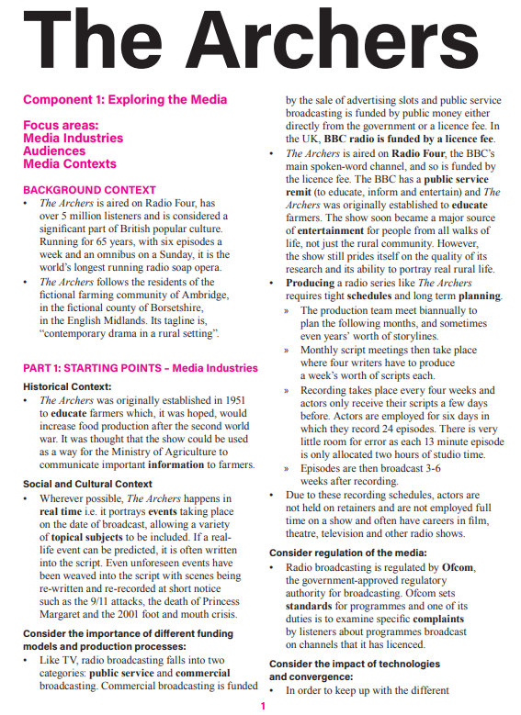
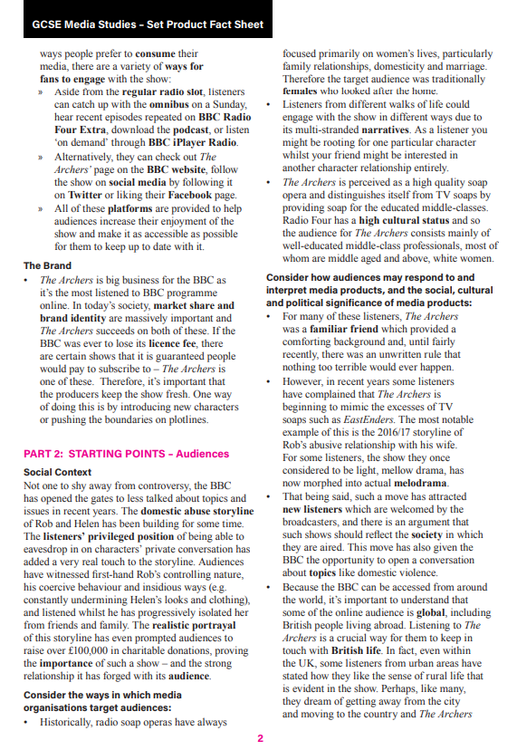
LINK TO ALL THE INFORMATION ON The Archers
CLICK HERE TO SEE THE EDUQAS FACT SHEET ON The Archers

Slide 75
POKEMON GO

Slide 76
Component 1: Exploring the Media
[PRODUCT CONTEXT]
Produced by Niantic and in collaboration with Nintendo, Pokemon Go is an augmented reality video game for iOS and Android devices.
Using the same technology as Google Maps, Pokemon Go relies on players’ GPS to allow them to locate, capture, battle and train virtual creatures called Pokemon in the real world.
Pokemon Go had an extended launch, being released in Australia, New Zealand and the United States first on July 6th 2016, and then in other countries (e.g. South Korea in January 2017).
The game is free to download and play but there is the possibility to spend real money purchasing PokeCoins, the in-game currency to get extra items and enhancements.
[FUNDING MODELS]
Within days of its release, the game managed to break records set by other games in the Apple iTunes Store. It did this by making the app completely free to download and play so how does it make any money?
A big part of the game’s revenue is generated through in-app purchases. Players can buy PokeCoins to purchase extras that can enhance their gaming experience – power-ups, extra Poke Balls, lures and character upgrades.
A YouGov survey estimated that 1 in 5 players of Pokemon Go spend money on in-app purchases with the majority of those users spending between 80p and £14.99 in the first month of its release.
Throughout the year, the game holds limited time in-game ‘events’ such as Halloween. During the event, users are more likely to see ghost Pokemon, the game pays out double candy (a resource needed to upgrade and evolve Pokemon) and drastically shortens the distance you need to walk before a player’s buddy Pokemon produces candy.
In-game time is more lucrative for users who are able to upgrade their Pokemon collection quicker. During this event, users increased their spending on in-app purchases.
In addition to in-app purchases, Niantic makes money from sponsored locations – businesses such as McDonalds, movie theatres and pubs pay to show up as prominent locations in the game. In the UK, many small businesses are exploiting their status as Pokestops to try and attract new customers, some even use lures – in-app features that turn Pokestops into magnets for Pokemon to attract more customers.
[CULTURAL CONTEXT]
Pokemon’s status as a globally popular franchise has left a significant mark on today’s popular culture.
The Pokemon characters themselves have become pop culture icons.
Aside from the thousands of merchandise items available, there has also been a Pokemon travelling theme park in Japan, two different Pikachu balloons in the Macy’s Thanksgiving Day Parade and All Nippon Airways even operates Pokemon Jets.
Given the success of the franchise, it was probably safe to assume that a ground breaking video game was always going to be successful.
Pokemon Go App

Slide 77
[SOCIAL/CULTURAL CONTEXT]
Although Pokemon Go has been hugely successful, the game does have downsides. Within its first two days of release, Pokemon Go raised safety concerns among players.
Multiple people also suffered minor injuries from falling while playing the game due to being distracted.
In addition, police departments in various countries have issued warnings regarding inattentive driving, trespassing on other people’s property and being targeted by criminals due to players being unaware of their surroundings.
In addition, there are all of the obvious risks associated with online social media – not knowing who you’re chatting to, keeping personal information safe, concerns around arranging to meet strangers offline.
[MEDIA ORGANISATIONS TARGET AUDIENCES]
While Pokemon’s target audience is young boys, Pokemon Go seems to have captured the imagination of a much wider demographic.
Pokemon’s core fan base – those that saw the first film and have been a follower ever since – were another obvious target audience group, but given its innovation, there are actually many more gamers than maybe even the creators could have imagined.
In its first month, the game’s average player demographic was categorized as a highly educated, well-paid, 25-year-old white woman.
The craze has settled down – a YouGov survey shows that, demographically speaking, the average player is aged 18-34, enjoys Kinder, Smirnoff and Domino’s Pizza and is ‘more likely to be unmotivated’ than the average citizen.
Knowing their audience so well means the game has created more marketing opportunities both for itself and for others.
[MEDIA REGULATION]
Age ratings are systems used to ensure that entertainment content, such as computer games, are clearly labelled by age according to the content they contain. Age ratings provide guidance to consumers (particularly parents) to help them decide whether or not to buy a particular product. The rating on a game confirms that it is suitable for players over a certain age.
In 2012, the PEGI system was incorporated into UK law and The Video Standards Council was appointed as the statutory body responsible for the age rating of video games in the UK using the PEGI system.
Pokemon Go was awarded a PEGi 3+ rating in the UK. However, there is still some confusion for users as, in the iOS app store, it is state as being suitable for those aged 9 years and over due to mild fantasy violence, and the lobby group Commonsense Media say it is really only suitable for children aged 13 years and over due to privacy and personal safety concerns. Perhaps the wide variance in this age guidance is a sign of just how ground-breaking Pokemon Go is.
[TECHNOLOGIES AND CONVERGENCE]
For an industry to survive over forty years, it has to constantly evolve and serve the needs of its audiences.
The video games industry has done just that. By 2010, virtual reality and augmented reality were emerging as major drivers for game hardware and gameplay development.
There was also a huge rise in casual gaming through mobile devices.
In 2016, the mobile gaming market was estimated to have taken $38 billion in revenue. This is where Pokemon Go stepped in.

Slide 78
Production Context Produced by Niantic and Nintendo. Uses augmented reality and is playable on iOS and Android devices. Uses the same tech as Google Maps (GPS). Had an extended release: 6th July 2016 USA, Australia and NZ then later in other countries (e.g. South Korea in Jan 2017). Free to download and play but there is the ability to spend real money by purchasing PokeCoins which allow you to get extra items and enhancement | The Target Audience It was aimed at young boys but appealed to a much wider audience. In the first month the average player was a highly educated, well paid 25 white women. Now the average player (according to YouGov) is aged 18 - 34, male, likes Kinder, Smirnoff and fast food especially Domino’s Pizza and is ‘more likely to be unmotivated’. This information was used to help market the film e.g. MacDonald’s, movie theatres and pubs were a Pokestops. |  | The Funding Model Funding was provided by Nintendo, Google and App distributor for Apple and Android - each would benefit if the game was successful. The game generated a lot of revenue via in-app purchases (pokecoins), in-game events like Halloween where ghost Pokémon and candy (to upgrade and evolve) were more available and distances were shorter. Sponsored Location (Pokestops) - companies pay to show up as prominent locations in the game. This helped businesses to increase/ attract customers
 | The Impact of technologies and convergence For an industry to survive they need to constantly evolve especially video games. Virtual reality and augmented reality are the ‘next big thing’ and the game uses both. More and more people are gaming (casual gamers) because of mobile devices, Pokémon takes advantage of this and the way phones have many technologies in them (convergence). The mobile gaming market took in an estimated $38 billion in 2016 - Pokémon Go was part of this (and is still popular now with regular updates). |  | Regulation Video games are rated by PEGI and based on an age rating system with key areas of focus (e.g. violence, drug use, online). The Video Standards Council uses PEGI to rate all games in the UK. In the UK Pokémon Go was awarded PEGI 3+ but the Apple store states it is suitable for those 9 and over (mild fantasy violence) and the group Commonsense Media recommends 13+ due to privacy and personal safety concerns
Cultural Context Part of a very popular global franchise. Many different parts e.g. films, TV, merchandise, theme parks. Given the success of the franchise it was safe to assume it would be successful. | Issues around Audiences Core fan base is those who grew up with the franchise but it has more fans because of its innovative nature. Within the first few days of release there were issues. Every time the game was released in a new place there were issues with downloading it (due to demand), safety concerns included players getting injured while play due to being distracted, or playing and driving, trespassing and players being targeted by criminals due to people being unaware of their surroundings. There was also concern about the risks associated with online social media - not knowing who you are chatting to, keeping personal information safe and concerns around arranging to meet strangers offline. Pokémon character could also be placed in dangerous places as the game just used GPS and did not consider where the location were - it just made them a certain distance from players.
Use and Gratifications Theory Entertainment/Diversion - can play the game for fun, easy to play, can play anywhere, can easily progress and feel good about this Social Interaction - can interact with other players online esp via Twitter and Facebook, they challenge each other to battle, meet in ‘gyms’ to train, meet up at events etc. |  | The Pokemon Franchise Started in 1995 and the trademark is owned by Nintendo. It began as a pair of video games for the Gameboy but now includes more video games, an animated TV series, a trading card game, 17 films, comics, books and toys. It is the second best-selling video game franchise behind Mario and is one of the highest grossing media franchises of all time. It has a huge fan base because of its long history and the way in which it has adapted to include new technology and a changing fan base
KNOWLEDGE ORGANISER: POKEMON GO

Slide 79
LINK TO ALL THE INFORMATION ON Pokemon Go
CLICK HERE TO SEE THE EDUQAS FACT SHEET ON Pokemon Go

Slide 80
You could also be asked a LARGE question on Newspaper Websites for The Sun and The Guardian

Slide 81
The Sun Website vs The Guardian Website
Log into the two websites regularly (links are above) - these are the points you will need to consider in an exam response:
Is there clear branding (House Style)? How is this created?
How is an audience targeted? Who is the audience?
What interactive features are there? What can an audience ‘do’?
How can users gain further information about the film?
Are there entertainment/diversion features?
How is an online community encouraged?
Can you find examples of convergence?
Can you find examples of synergy?
Can you find examples of e-commerce?
Can you apply enigma codes?
How might people access these pages?
How does it encourage an ‘active audience’?
How are demographics REPRESENTED?

Slide 82
007 James Bond Website

Slide 83
GLOSSARY A-Z

Slide 84
GLOSSARY A-Z

Slide 85
GLOSSARY A-Z

Slide 86
GLOSSARY A-Z

Slide 87
GLOSSARY A-Z

Slide 88
GLOSSARY A-Z

